Slide 1
The cell cycle

Slide 2
Cell division result in genetically identical
daughter cell .
most of the cell division involve the distribution of the identical genatic material – DNA- to daughter cell .
cellular organization of the genetic material
A cell endowment of the DNA , its genetic information Is called genome .
Prokryotic genome is often a single long DNA
Eukaryotic genome is usually consist of number of DNA
The replication and distribution of so much DNA is manageable because the DNA molecules are package into chromosomes .

Slide 3
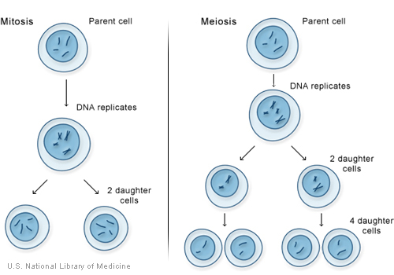
Distribution of the chromosomes during
Eukaryotic cell division
When a cell is not dividing , and even as it duplicated its DNA in prepration of cell division ,each chromosomes in the form of long thin chromatin fiber .
After duplication each chromosomes has two sister chromatids
Mitosis , the division of the nucleus is usually followed immediately cytokinese the division of the cytoplasm .
Meiosis the division which yield non identical daughter cell that have only one
set of chromosomes it occurs only in gonads.

Slide 4
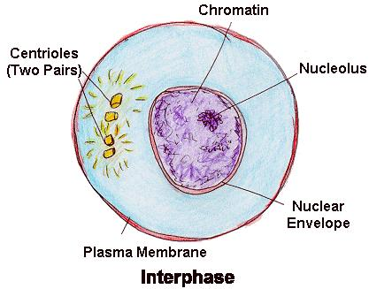
mitotic division of cell cycle
Phase of the cell cycle
Mitotic M phase include both ( A)mitosis and( B ) cytokinesis
It consist of several stages
(A)- interphase ( G1, S, G2 )
(B ) 2- PROPHASE
3- PROMETAPHASE
4-METAPHASE
5- ANAPHASE
6-TELOPHASE

Slide 5
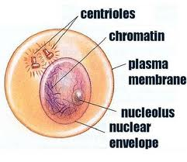
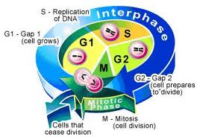
G2 INTERPHASE

Slide 6
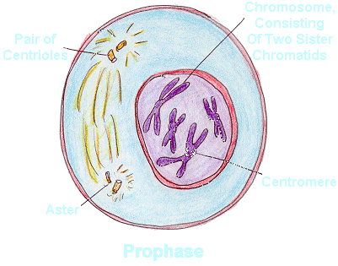
PROPHASE

Slide 7
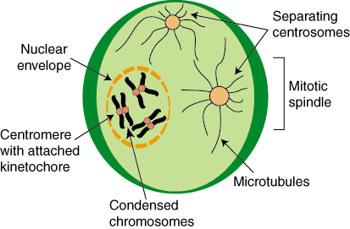
PROMATOPHASE

Slide 8
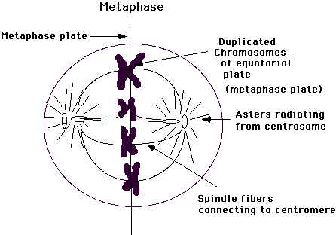
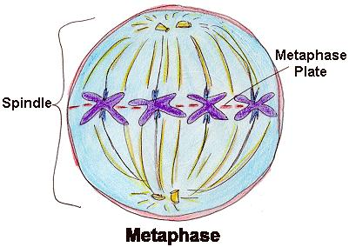
METAPHASE

Slide 9
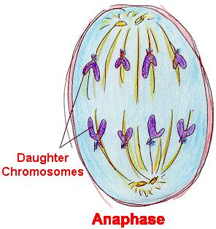
ANAPHASE

Slide 10
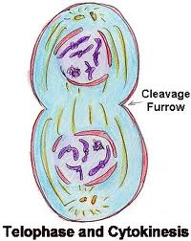
TELOPHASE AND CYTOKINESES

Slide 11
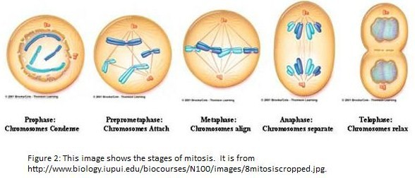
MITOTIC DIVISION OF ANIMAL CELL

