Slide 1
Drugs affecting respiratory system
Lecture 11

Slide 2
Bronchodilators
Drugs that reverse airway constriction are classified as bronchodilalors.
Indications
Treatment for obstructive pulmonary diseases
Asthma, chronic bronchitis, and emphysema
Classified as:
Sympathomimetic drugs
Xanthine derivatives
Many agents are administered by inhalation via a nebulizer or pressure cartridge

Slide 3
Bronchodilators
Sympathomimetic Drugs
Nonselective adrenergic drugs:- Epinephrine
Have alpha, beta-1 (cardiac), and beta-2 (respiratory) activities
Nonselective beta-adrenergic drugs:- Isoproterenol inhalation (Isuprol)
Have both beta-1 and beta-2 effects
Selective beta-2 receptor drugs:-
Act primarily on beta-2 receptors in the lungs
Short acting as salbutamol (Ventolin) (4hrs)
Long acting as formoterol (12-24 hrs)

Slide 4
Bronchodilators
Xanthine Derivatives
Xanthine drugs include caffeine, theophylline, and theobromine
Actions
Relax smooth muscle (particularly bronchial smooth muscle)
Stimulate cardiac muscle and CNS
Increase diaphragmatic contractility
Promote diuresis through increased renal perfusion
Not first line drugs in acute asthma.

Slide 5
Bronchial Asthma
Asthma is a chronic disease characterized by airflow obstruction and hyperactivity and inflammation of the airway mucosa.
Asthma results from:-
*bronchoconstriction
*Inflammation of the bronchial wall, and increased mucous secretion
N.B (Asthma may be acute or chronic)
Therapeutic strategy:-
↓Decrease bronchoconstriction→ by making bronchodiltation using bronchodilators
↓ Decrease inflammation of the bronchial wall→ by Anti-inflammatory agents

Slide 6
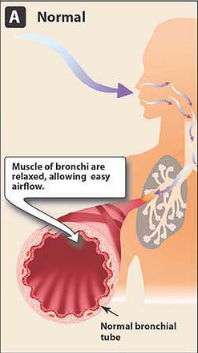
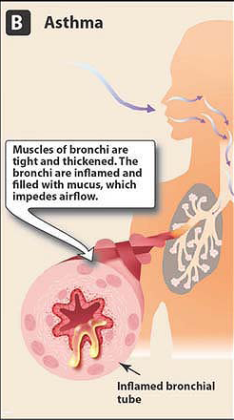
Bronchial Asthma

Slide 7
Bronchial Asthma
For quick relief of asthmatic attacks →short acting B2 agonist as salbutamol inhaler
For long term control of asthma→
Inhaled corticosteroids as beclomethason or budesonide
Long-acting beta2-agonists as formoterol.
Leukotriene modifiers as Montelukast(Singulair)
Taken daily over a long period of time
For prophylaxis cromolyn or nedocromil are used, they are mast cell stabilizers.
* They are not helpful during acute attacks

Slide 8
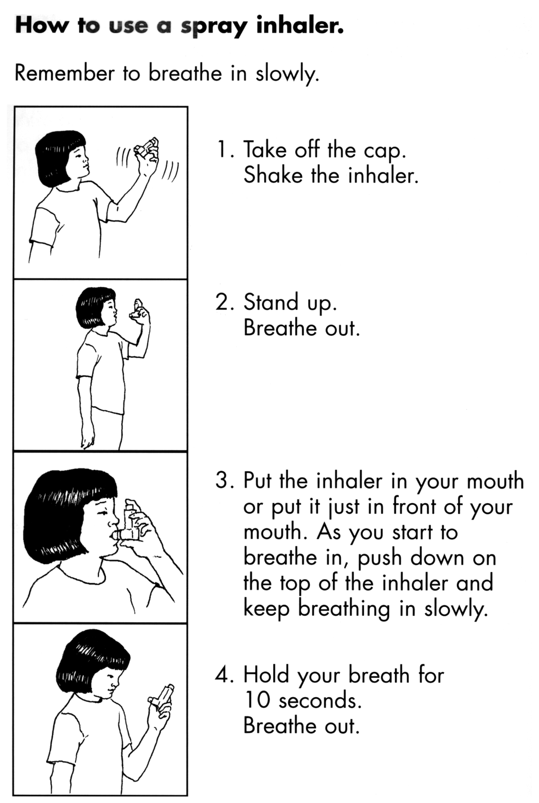
Using the inhaler

Slide 9
Other Respiratory Drugs
Respiratory Stimulants (analeptics)
Increase rate and depth of respirations
Spirits of ammonia only inhalation drug given as respiratory stimulant
Administered during cases of fainting

Slide 10
Other Respiratory Drugs
Respiratory Depressants
Includes opium and barbiturate groups
Respiratory depression is a common side effect
Seldom given to intentionally inhibit rate and depth of respiration

Slide 11
Other Respiratory Drugs
Cough Suppressants:
Cough is a protective reflex to expel harmful irritants
It may be:
Productive (removes airway secretions)
Nonproductive (dry and irritating)
Antitussive agents: used for dry cough
Narcotic agents :- codeine
Nonnarcotic agents :- dextromethorphan

Slide 12
Other Respiratory Drugs
Mucokinetic Drugs: used for productive cough
Expectorants: Move respiratory secretions and sputum along tracheobronchial tree so they help in the expulsion of the screations. (Guaifenasine)
Mucolytics: reduce the sputum viscosity, so it can be removed more easily. (Bromhexin)
Oxygen
Treatment of hypoxia and hypoxemia

Slide 13
Antihistamines
Histamine is chemical mediator in most body tissues
Highest in the skin, lungs, and GI tract
Histamine is released into the bloodstream by the mast cells in response to the presence of several different stimuli such as drugs, trauma, or antigens to which an individual may be allergic.
Histamine release produces the allergic responses in asthma, rhinitis, eczema and urticaria.
Antihistamines compete with histamine for receptor sites and prevent actions of histamine.

Slide 14
Antihistamines
Histamine has two types of receptors:
H 1 receptors…envolved in allergic reactions
Act primarily on blood vessels and bronchioles➔
Vasodilation, swelling, increased blood flow and bronchoconstriction
H 2 receptors…involved in ulcer
Act mainly on GI tract➔ increase acid secretion
H2 receptor blockers are used as part of ulcer treatment.
H2 blockers as cimitidine (Tagamet)
ranitidine (Zantac)

Slide 15
Antihistamines
Primary clinical use is prevention or treatment of symptoms of allergic disorders that are either seasonal or acute
Also for motion sickness, sedative, antiemetic
Side effects: Anticholinergic effects, like constipation, sedation, dryness of mouth.
Examples
Dimenhydrinate (Dramamine)
Diphenhydramine (Benadryl)
Promethazine (Phenergan)
Loratadine (claritin)

Slide 16
Drugs Affecting The Gastrointestinal Tract

Slide 17
Drugs that affect stomach
1. Antacids: neutralize HCl in the stomach
* Use: hyperacidity, peptic ulcer, esophagitis.
* Gaviscon
Antiflatulents: prevent the formation of gas in the GIT
* Use: ulcer disease, irritable colon.
* Simethicon, activated charcoal.
Emetics and antiemetics:
Emetics induce vomiting, rarely used
* syrup of ipecac

Slide 18
Drugs that affect stomach
Antiemetics : drugs that are used to treat nausea and vomiting.
*Should be taken before nausea and vomiting begin.
*Uses: motion sickness, chemotherapy induced vomiting.
*promethazine, hydroxizine, ondansteron.
Digestants: drugs that promote digestion
*They release digestive enzymes in the intestine.
*pancreatin, pancrelipase.

Slide 19
Drugs Affecting the stomach
Drugs for ulcer:
* Cytoprotective agents
Protect cells from damage
Sucralfate, misoprostol
*H2 receptor antagonists
Reduce volume and acidity of gastric acid
Ranitidine (Zantac) cimitidine (Tagamet)
*Proton pump inhibitors
Treat symptomatic gastroesophageal reflux disease, esophagitis
Omeprazole (Nexium), pantoprazole.

Slide 20
Drugs Affecting the Lower GI Tract
Laxatives
* Used to accelerate the movement of food through the gastrointestinal tract in many cases of constipation
*Constipation results from: Neurological disease, pregnancy, rectal disorders, surgery, drug poisoning
Stimulant laxatives: castor oil
* Contraindicated in pregnancy
Bulk forming laxatives: bran; methyl cellulose
Lubricant laxatives: glycerine,liquid paraffin
osmotic laxatives: Epsom salts.

Slide 21
Drugs Affecting the Lower GI Tract
2. Antidiarrheal drugs decrease stool liquidity
*Diarrhea result from increased motility of the gastrointestinal tract and decreased absorption of fluid.
*Antimotility agents→ Opiod agonist such as diphenoxylate; loperamide
*Adsorbents→ Kaolin; Charcoal
*Bismuth subsalicylate.
Goal of treatment is to correct dehydration → oral rehydration solution(ORS)
NaCL/glucose/NaHCO3/KCL

Slide 22
Drugs for eye and ear

Slide 23
Drugs for eyes
1. Antiglucauma agents
Glaucoma is an eye disease in which the pressure of the fluid in the eye is abnormally high →compression or obstruction of small vessels,nerve fibers→partial or complete loss of vision.
Treatment goal: reduce the pressure inside the eye.
Drugs:
Anticholinesterase: Pilocarpine
Carbonic anhydrase inhibitor: Acetazolamide.
If drugs are not effective surgery is indicated.

Slide 24
Drugs for eyes
2. Mydriatic ,cycloplegic agents
They cause dilation of the pupil and paralysis of accommodation to light.
Uses:
Treat inflammation
Relieve ocular pain
Used in ocular examination and surgery.
Drugs:
Atropine, homatropine.
Cyclopentolate

Slide 25
Drugs for eyes
3. Anti infective, anti inflamatory
For treatment of conjunctivitis, keratitis, sty.
Drugs:
Chloramphenicol,Erythromycine.
4. Topical anesthetics
Used to prevent pain during surgery or examinations.
Used in treatment of eye injuries.
Drugs:
Proparacaine HCl, tetracaine HCl
5. Other drugs:
Artificial tears, Antiallergic

Slide 26
Drugs for Ears
Antibiotics for infection
Chloramphenicol, Gentamycine
Steroid/antibiotic combinations
for superficial bacterial infections
Neomycine/polymexin/hydrocortisone( Cortisporin Otic)
Miscellaneous preparations
Treat ear wax, fungal infections, inflammation

