Slide 1
Security in Internet Explorer 9
Jeff Alexander
IT Pro Evangelist
Microsoft Australia
http://blogs.technet.com/jeffa36

Slide 2
Agenda
Reliable, Industry-leading Security
Internet Explorer 9 Security and Group Policy

Slide 3
Security in IE8 and IE9
 | Internet Explorer 8 | Internet Explorer 9
SmartScreen Filter
Download Reputation
Improvements to SmartScreen URL reputation
InPrivate Browsing
InPrivate Filtering
Tab isolation and recovery
Cross-Site Scripting Filter
ClickJacking protection
Domain Highlighting
User preference protection
Cross-Domain Requests

Slide 4
Internet Security Threats
Browser and add-on vulnerabilities
Web application security improvements
Protection against socially-engineered attacks
Privacy Improvements

Slide 5
Internet Explorer Security
Source: NSS Labs Web Browser Security Socially-Engineered Malware Protection
http://www.nsslabs.com/browser-security

Slide 6
Crash Recovery
Hang Recovery
Automatic Crash Recovery
Tab Isolation

Slide 7
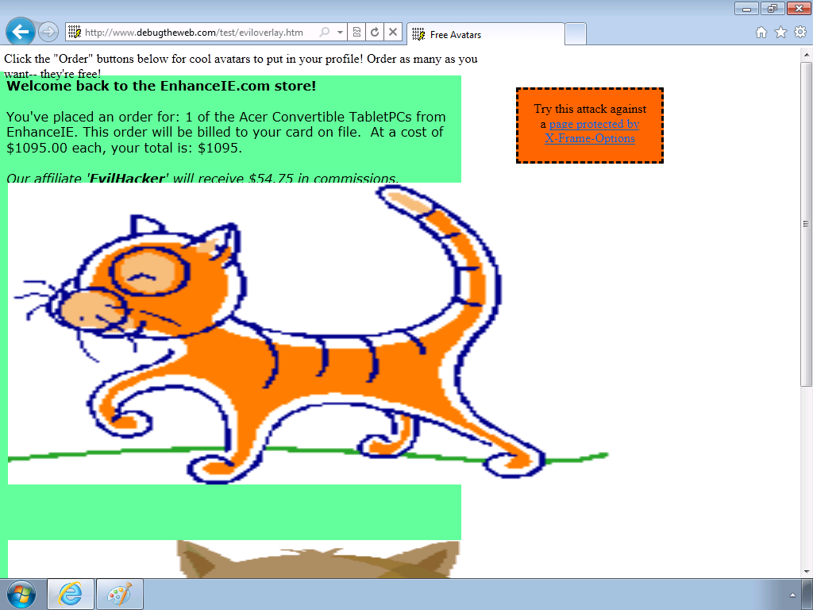
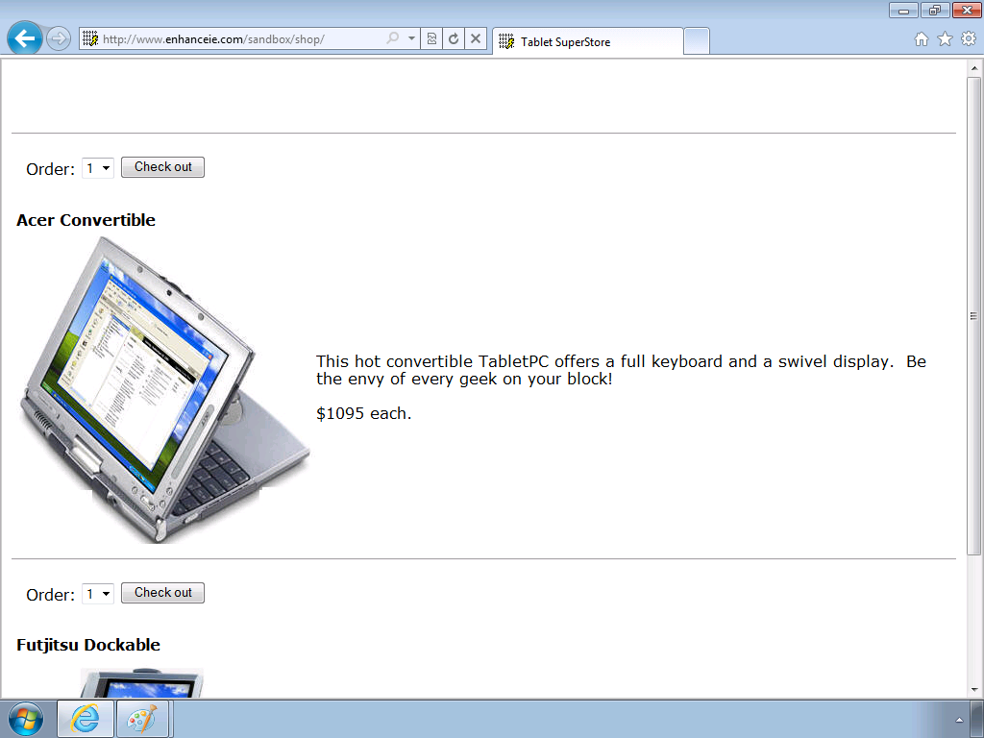
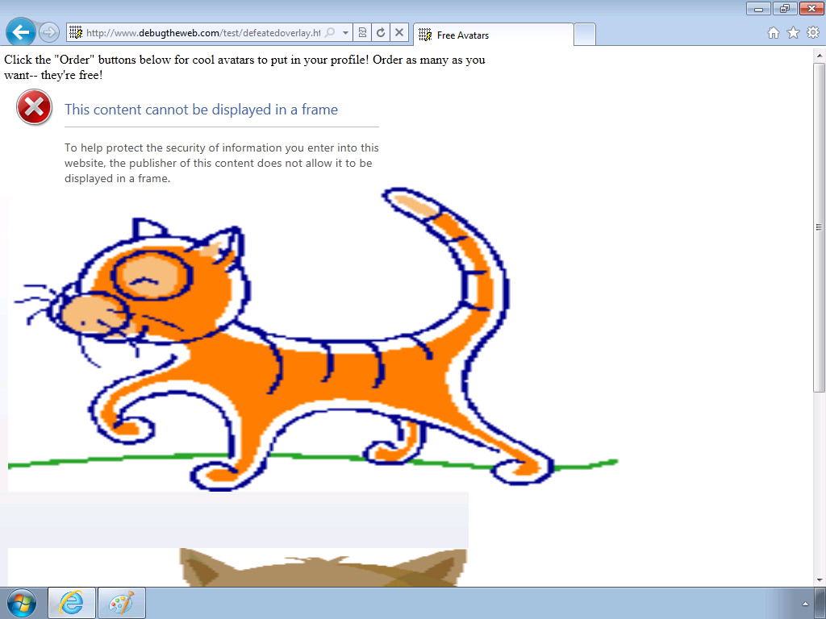
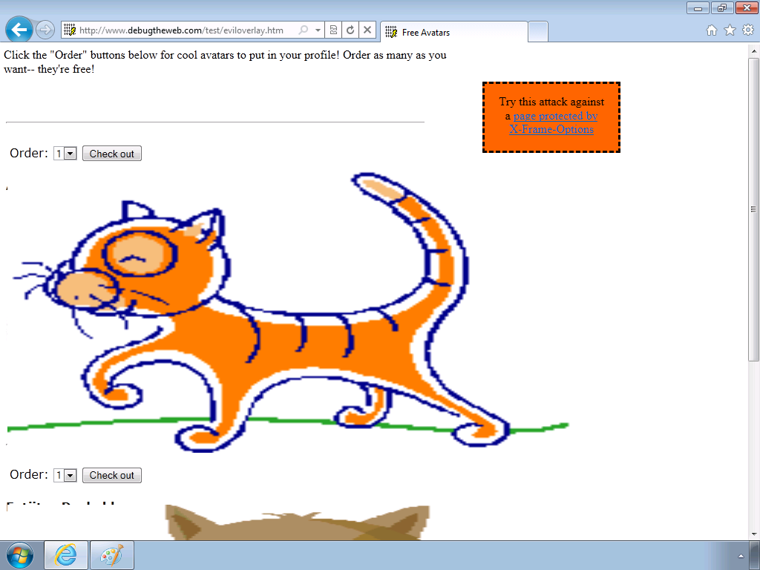
ClickJacking
A user is tricked into making an unwanted transaction
A simple Web shop that uses cookies
A malicious site
Using X-FRAME-OPTIONS

Slide 8
Type-1 Cross-Site Scripting Threats
A website has a XSS vulnerability
A URL is created to exploit the vulnerability
User is directed to the legitimate website with the malicious code embedded
The URL is sent out to users
http://www.foo.xss.com
User clicks on the URL

Slide 9
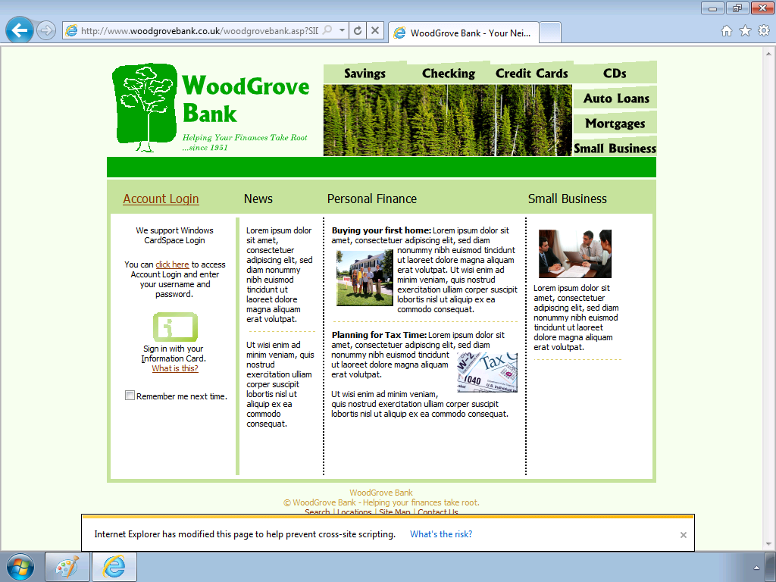
Cross-Site Scripting (XSS) Filter

Slide 10
Cross-Site Scripting Filter Architecture
No
Yes
No
No
Navigation to HTML?
Signature match on response body?
Neuter appropriate characters for each signature match
Log results and inform the user that an XSS attack has been blocked
Navigation to HTML?
Heuristic match on GET/POST Data?
Same Site
Heuristic match on GET/POST Data?
Provide HTTP Response to Web Browser
Same Site
Build a signature for each heuristic match
HTTP Response
Build a signature for each heuristic match
HTTP Response
Yes
No
Yes
Yes
Web Server
HTTP Request
HTTP Response
Browser
XSS Filter Logic

Slide 11
Cross Domain Requests
Before IE8
Your Mashup in IE
Mashup Web Server
Contoso Web Server
GET Mashup
Proxy Server
XHR Request
GET Data
With IE8 and IE9
Your Mashup in IE
Contoso Web Server
Cross Domain Request (XDR)

Slide 12
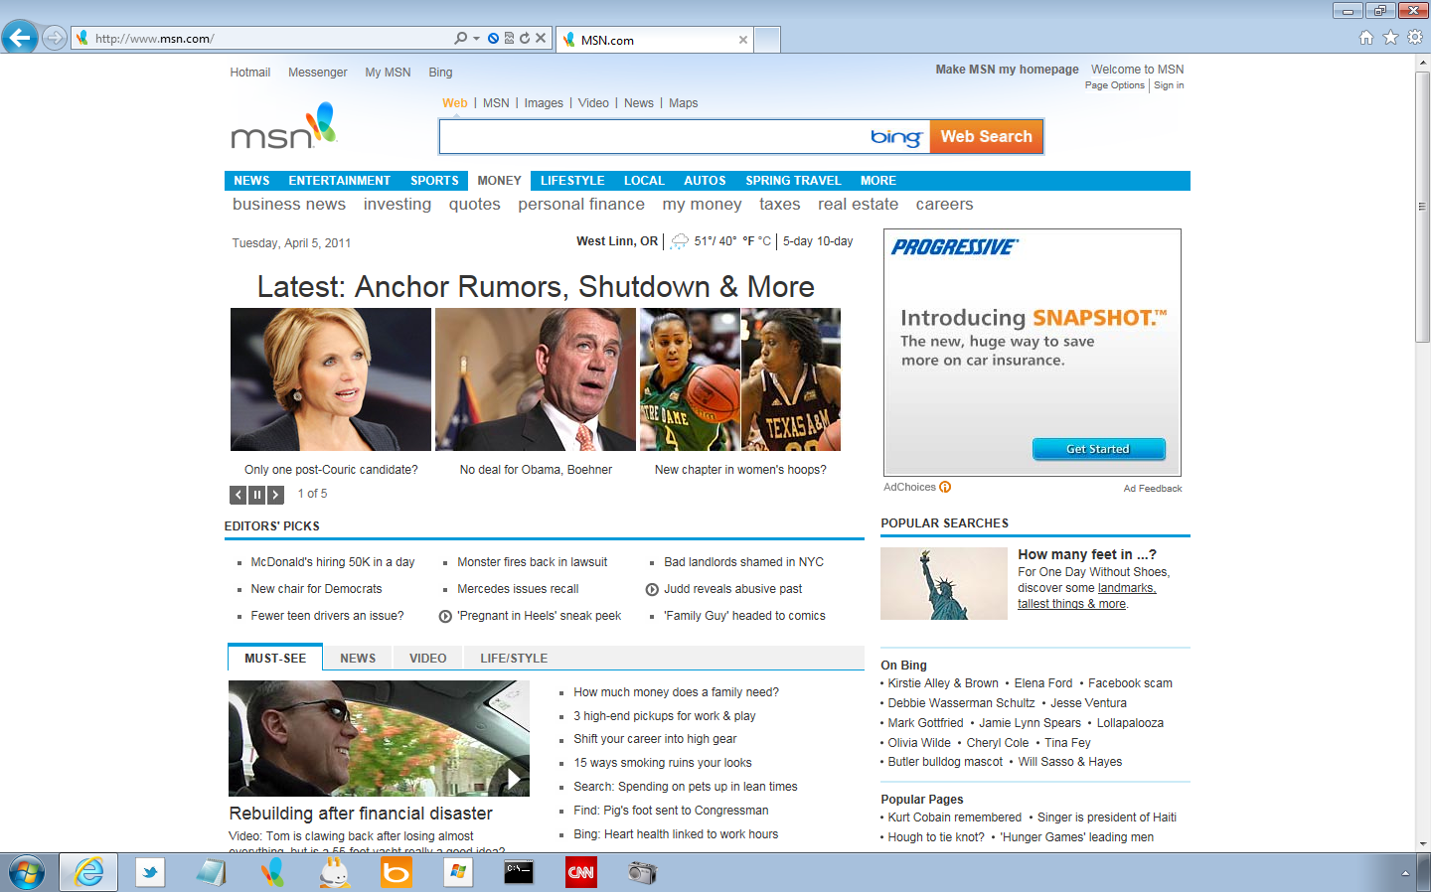
Domain Highlighting and SSL Certificates
Domain Highlighting
SSL Padlock
Security Status Bar

Slide 13
User Preference Protection
When a program on your computer attempts to change the IE default search provider you will get a dialog to confirm
IE8 introduced a new API for setting the search default
IE9 moved all dialogues for user preference protection to the new notification model
The dialogues for user preference protection are non-modal notifications in IE9

Slide 14
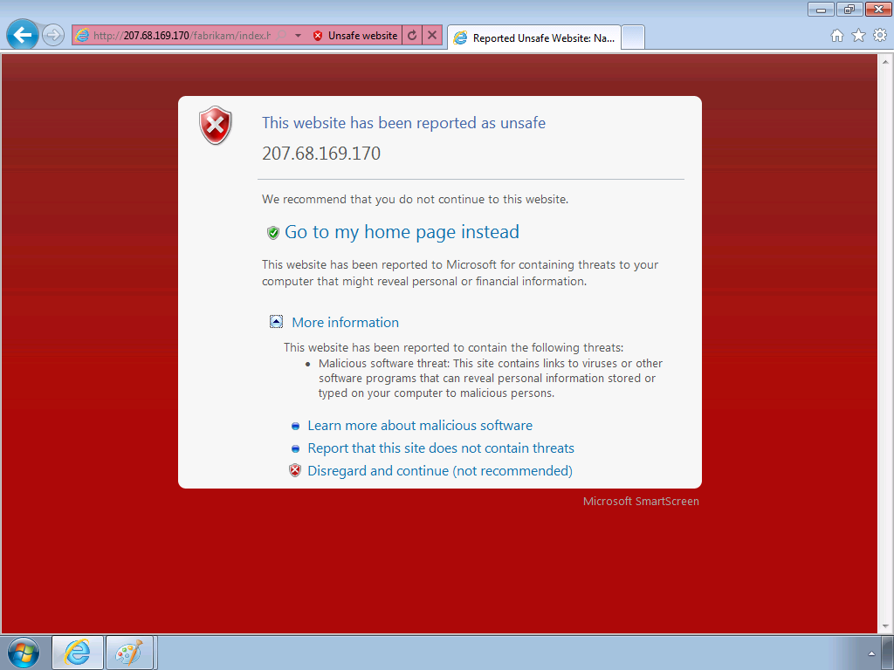
SmartScreen Filter
The SmartScreen Filter can request feedback on sites of unknown reputation.
SmartScreen blocking page offers guidance to help you avoid known-unsafe websites.

Slide 15
SmartScreen Application Reputation
Program is downloaded
File identifier and publisher is sent to Application Reputation Service

Slide 16
Best Practices for Application Reputation
Digitally sign programs
Ensure downloads are not detected as malware
Apply for a Windows Logo

Slide 17
InPrivate Browsing
Information | How it is affected by InPrivate Browsing
Cookies | Kept in memory so pages work correctly, but cleared when you close the browser.
Temporary Internet Files | Stored on disk so pages work correctly, but deleted when you close the browser.
Webpage history | This information is not stored.
Form data and passwords | This information is not stored.
Anti-phishing cache | Temporary information is encrypted and stored so pages work correctly.
Address bar and search AutoComplete | This information is not stored.
Automatic Crash Restore (ACR) | ACR can restore when a tab crashes in a session, but if the whole window crashes, data is deleted and the window cannot be restored.
Document Object Model (DOM) storage | The DOM storage is a kind of "super cookie" web developers can use to retain information. Like regular cookies, they are not kept after the window is closed.

Slide 18
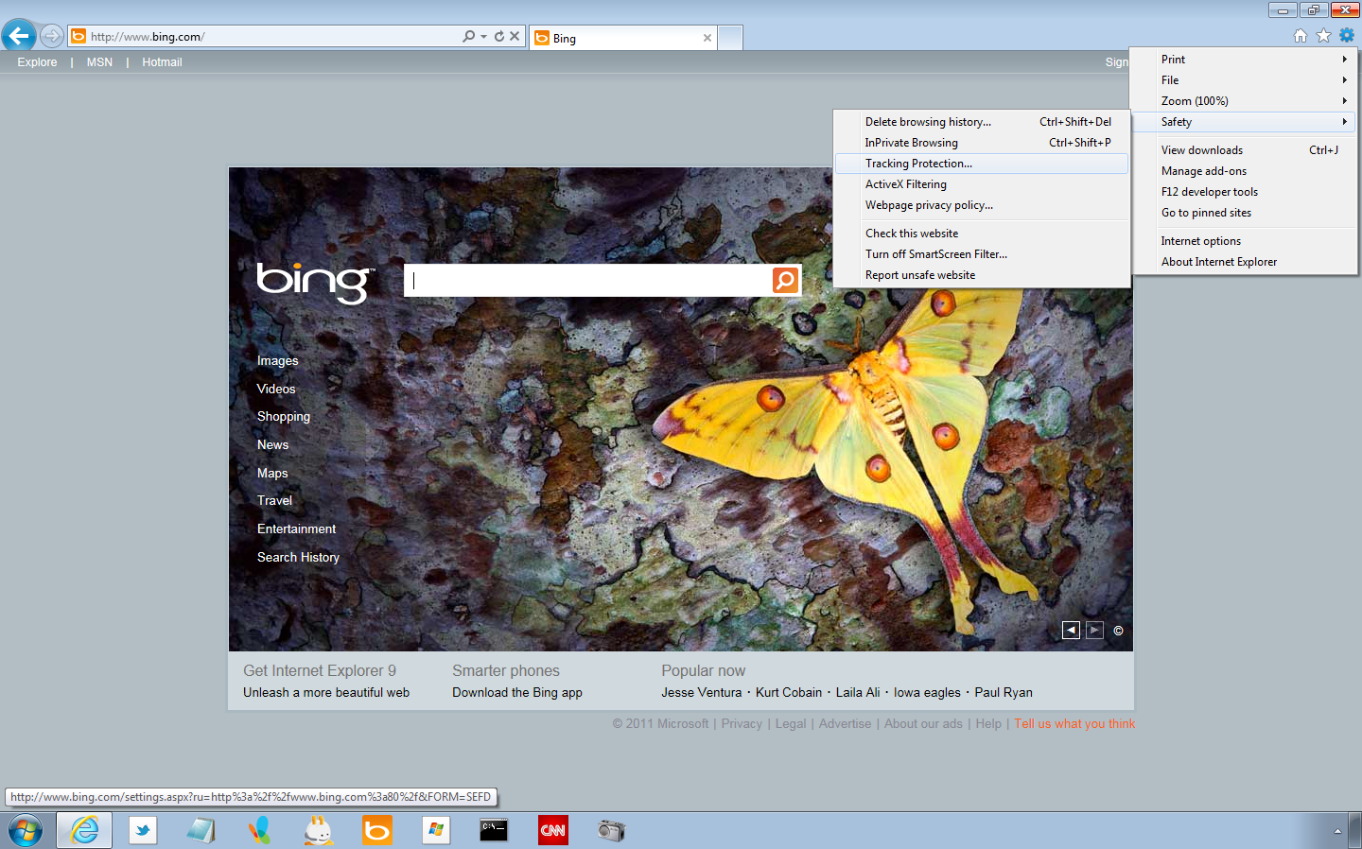
Tracking Protection
http://iegallery.com/en/trackingprotectionlists/

Slide 19
Online Tracking
Shopping Website
Health Food Blog
Medical Website
Buy an Xbox: $300
Article on the benefits of spinach
Article on Diabetes
Data Collected:
Tracking Service:
Aggregates information from: Web Beacons, Tracking Scripts, Cookies, & more…
Cookies
Interests:
Health
Technology & Games
Profile:
High Income
Medical Condition

Slide 20
Demonstration
Tracking Protection

Slide 21
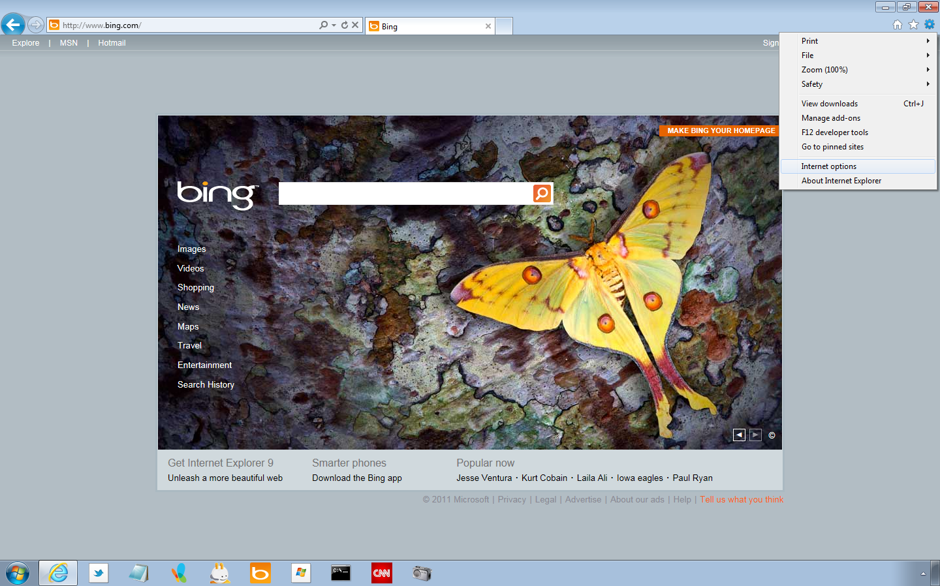
Delete Browsing History

Slide 22
ActiveX and Internet Security
ActiveX controls – when misused – can stop computer from functioning correctly, collect personal information, or give you content you don’t want.
ActiveX Security Feature | When Introduced
Manage Add-Ons to enable or disable ActiveX controls | Internet Explorer 6 and higher
ActiveX Opt-In Feature | Introduced in Internet Explorer 7
Per-Site ActiveX | Introduced in Internet Explorer 8
ActiveX Filtering | Introduced in Internet Explorer 9

Slide 23
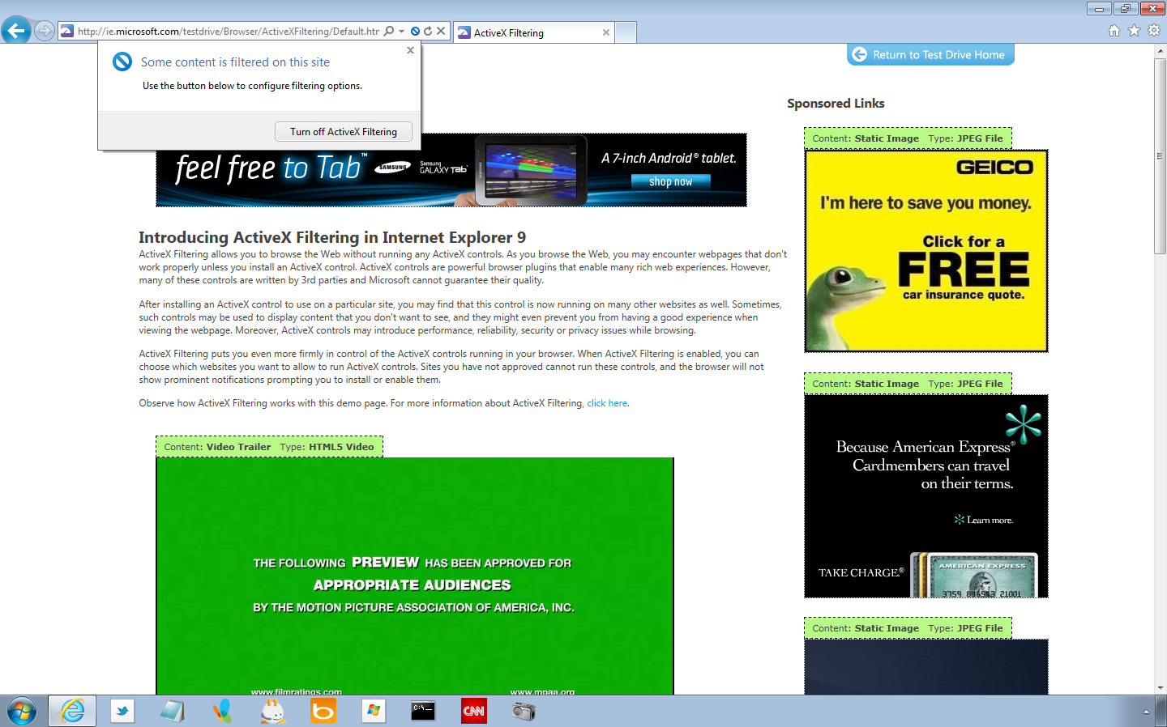
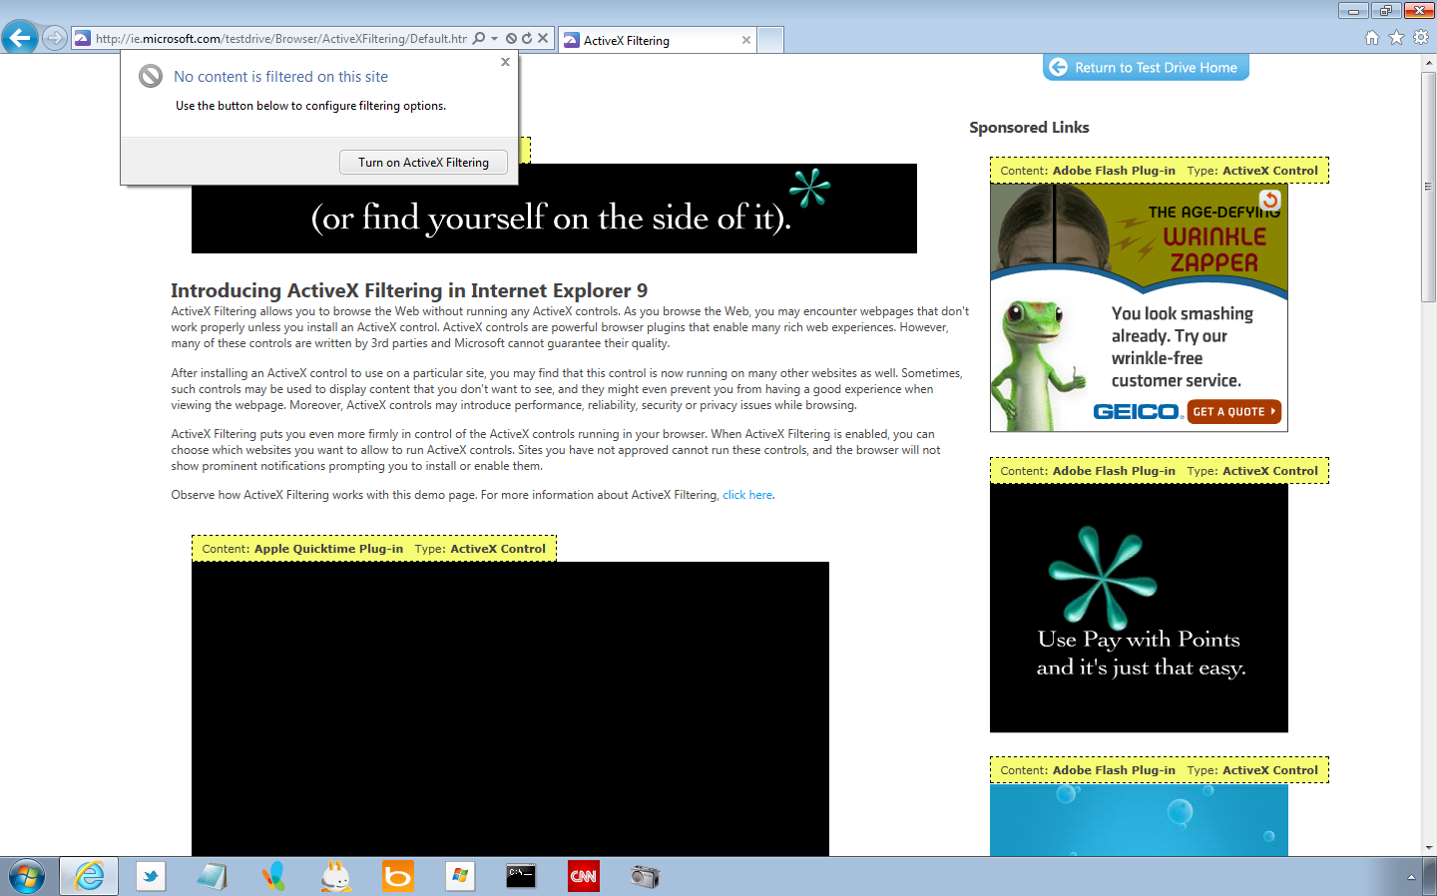
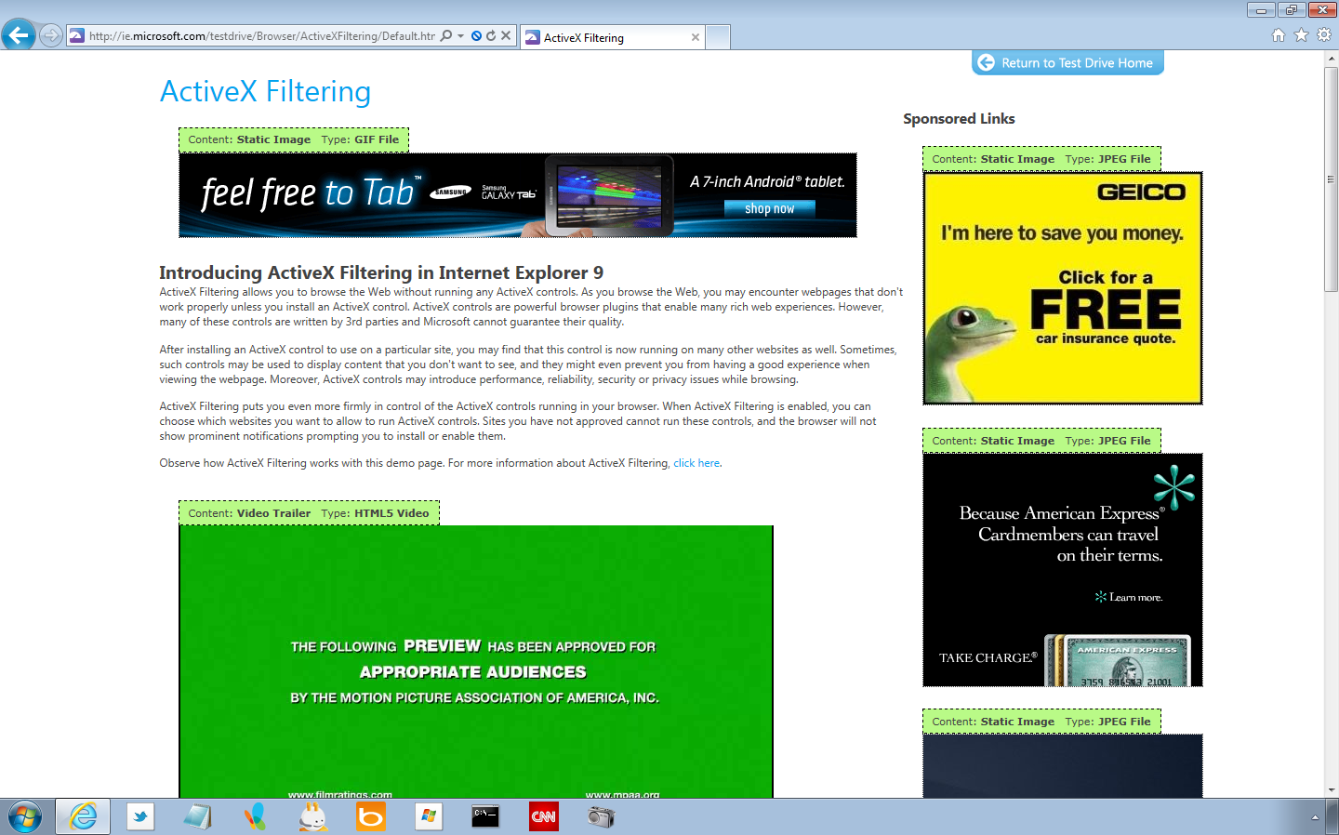
ActiveX Filtering

Slide 24
Demonstration: UI Features that Enhance Security
Review Address Bar, Search Provider Privacy, InPrivate Browsing
Tab Isolation and Recovery
Click-jacking Protection
Cross-site Scripting Filter
Application Reputation and SmartScreen Filter
ActiveX Filtering

Slide 25
Agenda
Reliable, Industry-leading Security
Internet Explorer 9 Security and Group Policy

Slide 26
Group Policy for IE 9 Security
Restrict users from making configuration changes
Configure SmartScreen Filter settings
Restrict which add-ons may be installed or run
Ensure users are not spoofed by fraudulent certificates or unsigned software
Control which HTTPS algorithms are enabled
Control which security zone settings are applied to specified sites
Reduce attack surface

Slide 27
Demonstration: Configure High Security Settings in Group Policy
Configure Group Policy Settings Manually
Test Group Policy Settings
Create Group Policy Settings using Security Compliance Manager
Test Group Policy Settings

Slide 28
Install Internet Explorer 9 Now!
Migrate your applications off Internet Explorer 6
Download and install Internet Explorer 9
and test your site!
Learn more at…
http://www.beautyoftheweb.com

Slide 29
Questions

Slide 30
Internet Explorer 9

