Slide 1
An Update for IT Pro’s
Jeff Alexander
Microsoft Australia
http://blogs.technet.com/jeffa36

Slide 2
Agenda
Windows 7 Development Process
What we heard from customers
Windows 7 Overview:
User Efficiency
Enhanced Security and Control
Streamlined PC Management
Windows Desktop Optimisation
3

Slide 3
The Making of
Listen & Learn
Quality & Fundamentals
Enable IT Pros & Developers
Excite End-Users
PLANNING
PREDICTABILITY
ECOSYSTEM

Slide 4
Improved Fundamentals
Decrease
Increase
Memory Reference set, Graphics
Disk I/O Registry Reads, Indexer
Power DVD Playback, Panel, Timers
Speed Faster Boot, Device Ready
Responsiveness Start menu, Taskbar
Scale 256 cores

Slide 5
Windows 7 Builds on Windows Vista Deployment, Testing, and Pilots Today Will Continue to Pay Off
Similar Compatibility:
Most software that runs on Windows Vista will run on Windows 7. Exceptions will be low level code (AV, Firewall, Imaging, etc).
Hardware that runs Windows Vista well will run Windows 7 well.
Few Changes: Focus on quality and reliability improvements
Deep Changes: New models for security, drivers, deployment, and networking

Slide 6
What We Heard from Customers
“My users are becoming more savvy and have more diverse needs. How do I keep people connected to what they need?”
“How can I enable the software and devices my users require and minimize their risk?”
“How can I reduce costs and take advantage of new technologies like virtualization?”

Slide 7
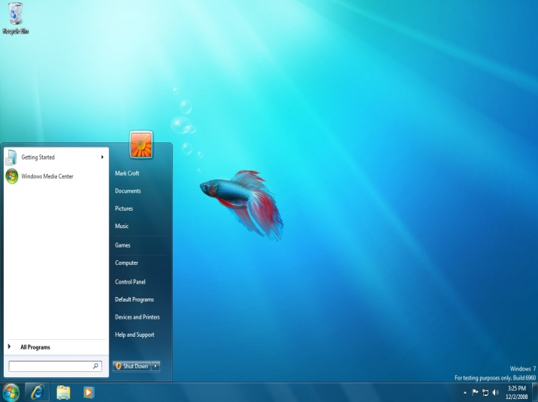
Works The Way You Want
Faster & More Responsive
“I want my PC to be fast and responsive.”
Better performance
Faster startup & shutdown
Quicker task management
Improved battery life
Closer development with PC Manufacturers

Slide 8
Works The Way You Want
Memory Consumption Comparison (Lower bars are better)
Windows 7 Pre Beta
Windows Vista
Preliminary data gathered on
Windows 7 pre-release builds
Windows 7 memory consumption is independent of number of open windows

Slide 9
Battery Life Increase Example
Works The Way You Want
DVD Battery Life (Taller bars are better)
DVD Rundown Battery Life (Minutes)
System A System B System C
Preliminary data gathered on
Windows 7 pre-release builds
on sample of test systems.
Windows Vista SP1
Windows 7 Pre-Beta

Slide 10
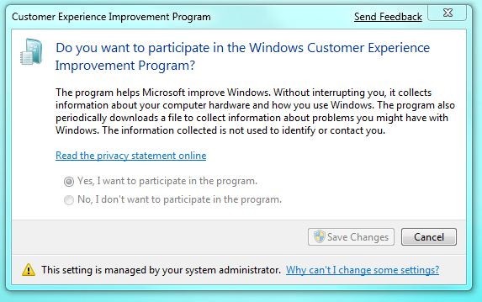
Works The Way You Want
Broad Compatibility
“All my applications and devices should just work with my PC.”
Improved compatibility
& easier troubleshooting
If it works with Windows Vista, it should work with Windows 7
New Program Compatibility Troubleshooter
Effortless updates to applications
& device drivers

Slide 11
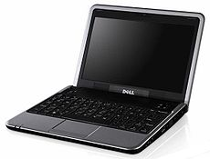
Works The Way You Want
Low Cost PCs
“I’d like a small notebook PC, but don’t want to compromise on functionality”
Windows 7 runs great on low-cost hardware
Enjoy the latest features & new experiences on the go
Windows 7 with Internet Explorer & Windows Live for the best Internet experience

Slide 12
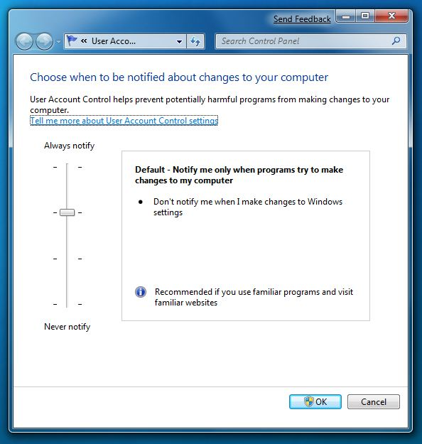
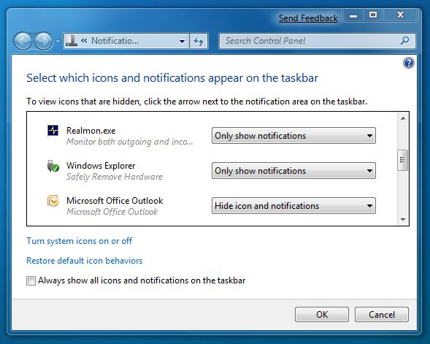
Works The Way You Want
Fewer Interruptions
Fewer prompts & more control over settings
“When I choose to do something on my PC, I don’t want it to constantly ask me if I’m sure.”

Slide 13
Demo
Windows 7 Taskbar
Jump lists
Aero Peek, Snap and Hover

Slide 14
Windows 7 for the Enterprise Makes the things you do today faster and easier, and new things possible
Make Users Productive Anywhere
Enhance Security & Control
Streamline PC Management
At their desk
In a branch
On the road
Protect data & PCs
Built on Windows Vista foundation
Easy migration
Keep PCs running
Virtualization

Slide 15
Make Users Productive Anywhere
Remove Barriers to Information
Faster & Easier for Everyday Tasks
Search your PC and intranet
Internet Explorer 8 retrieves data beyond the page
Responsive, reliable performance
Intuitive UI and navigation
Access Information From Anywhere
DirectAccess™ mobile connectivity
BranchCache™ network boost

Slide 16
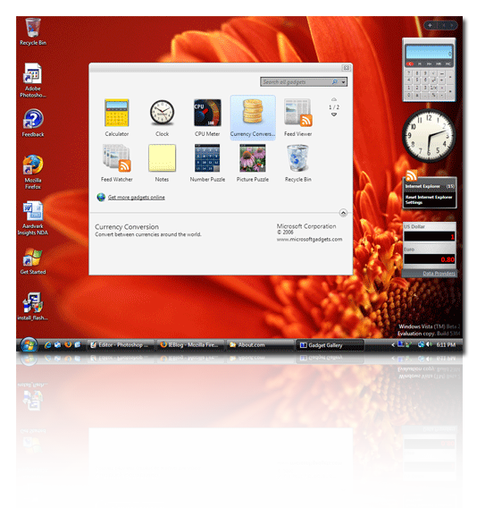
Enterprise Search Make Users Productive Anywhere
Situation Today
Windows 7 Solution
Search Federation
Consistent user experience for finding data from multiple locations
IT can pre-populate links on Start menu and Explorer to preferred sites with “Enterprise Search Scopes”
Current desktop and Enterprise search solutions are good, but not integrated
Users need to take different steps to find data on PC and data on servers
Data sources are hard to discover

Slide 17
Demo
Search Federation

Slide 18
Remote Access for Mobile Workers Make Users Productive Anywhere
Situation Today
Windows 7 Solution
DirectAccess™
Office
Home
Office
Home
New network paradigm enables same experience inside & outside the office
Seamless access to network resources increases productivity of mobile users
Easy to service mobile PCs and distribute updates and polices
Difficult for users to access corporate resources from outside the office
Challenging for IT to manage, update, patch mobile PCs while disconnected

Slide 19
Demo
DirectAccess

Slide 20
Branch Office Network Performance Make Users Productive Anywhere
Situation Today
Windows 7 Solution
BranchCache™
Application and data access over WAN is slow in branch offices
Slow connections hurt user productivity
Improving network performance is expensive and difficult to implement
Caches content downloaded from file and Web servers
Users in the branch can quickly open files stored in the cache
Frees up network bandwidth for other uses

Slide 21
Demo
BranchCache™

Slide 22
Enhance Security & Control
Protect Data on PCs & Devices
BitLocker To Go™ protects data on removable drives
BitLocker™ simplifies encryptions and key management for all drives
Protect Users & Infrastructure
Build on Windows Vista Security Foundation
AppLocker™ controls what applications run
Internet Explorer 8 helps keep users safe online
User Account Control prompts less
Security Development Lifecycle for defense in depth

Slide 23
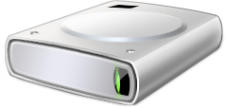
Data Protection Enhance Security & Control
Situation Today
Windows 7 Solution
BitLocker To Go™
+
Worldwide Shipments (000s)
Protect data on internal and removable drives
Mandate the use of encryption with Group Policies
Store recovery information in Active Directory for manageability
Simplify BitLocker setup and configuration of primary hard drive
Gartner “Forecast: USB Flash Drives, Worldwide, 2001-2011” 24 September 2007, Joseph Unsworth
Gartner “Dataquest Insight: PC Forecast Analysis, Worldwide, 1H08” 18 April 2008, Mikako Kitagawa, George Shiffler III

Slide 24
Demo
Bitlocker To Go™

Slide 25
Application Control Enhance Security and Control
Situation Today
Windows 7 Solution
AppLocker™
Users can install and run unapproved applications
Even standard users can install some types of software
Unauthorized applications may:
Introduce malware
Increase helpdesk calls
Reduce user productivity
Undermine compliance efforts
Eliminate unwanted/unknown applications in your network
Enforce application standardization within your organization
Easily create and manage flexible rules using Group Policy

Slide 26
Demo
Applocker™

Slide 27
Streamline PC Management
Keep PCs Running Smoothly
Easier Deployment from Windows Vista
Compatibility with Windows Vista hardware, software, tools
New tools speed image creation, migration, and deployment
PowerShell & Group Policy management ease configuration
Troubleshooting platform reduces help desk issues
Better Support for Client Virtualization
Improve VDI experience with multi-monitor and mic support
Same tools to manage and service VHD & WIM images

Slide 28
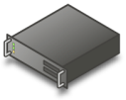
Virtual Desktop Infrastructure Streamline PC Management
Situation Today
Windows 7 Solution
Richer Remote Experience
Richer graphics with improved multi-monitor support
Use voice for telephony & applications with microphone support
Improved printing
What is Virtual Desktop Infrastructure?
Do More With VHDs
Maintain VHD: Offline servicing of VHD images with same tools used for WIM
Boot from VHD: Reuse VHD files for deployment to managed desktop PCs
Deploying desktops in virtual machines on server hardware
Centralized management & security
Users can access their desktop and applications wherever they are
*
Using Windows for VDI scenarios requires additional VECD license

Slide 29
Demo
Booting from VHD

Slide 30
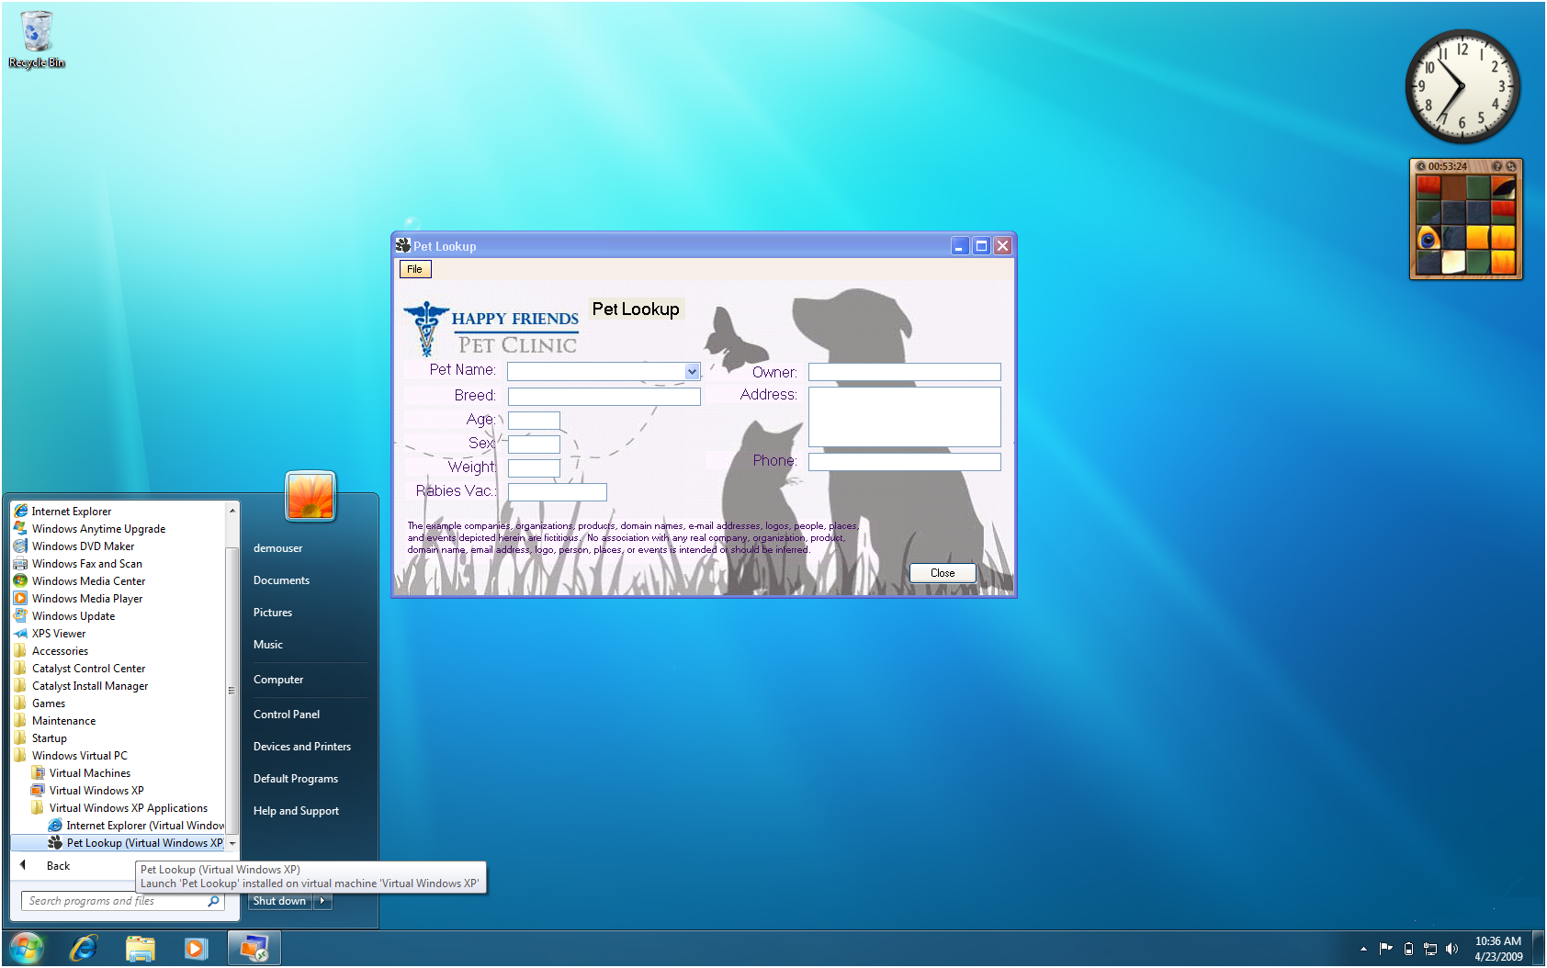
Virtual Windows XP
Pre-configured Windows XP VHD image
USB Support New Windows 7 style UI
Seamless Applications

Slide 31
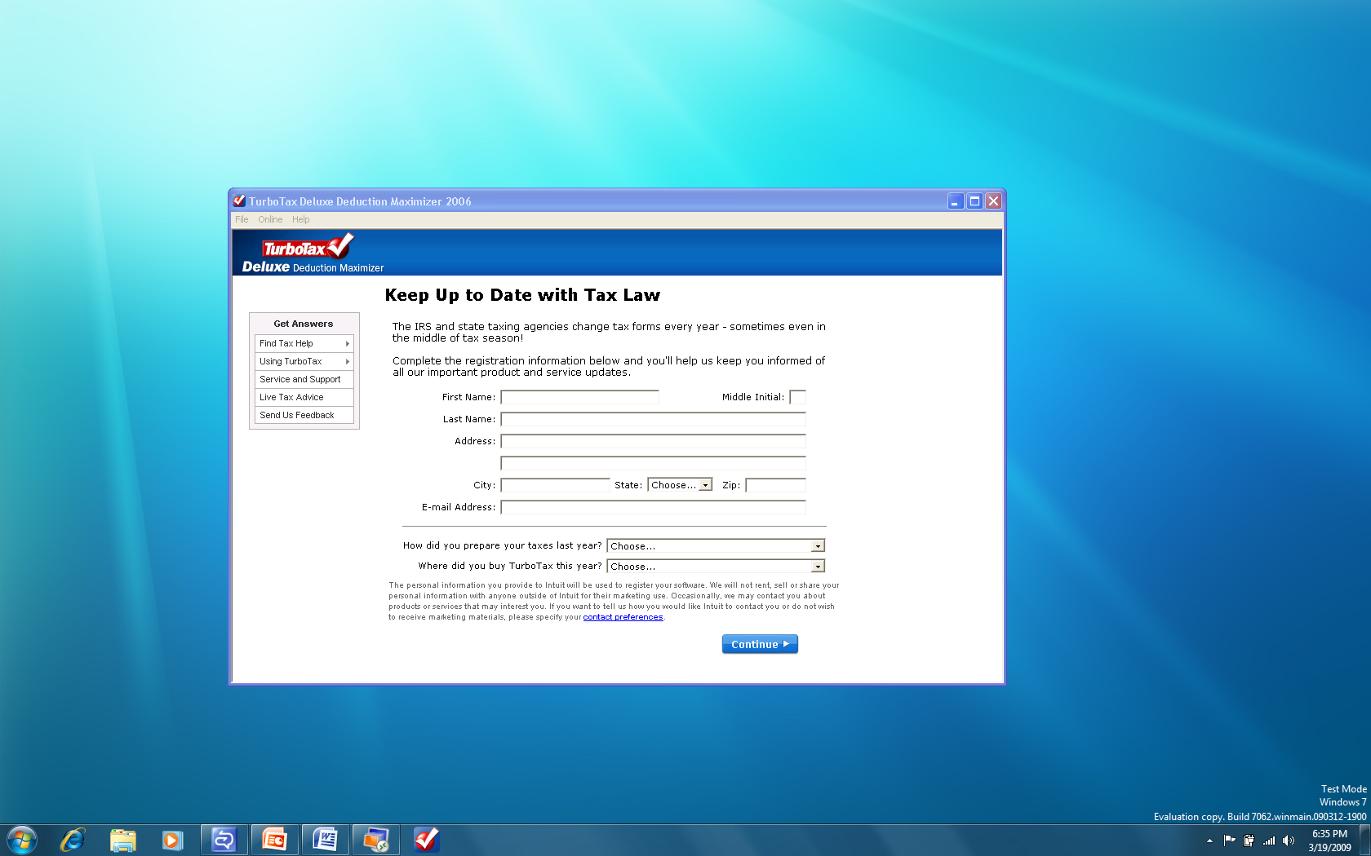
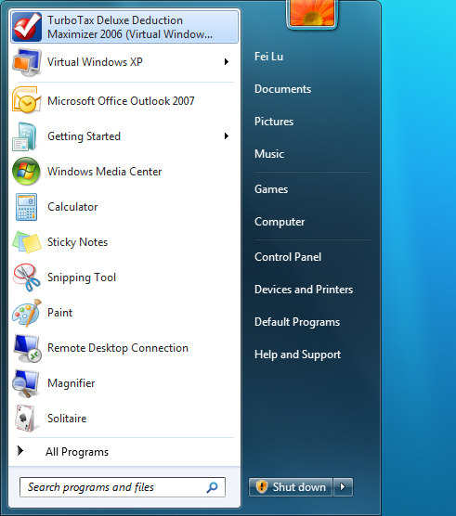
Windows 7 experience for Windows XP Apps
Pin and Launch Pin Windows XP App from Windows 7 Start Menu
Pin and Launch Pin Windows XP App from Windows 7 Taskbar

Slide 32
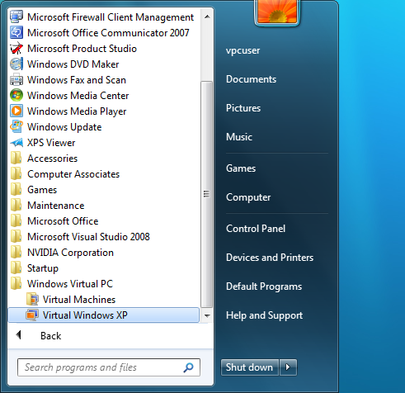
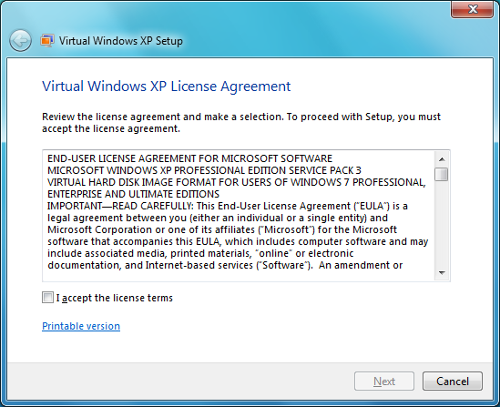
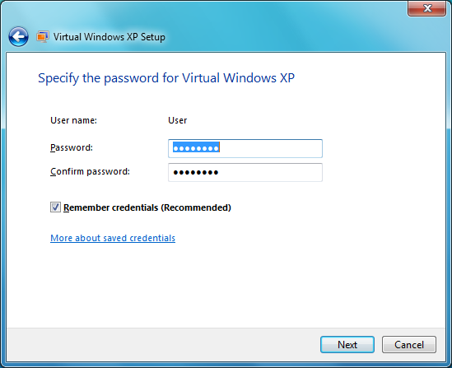
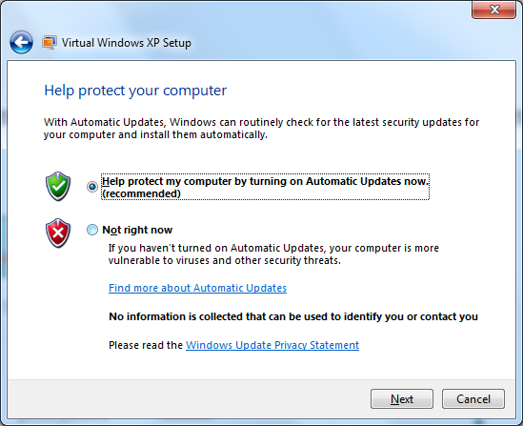
Easy setup from a Windows 7 Desktop

Slide 33
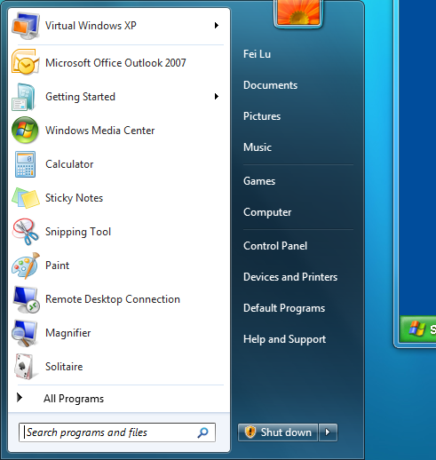
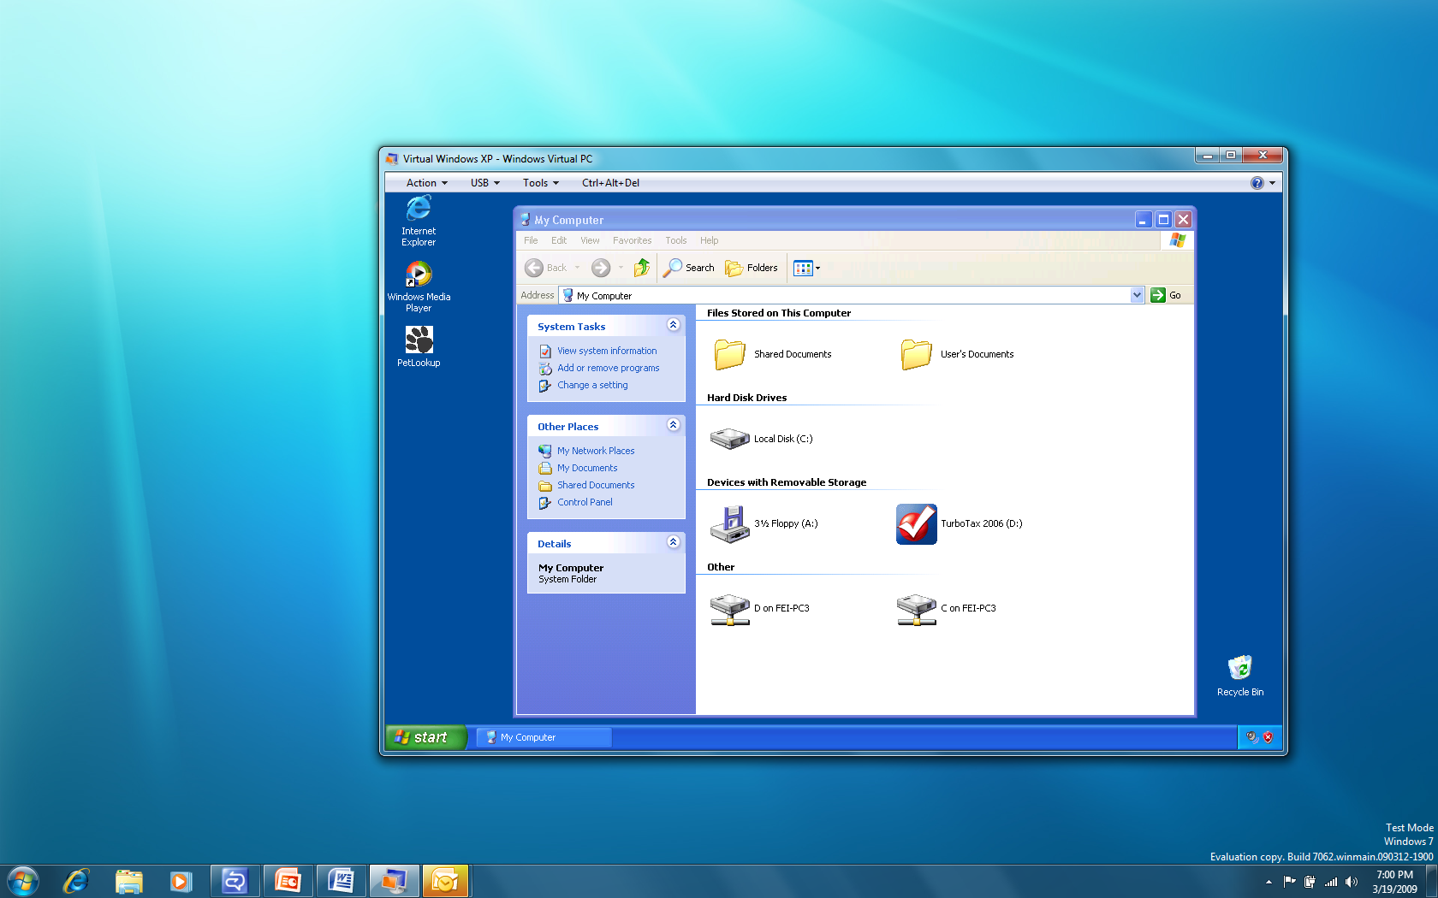
Install Applications in Virtual Windows XP is Easy
Open Virtual Windows XP from Windows 7 Start Menu
Install Windows XP applications like you normally do

Slide 34
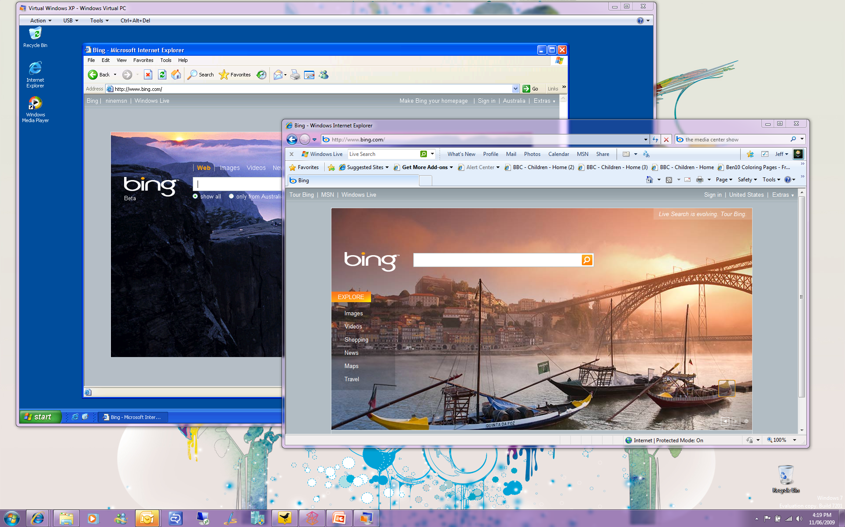
… and address IE6 compatibility concerns for Windows 7

Slide 35
Demo
Windows Virtual PC
Windows XP Mode

Slide 36
Automation Streamline PC Management
Situation Today
Windows 7 Solution
PowerShell v2.0 In the Client
IT Pros rely on scripting to automate repetitive tasks
Previous Windows scripting languages were limited in scope and difficult to use
PowerShell helps IT professionals achieve greater control and productivity in managing servers
Use the same powerful tools for automation of servers and PCs
New graphical editor makes it easy for IT pros to learn and use scripting
Run automated tasks remotely across your entire organization

Slide 37
Demo
Streamlined PC Management

Slide 38
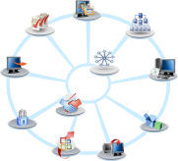
Deployment Enhancements
IMAGING
DELIVERY
MIGRATION
Deployment Image Servicing and Management
Add/Remove Drivers and Packages
WIM and VHD Image Management
Windows Deployment Services
Multiple Stream Transfer
Dynamic Driver Provisioning
VHD and WIM Support
User State Migration Tool
Hardlink Migration
Offline File Gather
Improved user file detection
INTEGRATED SOLUTIONS CONTINUE
Microsoft Assessment and Planning
Application Compatibility Toolkit
Microsoft Deployment Toolkit

Slide 39
Demo
Deployment Tools

Slide 40
Windows Optimized Desktop
End-User Productivity
Security & Control
PC Management
DirectAccess
BranchCache
Federated Search
Navigation
BitLocker
BitLocker To Go
AppLocker
Security development lifecycle
PowerShell
Windows Troubleshooting Platform
Deployment Tools
VDI Enhancements
Microsoft Desktop Optimization Pack
App-V
MED-V
AIS
DEM
DART
AGPM
Fundamentals
Performance | Reliability | Compatibility

Slide 41
Windows Optimized Desktop: MDOP Better management to save costs; ease future upgrades
What the Desktop Optimization Pack provides
SA Customer Satisfaction
Provide immediate ROI
1
Regular updates
Faster upgrade cycle, separate from Windows
Minimal deployment effort
Deliver end-to-end solutions
2
Run out of the box
Integrate with existing management solutions
3
Lower Desktop TCO
>95% of MDOP customers are (very) satisfied
$70-$80 net cost savings per PC per year using MDOP*
* Gartner, Inc. “Quantifying the Value of Microsoft’s Desktop Optimization Pack”, July 2008

Slide 42
So What do I do Now?
If you are…
Deploying Windows Vista
Continue deployment – Your investment is protected!
Focus your testing on Windows 7
Testing Windows Vista
Waiting for Windows 7
Start Windows 7 evaluation & adoption planning
Utilize the Windows 7 SDK
Test Current Apps
Build Windows 7 Ready Applications
ISVs & Developers

