Slide 1
Relationships and Sexual Education
at
Emma Heasman – PSHE Co-ordinator

Slide 2
RSE at Cobham
Rationale
The teaching of Relationship and Sex Education (RSE) is more than the biological teaching of sex.
As well as accurate information, children need to be given the opportunity to discuss and consider relationships, in the context of marriage and the family, recognising other stable relationships, and reflect on difficult moral and social issues, so that they learn to respect themselves and others as they grow up.
We deliver a balanced, age-appropriate programme of intervention and support which builds children’s self-esteem and achievements, and enables them to take responsible decisions about their lives.

Slide 3
RSE at Cobham
Aims of RSE
The development of a personal identity, to be able to value themselves and others
The development of positive social interaction, and the skills to live and work with others

Slide 4
RSE at Cobham
Objectives
Develop a clear set of values and attitudes, establishing a strong moral code and keeping to it
Value themselves as unique human beings, capable of spiritual, moral, intellectual and physical growth and development
Learn to live and enjoy a healthy, safe lifestyle
Develop an active role as a member of a family and of the community
Value family and marriage as one
of the foundations of a civilised society

Slide 5
RSE at Cobham
Objectives
Continued
Respect the rule of law and encourage others to do so
Know and understand their own physical development
Respect themselves and others
Manage emotions and relationships confidently and sensitively
Recognise and avoid abuse
Be responsible for their actions and their consequences
Develop the life skills of communication, listening, negotiation and recognising pressures

Slide 6
RSE at Cobham
Year R
Have a developing awareness of their own needs and be sensitive to those of others.
Understand that they can expect others to treat their needs with respect.
Have a developing respect for their own cultures and beliefs and those of other people.
Find out about events in their own lives, in those of their families and other people they know.

Slide 7
RSE at Cobham
Year 1
Learn how to look and sound friendly, and consider the qualities we look for and need to develop in order to have and be a good friend.
Know that emotions vary in intensity from mild to very powerful.
Know that sometimes we have to share people and things.
Know how we make changes in our lives and cope with them.
To extend their understanding of their own and others’ healthy lifestyles.

Slide 8
RSE at Cobham
Year 2
To experience how supportive it feels to belong to and be valued by a group.
To develop an understanding that our behaviour influences the feelings and behaviour of other people.
To use knowledge and skills to make informed and responsible personal choices.
Understand that people have to make hard choices that affect others.

Slide 9
RSE at Cobham
Year 3
To be introduced to some basic skills of assertiveness.
Become more responsible for their healthy lifestyle.
Know that more than one feeling can be experienced at a time.
To consider some ways in which change is positive, developmental and necessary.
To understand that people make their own choices.
To develop their understanding of happiness and excitement, sadness and fearfulness, as well as ways to manage feelings.
To be introduced to the correct terminology for their public and private bodily areas.

Slide 10
RSE at Cobham
Year 4
To be able to resist pressure and influence.
To know some of the changes in their bodies as they approach puberty and how to deal with them.
Know that a degree of apprehension about change is normal and that humans have a range of strategies for coping flexibly with it.
Develop strategies to recognise feelings in others and to help others overcome negative feelings.
Use problem- solving skills to generate solutions, decide on a course of action, implement it, and review it.

Slide 11
RSE at Cobham
Year 5
Explore friendship choices.
To revise knowledge of some of the changes in their bodies as they approach puberty and how to deal with them.
To be able to assess risks and make appropriate, safe decisions.
Explore the idea that negative feelings about change do not last for ever.
To learn about every human’s basic rights and the differences between needs, wants and rights.
To be aware of the greater need for personal hygiene.

Slide 12
RSE at Cobham
Year 6
Know that there are both internal and external body changes during puberty.
Know that each person is made from an egg from a woman and a sperm from a man.
Know how it feels to hold a minority opinion, feel confident in standing up for your beliefs.
To explore the importance of taking responsibility for action and behaviour.
Develop strategies for managing their feelings.
Learn a number of strategies for dealing with embarrassment.
Develop strategies that enable them to manage change more effectively.

Slide 13
RSE at Cobham
Parents
Parents and carers are the key people in teaching their children about RSE and helping them to cope with the physical and emotional aspects of growing up.
You are the main contributors to your children’s development of values and attitudes. We aim to build on the learning that takes place at home.
We understand some parents find it difficult to talk with their children about sex and relationships and may need support in how to do this.

Slide 14
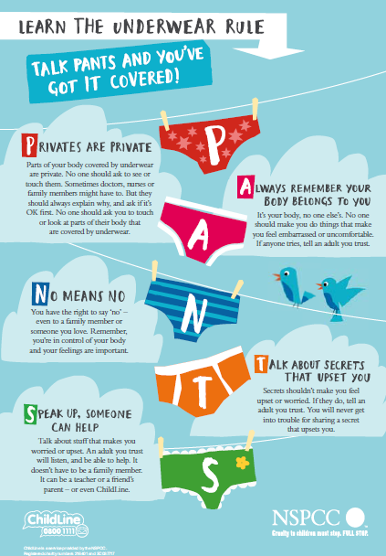
RSE at Cobham
Keeping your
children safe

Slide 15
RSE at Cobham
Keeping your children safe:
Keep surprises NOT secrets
Teach your children that we don’t keep secrets from one another, but we can keep surprises.
Surprises are things that people will all find out soon, like birthday presents, or Christmas presents, a new baby coming or a special dinner. Surprises can be fun and make you feel happy and excited.
Secrets are things that people tell you that you can never ever tell. Secrets can make you feel yucky or sad or frightened. Some people may even say that something bad will happen if you ever tell the secret.

Slide 16
RSE at Cobham
Equal Opportunities
To encourage the children to have an understanding of the difference and diversity in the world around them we have invested in various books which deal with the following categories:
Gender Roles
Relationships
Different Families
Lesbian and Gay Characters
Please have a look at the books which are on display.

Slide 17
RSE at Cobham
Thank You!
Thank you for making time to come today.
Please feel free to have a look at the new books we have bought and some of our teaching resources.
If you have any questions please feel free to come and ask them!
We have a questionnaire about your feelings towards the teaching of RSE in schools and we love it if you could take the time to fill it out!

