Slide 1
Windows Intune:
Cloud Services for PC Management
Jeff Alexander
IT Pro Evangelist
Microsoft Australia
http://blogs.technet.com/jeffa36

Slide 3
ENABLING DIVERSE WORKSTYLES

Slide 5
Microsoft is serious about the cloud

Slide 6
Microsoft Commercial Cloud Services
Used by Over 50% of the Fortune 500
“…by 2014, about 34% of all new business software purchases will be consumed via SaaS…”
- IDC, June 2010*
58% CIOs selected Microsoft cloud**
40,000 Accredited Online Resellers
PRODUCTIVITY
COMMUNICATIONS
COLLABORATION
BUSINESS APPS
MANAGEMENT & SECURITY
STORAGE
PLATFORM
*Worldwide Software as a Service 2010–2014 Forecast: Software Will Never Be the Same, Doc#223628, June 2010
**ISI CIO Survey, February 2011

Slide 7
Challenges in Managing Business PCs
Solution Cloud services
and Windows 7
Workers in Many Locations
Help Manage & Secure PCs Anywhere
(Cloud services)
Compromised security on remote PCs
Multiple Configurations, Versions, Licenses
The Best Windows Experience (Standardize OS on Windows 7)
Lack of Insight to PCs
Fits Your Business
(Big result with low investment)
High Infrastructure Investments Required

Slide 8
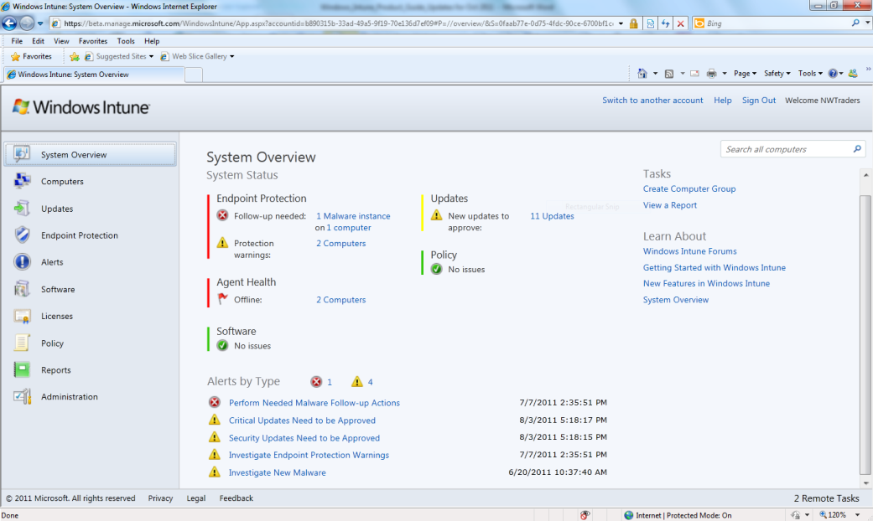
Help Manage & Secure PCs Anywhere Simple Web-Based Administration Console
Help protect PCs from malware
Manage updates – Updated
Distribute software - New
Proactive monitoring and alerts- Updated
Provide remote assistance- Updated
Inventory hardware and software
Monitor & track licenses - Updated
Increase insight with reporting - Updated
Set security policies
Enabling Flexible Workstyles
Users can be managed from the office, branch office, or on the road
IT and partners can work from virtually anywhere

Slide 9
The Best Windows Experience Get Windows 7 Enterprise and more
Standardize on a single version of Windows to increase efficiency
Upgrade to Windows 7 Enterprise
BitLocker To Go™
Run any version of Windows
Improved UI & Search
Better Mobility Experience
Upgrades to future Windows versions
Speed, reliability, and responsiveness

Slide 10
Fits Your Business Big tech results with a small tech investment
No infrastructure overhead
IDC REPORTS**
$702
Savings/PC/Year
Reduced maintenance costs
Standardized PC environment
IT Staff Productivity
User Productivity
Elimination of Other Tools
Instant insight to PC environment
Always current with seamless updates
Simple, predictable billing: $11/PC/month*
* Pricing may vary by region
** IDC White Paper “A First Look at How Windows Intune Can Lower Costs and Raise Productivity”, March 2011

Slide 11
Our vision for Windows Intune is to always deliver the best Windows experience with enterprise-class management and security.
ENABLE
FLEXIBLE WORKSTYLES
SMART
MANAGEMENT
LATEST IN
WINDOWS
RAPID RELEASE CYCLES
Empower users to work from anywhere, anytime with the tools they need.
Deliver simplified, enterprise-class management for IT with less costs and higher productivity.
Give users a modern OS experience for greater productivity, security, and mobility benefits.
Provide customers continuous improvements & new features without costly deployments.

Slide 12
Which PC management solution is right for you today? Microsoft Offers Flexibility and Choice with Best-in-Class Management
Online
On-premises
No infrastructure required
Delivers management essentials
Easily extends to unmanaged PCs
Enterprise-grade
Recommended for most
large organizations

Slide 13
Opportunity for Windows Intune from SMB to Enterprise A choice for every customer with unmanaged PC’s that needs core management
Windows Intune Delivers Management & Security Essentials
Off-Network
Employees
Field & Contract Employees
Highly Distributed
Offices
Early Cloud
Adopters
Quick Deployment Scenarios
Limited IT
Resources
Use System Center If The Following Apply To You
Managing more than 5,000 PCs
Poor bandwidth
Advanced management requirements
Single solution to manage all devices

Slide 14
Windows Intune July Beta Compared to On-Premises Solution Delivering a subset of rich functionality common to on-premises solutions today
Key Benefits
Cloud
On-premises
Operating system distribution
Full Group Policy Support
Mobile Device Management
Active Directory Federation
Software Distribution
Basic
Alerts & Monitoring**
Remote Assistance
Hardware, software, and license inventory
Malware protection
Update management
**The “alerts” workspace within Windows Intune manages an optimized list of pre-defined system events. Access to comprehensive monitoring events is available in our on-premises solution.

Slide 15
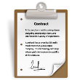
Licensing & Pricing
Pricing
Windows Intune Standalone: $11 USD*/Device/Month
Windows Intune Add-On : $5/Device/Month (for Windows Client EA customers)
Microsoft Desktop Optimization Pack Add On: $1 USD/Device/Month
Discounts
$
PCs Already Covered by Software Assurance
Volume Purchases (>250 PCs)
Available to Purchase Through
Microsoft Online Services Portal
Volume Licensing: Enterprise Agreement (EA and EAS) and Enrollment for Education Solutions (EES)
Terms
Windows Intune software & services are non-perpetual, subscription licenses
“Buyout” available for Windows enterprise license**
Device Subscription License (DSL)
Qualified OS Requirements
Windows Professional, Enterprise, or Ultimate SKU
Pricing may vary by region
**“buyout option applies only to purchases made through MOCP

Slide 16
Windows Intune Geographic Availability
Central & Eastern Europe
Cyprus
Czech Republic
Greece
Hungary
Poland
Romania
Western Europe
Austria
Belgium
Denmark
Finland
France
Germany
Ireland
Italy
Luxemburg
Netherlands
Norway
Portugal
Spain
Sweden
Switzerland
UK
Canada
United States
Asia Pacific
Australia
Hong Kong
India
Japan
Malaysia
New Zealand
Singapore
Middle East & Africa
Israel
Latin America
Brazil
Chile
Colombia
Costa Rica
Mexico
Peru
Puerto Rico
Trinidad & Tobago
Product localization languages for commercial release: Chinese (traditional), Chinese (simplified), English (default), French, German, Italian, Portuguese (Brazilian), Japanese, Korean, Russian, Spanish
Product localization languages for October 2011 release: Arabic ,Czech, Danish, Dutch, English, Finnish, French, German, Greek, Hungarian, Italian, Japanese, Korean, Norwegian, Polish, Portuguese (Brazilian), Romanian, Russian, Simplified Chinese, Spanish, Swedish, Traditional Chinese, Turkish

Slide 17
Windows Intune™ Console

Slide 18
Business Benefits with Windows Intune Improve Security, Increase Productivity, Reduce Costs
Improves Security by keeping your PCs more protected and up to date.
Increases Productivity
for both end-users and the IT team.
Lowers Costs
by optimizing PC management and support.
Windows Intune Endpoint protection
BitLocker
Security Policies & Firewall Management
IT Team
Single, easy-to-use web-based console
Proactive monitoring
End-user
Latest Windows OS
Up-to-date, highly secure PC
Reduced downtime
No hardware infrastructure or related maintenance
Predictable IT spend with lower CapEx costs

