Slide 1
Infant growth and development

Slide 2
Definition of normal infant:-
It is the period which starts at the end of the first month up to the end of the first year of age. Infant's growth and development during this period are rapid.

Slide 3
Physical growth of normal infant
Weight : the infant gains :
- Birth to 4 months → ¾ kg /month
- 5 to 8 months → ½ kg / month
- 9 to 12 months → ¼ kg /month
The infant will double his birth wt by 4-5 months and triple it by 10-12 months of age

Slide 4
Calculating infant’s weight
Infants from 3 to 12 months
Weight = Age in months + 9
2
Wt of 7 months old infant = 7+9 = 16 = 8 kg
2 2

Slide 5
Height
Length increases about 3 cm /month during the 1st 3 months of age,
then it increases 2 cm /month at age of 4-6 months,
Then, at 7 – 12 months, it increases 1 ½ cm per month

Slide 6
Head circumference
It increases about 2 cm /month during the 1st 3 months,
Then, ½ cm/month during the 2nd 9 months of age.
Posterior fontanel closes by 6-8 w of age.
Anterior fontanel closes by 12-18 months of age.

Slide 7
Chest circumference
By the end of the 1st year, it will be equal to head circumference.
Physiological growth of infants:-
Pulse 110-150 b/min
Resp 35 ± 10 c/min
Breath through nose.
Blood pressure 80/50 ± 20/10 mmHg

Slide 8
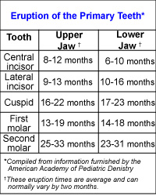

Slide 9
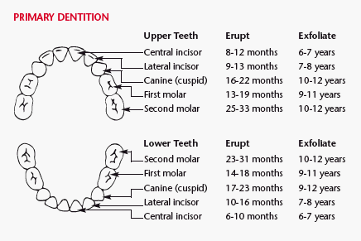

Slide 10
Dentition:
Eruption of teeth starts by 5–6 months of age. It is called "Milky teeth" or "Deciduous teeth" or "Temporary teeth".

Slide 11
Average age for teeth eruption:
Lower central incisors
Upper central incisors
Upper lateral incisors
Lower lateral incisors
Lower first molars
Upper first molars
Lower cuspids
Upper cuspids
Lower 2nd molars
Upper 2nd molars
Erupt at 6 months
Erupt at 7.5 months
Erupt at 9 months
Erupt at 11 months
Erupt at 12 months
Erupt at 14 months
Erupt at 16 months
Erupt at 18 months
Erupt at 20months
Erupt at 24 months.

Slide 12
Motor Development
At 2 months
Hold head erects in mid-position.
Turn from side back.
At 3 months, the infant can
Hold head erects and steady.
Open or close hand loosely.
Hold object put in hand

Slide 13
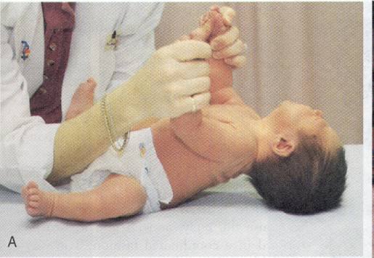
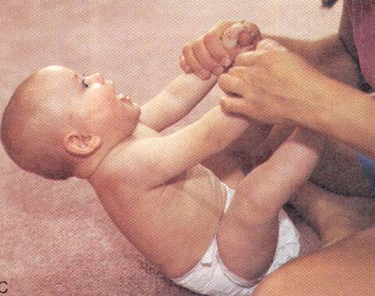
Head Control
Newborn
Age 6 months
Notes:
Newborn

Slide 14
At 4 months, the infant can:
Sit with adequate support.
Roll over from front to back.
Hold head erect and steady while in sitting position.
Bring hands together in midline and plays with fingers.
Grasp objects with both hands.

Slide 15
At 5 months, the infant can:
Balance head well when sitting.
Site with slight support.
Pull feet up to mouth when supine.
Grasp objects with whole hand (Rt. or Lt.).
Hold one object while looking at another

Slide 16
At 6 months, the infant can:
Sit alone briefly.
Turn completely over ( abdomen to abdomen ).
Lift chest and upper abdomen when prone.
Hold own bottle.

Slide 17
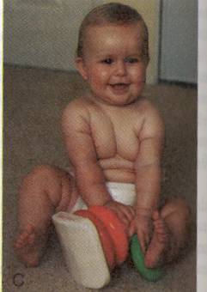
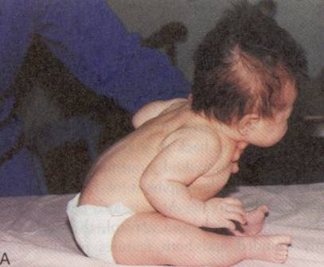
Sitting Up
Age 2 months
Age 8 months

Slide 18
At 7 months, the infant can:
Sit alone.
Hold cup.
Imitate simple acts of others.

Slide 19
At 8 months, the infant can:
Site alone steadily.
Drink from cup with assistance.
Eat finger food that can be held in one hand.

Slide 20
At 9 months, the infant can:
Rise to sitting position alone.
Crawl (i.e., pull body while in prone position).
Hold one bottle with good hand-mouth coordination

Slide 21
At 10 months, the infant can:
Creep well (use hands and legs).
Walk but with help.
Bring the hands together.
At 11 months , the infant can:
Walk holding on furniture.
Stand erect with minimal support

Slide 22
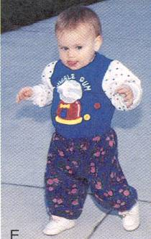
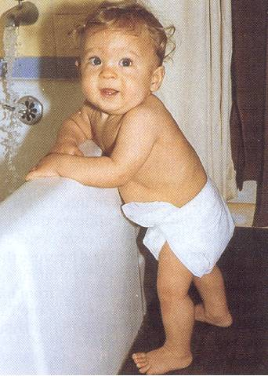
Ambulation
13 month old
Nine to 12-months
Notes:
N

Slide 23
At 12 months , the infant can:
Stand-alone for variable length of time.
Site down from standing position alone.
Walk in few steps with help or alone (hands held at shoulder height for balance).
Pick up small bits of food and transfers them to his mouth

Slide 24
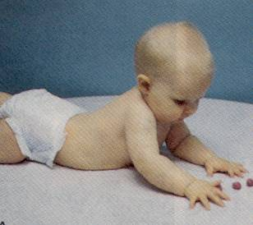
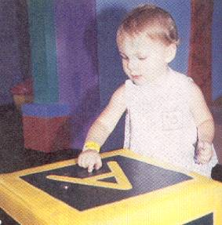
Fine Motor Development in infancy
6-month-old
12-month-old

Slide 25
Ambulation(motor growth)
9 month old: crawl
10 month old: creep
1 year: stand independently from a crawl & creep position
13 month old: walk and toddle quickly
15 month old: can run

Slide 26
Emotional development:
His emotions are instable, where it is rapidly changes from crying to laughter.
His affection for or love family members appears.
By 10 months, he expresses several beginning recognizable emotions, such as anger, sadness, pleasure, jealousy, anxiety and affection.
By 12 months of age, these emotions are clearly distinguishable.

Slide 27
Social development
He learns that crying brings attention.
The infant smiles in response to smile of others.
The infant shows fear of stranger (stranger anxiety).
He responds socially to his name.
According to Erikson, the infant develops sense of trust. Through the infant's interaction with caregiver (mainly the mother), especially during feeding, he learns to trust others through the relief of basic needs.

Slide 28
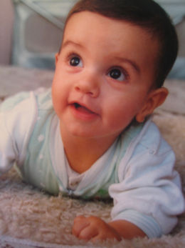
As an infant's vision develops, he or she may seem preoccupied with watching surrounding objects and people

Slide 29
Speech Milestones
1-2 months: coos
2-6 months: laughs and squeals
8-9 months babbles: mama/dada as sounds
10-12 months: “mama/dada specific

Slide 30
Hearing
BAER hearing test done at birth
Ability to hear correlates with ability enunciate words properly
Always ask about history of otitis media – ear aiding devices.
Early referral to MD to assess for possible fluid in ears (effusion)
Repeat hearing screening test
Speech therapist as needed

Slide 31
Red Flags in infant development
Unable to sit alone by age 9 months
Unable to transfer objects from hand to hand by age 1 year
Abnormal pincer grip or grasp by age 15 months
Unable to walk alone by 18 months
Failure to speak recognizable words by 2 years.

