Slide 1
”Vårt behov av en ny ekonomisk logik” Kommentarer av Anders Wijkman, ordförande i Romklubben, vid Klimatriksdagen i Norrköping 8 juni 2014

Slide 2
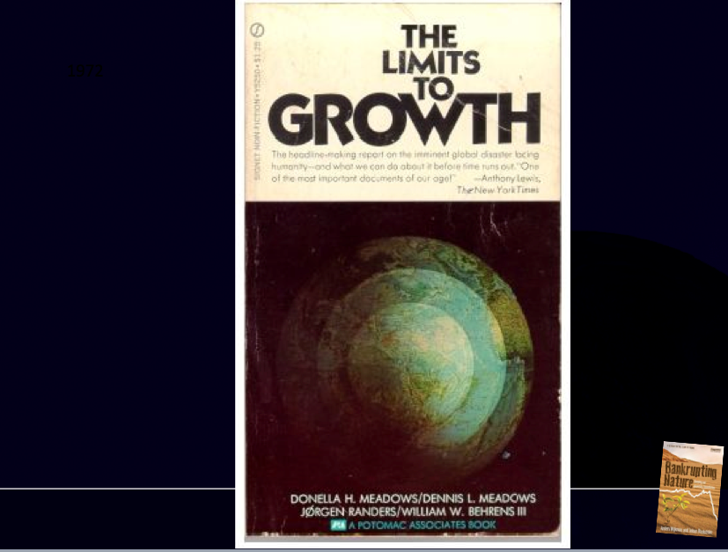

Slide 3
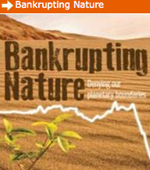

Slide 4
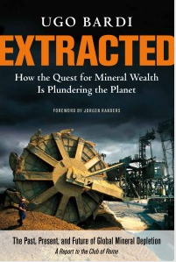

Slide 5
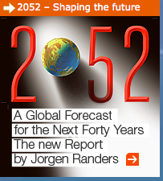

Slide 8
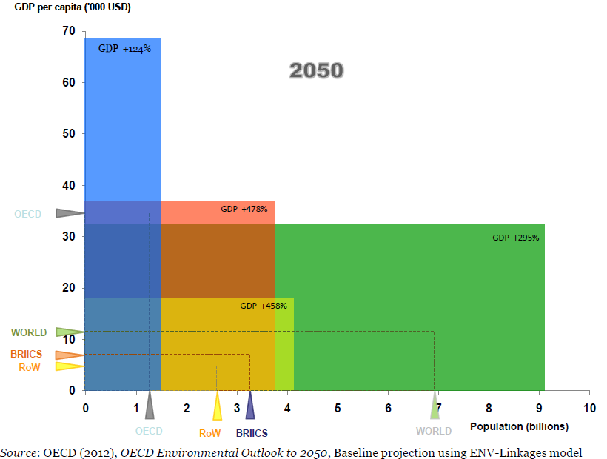

Slide 9
Global Economy is already on a collision course with Nature
Overuse of Nature is serious
Continued conventional growth is positive for poverty reduction – but will it last? – how can it be sustainable?
We are in ecological overshoot
Financial crisis told us we are, as well, in financial overshoot
The combination is very dangerous
Add to that a series of social challenges like unemployment and increasing income disparities
The industrial society logic no longer works!

Slide 10
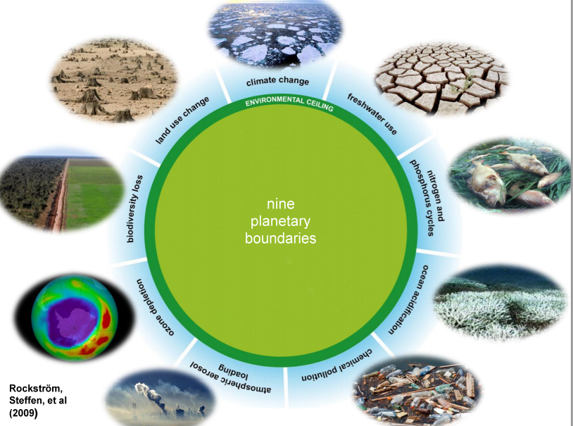

Slide 12
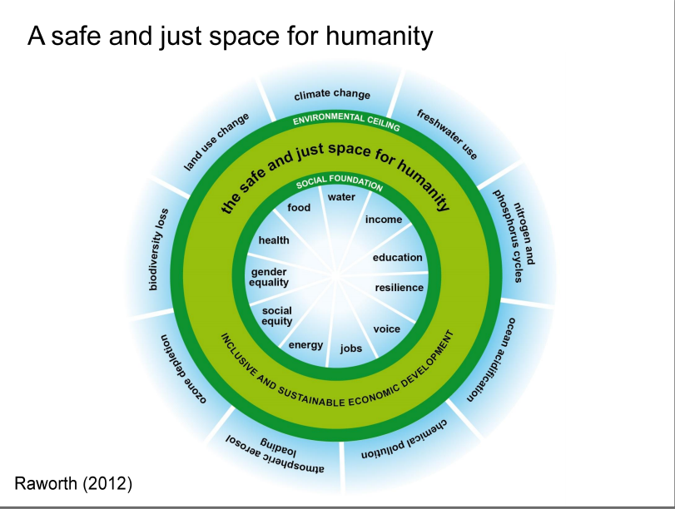

Slide 13
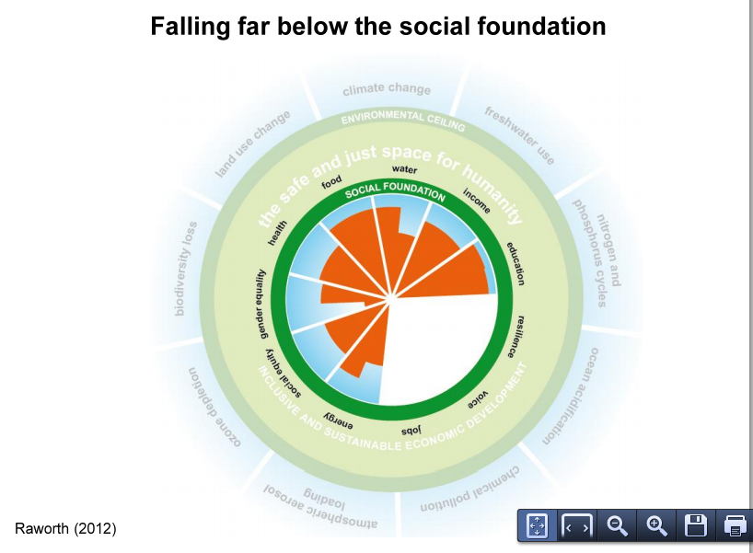

Slide 15
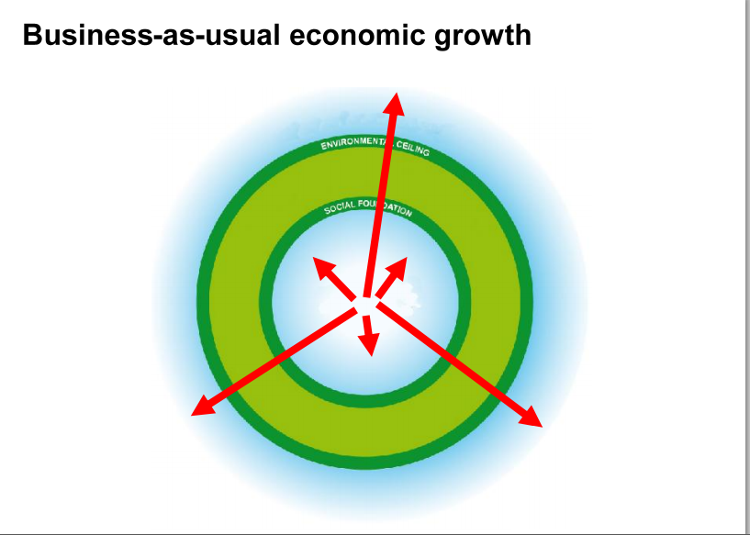

Slide 16
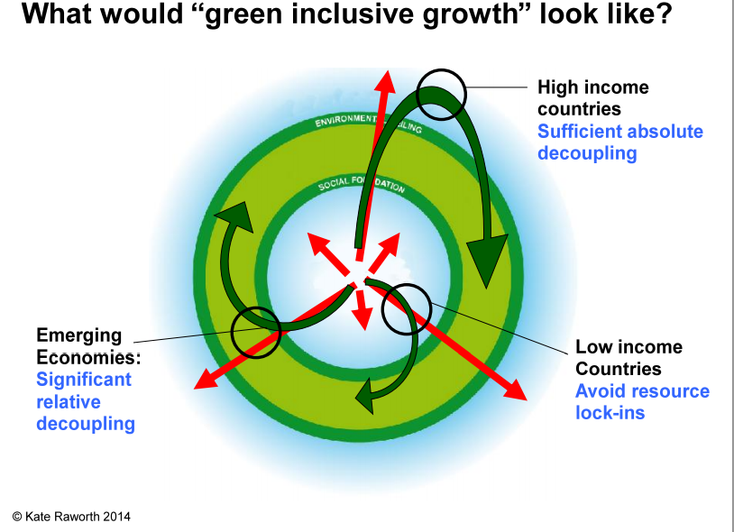

Slide 20
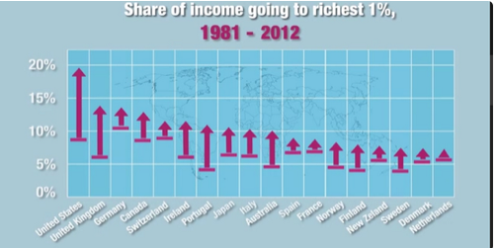

Slide 22
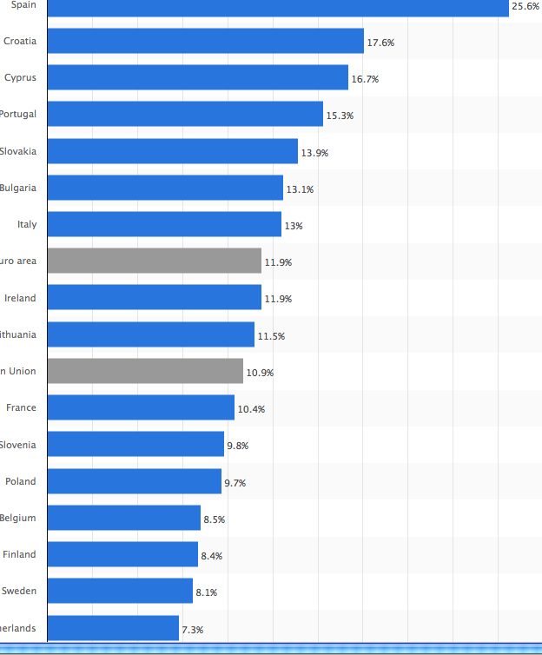

Slide 23
The ditigization of the economy
The digitization of the economy will offer endless new services – often at no cost - and huge improvements in productivity.
Many jobs will disappear, new jobs will be created but the net loss is most probably large.
The benfits are obvious, but there are huge challenges in terms of unemployment and wider disparities between capital and labor.

Slide 24
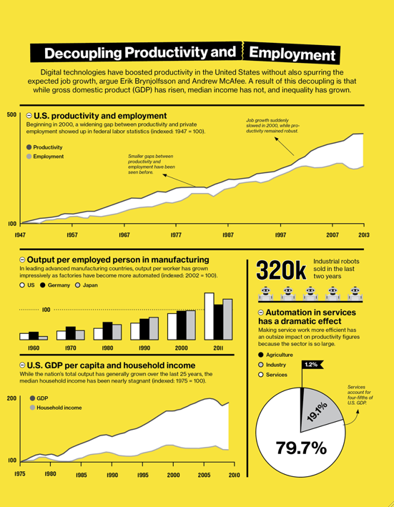

Slide 25
Quote by Erik Brynjolfsson, author of ”The Second Machine Age”:
It’s one of the dirty secrets of economics: technology progress does grow the economy and create wealth, but there is no economic law that says everyone will benefit.” In other words, in the race against the machine, some are likely to win while many others lose.

Slide 26
The Industrial Society logic and Conventional Growth policies will in no way be able to effectively address the ecological and social challenges we are facing!

Slide 27
Frågan är just vad vi ska ha ekonomin till?
Bruntlandrapporten talade om hållbar utveckling som balansakt mellan ekonomisk utveckling, social utveckling och miljöskydd
Tveksam definition
Socialt hållbart samhälle måste vara målet – inom ramen för Planetära Gränser – och då blir ekonomin en verktygslåda: inte ett mål i sig

Slide 28
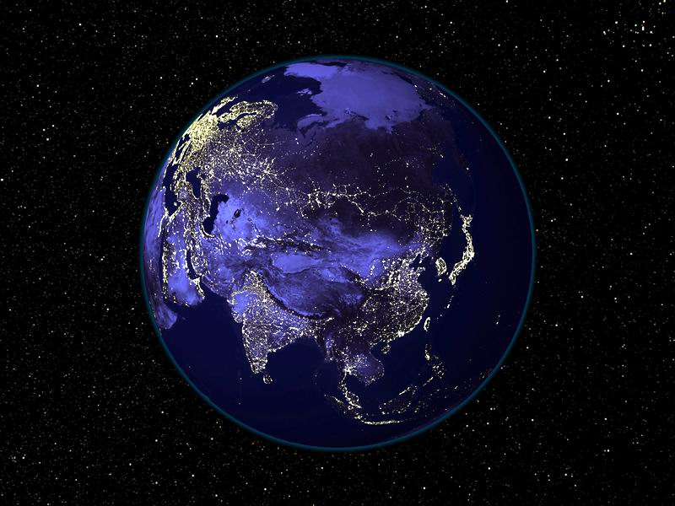
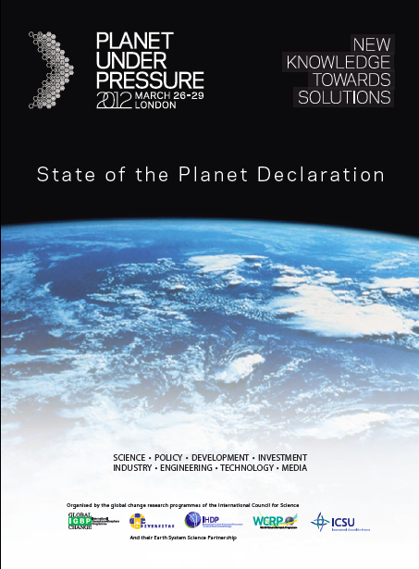
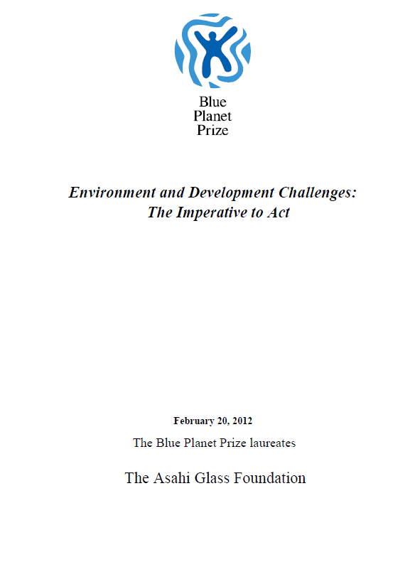
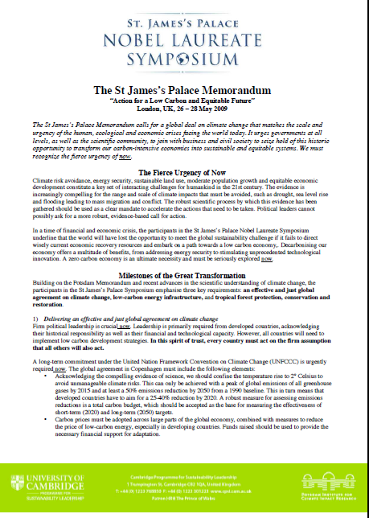
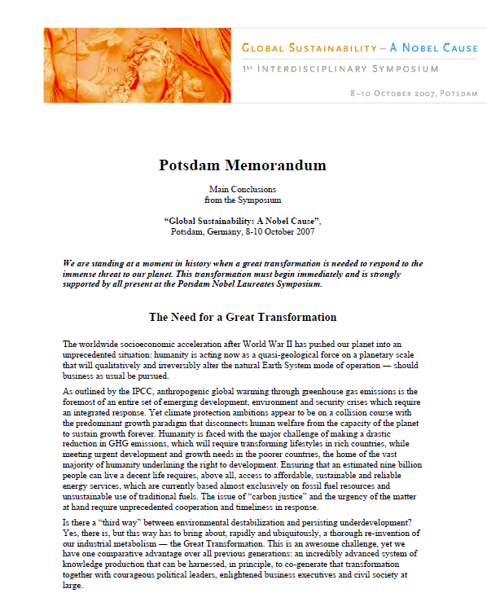
Humanity has reached a planetary saturation point
The Human ability to do has vastly outstripped our ability to understand
A resilient biosphere the basis for humen development
Fierce urgency of now
A great transformation to global sustainability necessary, possible, and desirable

Slide 29
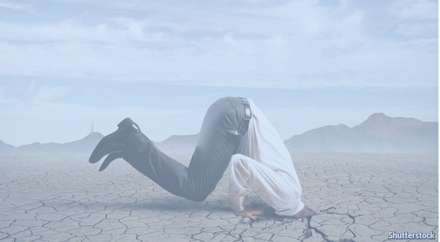

Slide 30
How did we get here? - Growing populations and economies - ”From a small economy on a big planet to a big economy on a small planet” - Short-termism of both markets and politics Externalities not acted upon– lack of political will - ”Conventional growth will fix it” - Shortcomings in conventional economics

Slide 31
Dilemma of conventional growth not recognised
There are limits to energy and material throughput
But negative growth is no solution either
To dodge the issue is irresponsible
Many things should grow – however, overall resource throughput must be curbed
Rethinking conventional growth must start in the developed countries
Conventional economics has some answers but ………
Still many people view climate and environment concerns as a cost

Slide 32
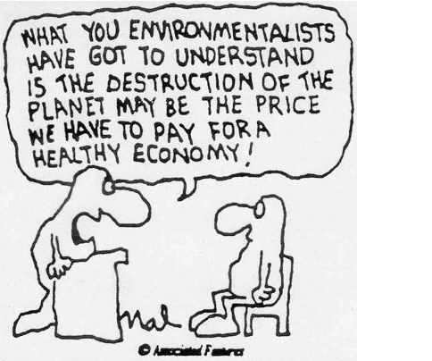

Slide 33
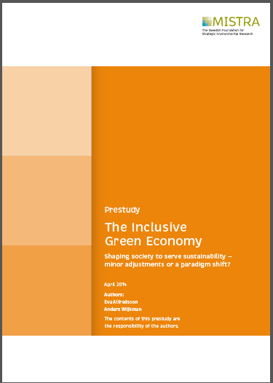

Slide 34
FOCUS: the difference between a “Brown economy” and a “Green Inclusive Economy”
The prevailing economic paradigm is unsustainable in ecological, social and economic terms alike.
“Business as usual” represents major risks and costs, and would be untenable in the long run.
Sustainable development will require full alignment of the economy with sustainability objectives
The Business community is a major player; unless the incentives guiding business are conducive with sustainability a transition is not possible

Slide 35
There is consensus among economists on some important principles
Need for long-termism, taking future generations into account
Polluter pays principle should be applied; but conventional economists do not talk much about it
Competitive markets - Neither sellers nor buyers should be too dominant
A well-functioning market economy requires symmetrical information,
GDP is not a measure of welfare, and has shortcomings as the main objective for economic policy

Slide 36
but also crucial differences
Failure to value natural capital and ecosystem services
“Strong” vs “weak” sustainability - definitions of sustainability
The discounting of future values
The way continued material growth is viewed
The notion that economic decisions are always reversible
Macro-economic models don´t include a fair damage function
The inability of current economic models to deal with non-linearity
The financial system and its role
Shareholder value vs stakeholder value

Slide 37
There is no lack of ideas and potential solutions among economists
A key challenge is the lack of dialogue among different types of economists; another is the lack of political will.
There is an urgent need to rethink education of economists. To quote Cameron Hepburn, leading British Economist: “Economics today is taught as it the last thirty years did not happen

Slide 38
Main research topics
Formation of social capital and wellbeing
Crucial role of natural resources and HQ energy
Qualitative vs Quantative Growth; How would a steady-state economy function?
How can the business sector become a force in favour of SD?
How can the Financial System become a force for SD?
Governance and institutions

Slide 39
The Green economy discourse - a paradigm change
Current economy | Green, inclusive economy
GDP growth: more economic activity the aim | ‘Beyond GDP’: prosperity the aim
Short-termism | Long-termism
Maximisation of return | Safeguarding of long-term incomes
Shareholder value | Stakeholder value: benefit to society
Extraction of natural resources | Management of natural resources
Linear production systems | Circular production systems
Short-life products for sale | Long-life services
Efficiency measured in monetary terms (CBA) | Multidimensional efficiency (e.g. multi-criterion analysis, MCA)

Slide 40
The crucial role of politics
Economic theory by itself will not lead to a transition to a sustainable economy
The transition will require a robust political discourse, based on the principles of sustainability – notably the principles of inter- and intergenerational equity as well as the planetary boundaries
How can we develop a framework in politics that respects the key principles of sustainability, notably the planetary boundaries?
How can we initiate the necessary shift in values?

Slide 41
How to move forward?
We need a vision for a sustainable society
Value discussion. What is Quality of Life?
The economy must fit within the Doughnut
How do we measure wealth?
Apply a system´s approach: Transformative solutions rather than incremental change
All that is produced and invested in should work in a world with 9 Billion people
Develop and demonstrate the necessary transition
The role of energy is crucial

Slide 42
Energy critical issue for climate – but, as well, for the economy
Cheap oil the magic behind high standard of living
Crude oil has peaked; HYPE around shale - bubble or?
Note the DOE report on methane leakage, june 2014!
Coal to liquids?
But Carbon Tracker: < ¼ of fossil reserves to be used
Dev:t of renewables + efficiency positive – but too slow
Price of energy crucial for the economy
When price > 140 US/barrel = growth halts and less innovation in alternative energy

Slide 43
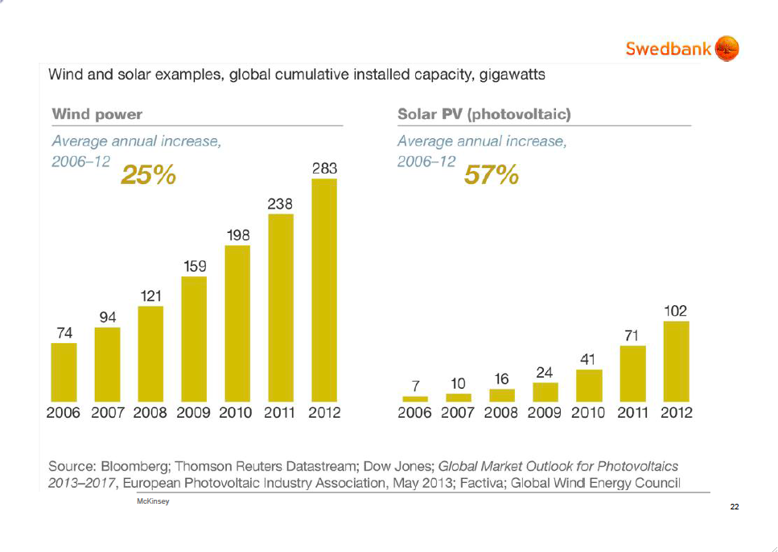

Slide 46
So we are in a double bind
World needs cheap energy for welfare and poverty reduction
Climate change concerns compel us to switch to alternatives
But Renewables + Efficiency investments only 25% of what would be needed to stay within 2° degree target
Major energy companies invest in fossil fuels - not in renewables
CCS technology is getting very limited attention
WE DESPERATELY NEED A GLOBAL STRATEGY FOR CLIMATE CHANGE AS WELL AS FOR ENERGY

Slide 47
De stora företagens roll alltmera problematisk
Global governance brister
Opererar gränslöst; betalar skatt där det lönar sig bäst; strävar efter att eliminera konkurrens
Too big to fail
Gigantisk subvention från Naturen
Investeringar i tex fossil-användning låser in samhället för decennier
Finansmarknaden alltmera frikopplad från reala ekonomin + extremt kortsiktig
Negligerar klimatrisker
Märk Av de 100 största ekonomiska enheterna i världen är hälften företag

Slide 48
Strategy for Sustainability
Priority to transdisciplinary science and education
Reform economic and finance policy frameworks,
incl ”beyond GDP”,value natural capital, remove harmful subsidies, address externalities, rethink discounting, redistribution of wealth etc
Carbon tax + major investments in renewables and efficiency
Harness benefits from digitization
Circular Economy/Performance Economy; tax resource use; no tax on normal incomes = more jobs
Green Chemistry
Income redistribution
Public Procurement proactive role in transformation
Rethink Company Law
Strengthen Global Governance – start with EU + Asia
Stabilise population

Slide 50
”Decoupling” – a challenge
Ever since Bruntland Report ”decoupling” has been seen as THE SOLUTION to address environment and resource constraints
Relative de-coupling is happening – but absolute de-coupling is far away
Efficiency gains normally eaten up by continued economic growth and the rebound effect
Efficiency is crucial but must be achieved within a differently organized economy, i e by doing the right things

Slide 51
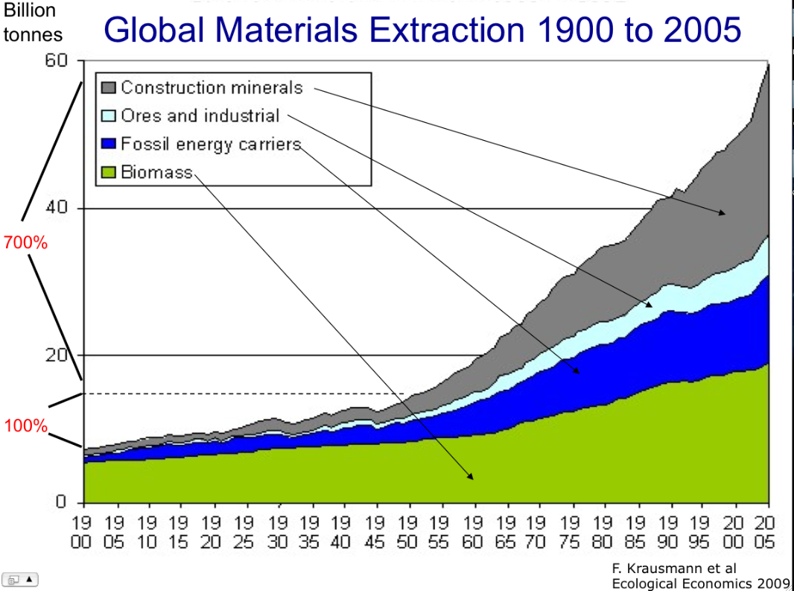

Slide 53
Key figures about recycling:
ENERGY SAVINGS THROUGH RECYCLING
Aluminium | 95%
Copper | 85%
Lead | 65%
Zinc | 60%
Paper | 64%
Plastics | 80%

Slide 54
Towards a circular/performance economy for manufacturing and construction
From products to services; Products to last longer
Reuse, recycling and reconditioning of materials
Service economy for maintenance and repair = jobs
Requires new business models for HQ service
Construction = 40% of all materials; must be part of it
Tax reform will help facilitate
Means much less pressure on the planet – both finite materials and renewables
Much lower GHG emissions
Functional sales already happen B2B – now B2C

Slide 55
För att sammanfatta :
Vad är ekonomins uppgift?
F n stora och ökande inkomstskillnader + arbetslöshet som ökar
En finansmarknad som distanserat sig från den reala ekonomin
Teknologiutvecklingen ger många fördelar men också problem….
Vi behöver en ny logik – både för att klara de sociala målen + klimat och ekologi
Politikens roll central

Slide 56
För att sammanfatta, klimatet:
Sverige driva på i EU för minst tre mål – egentligen fyra mål
Bara ett mål som delar av regeringen och finansen driver fångar inte upp den långa sikten;
Ett mål bara OK – dvs CO2 - om det är mycket ambitiöst, typ 60 %
Sverige måste gå före – VEM ANNARS?

Slide 57
To conclude:
A combination of technology and innovation, resource productivity (decoupling) and cultural change – stressing non-material aspects of life – is the hope we have
Labour productivity has increased twentyfold since 1850. It is not utopian to think of resource productivity increasing tenfold in 50 years! For that to happen, policy frameworks and Business Models must change - giving real priority to renewable energy, resource efficicency as well as sustainable land use

