Slide 1
Biochemistry
Prepared by
Prof. Dr. Margret Mansour

Slide 2
Proteins

Slide 3
Proteins are the most abundant and functionally diverse molecules in living systems. Examples of proteins: enzymes, polypeptide hormones, hemoglobin,…

Slide 4
Amino Acids
20 of the amino acids present in proteins are essential for health.
Humans can synthesize 12 of the 20 common amino acids.

Slide 5
Characteristics and Properties of Amino Acids
Introduction:
Each amino acid has at least one amine and one acid functional group as the name implies. The different properties result from variations in the structures of different R groups.
The R group is often referred to as the amino acid side chain.
Amino acids have special common names, however, a three letter abbreviation for the name is used most of the time. A second abbreviation , single letter, is used in long protein structures.

Slide 6
Structures of aminoacids
Amino Acid Name | A b r e v. | A b r e v. | Structure of R group (red) | Comments
Alanine | ala | A |  | Neutral Non-polar
Arginine | arg | R |  | Basic Polar
Asparagine | asn | N |  | Neutral Polar
Aspartic Acid | asp | D |  | Acidic Polar

Slide 7
Amino Acid Name | A b r e v. | A b r e v. | Structure of R group (red) | Comments
Cysteine | cys | C |  | Neutral Slightly Polar
Glutamic Acid | glu | E |  | Acidic Polar
Glutamine | gln | Q |  | Neutral Polar
Glycine | gly | G |  | Neutral Non-polar
Histidine | his | H |  | Basic Polar

Slide 8
Amino Acid Name | A b r e v. | A b r e v. | Structure of R group (red) | Comments
Isoleucine | ile | I |  | Neutral Non-polar
Leucine | leu | L |  | Neutral Non-polar
Lysine | lys | K |  | Basic Polar
Methionine | met | M |  | Neutral Non-polar
Phenyl- alanine | phe | F |  | Neutral Non-polar

Slide 9
Amino Acid Name | A b r e v. | A b r e v. | Structure of R group (red) | Comments
Proline | pro | P |  | Neutral Non-polar
Serine | ser | S |  | Neutral Polar
Threonine | thr | T |  | Neutral Polar
Trypto- phan | trp | W |  | Neutral Slightly polar
Tyrosine | tyr | Y |  | Neutral Polar
Valine | Val | V |  | Neutral Non-polar

Slide 10
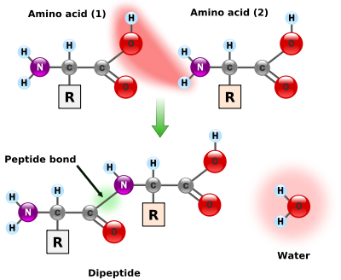

Slide 11
There are four different classes of amino acids determined by different side chains:
(1) non-polar and neutral
(2) polar and neutral
(3) acidic and polar
(4) basic and polar
Principles of Polarity:
The greater the electronegativity difference between atoms in a bond, the more polar the bond. Partial negative charges are found on the most electronegative atoms, the others are partially positive.

Slide 12
Non-Polar Side Chains: Side chains which have pure hydrocarbon alkyl groups (alkane branches) or aromatic (benzene rings) are non-polar. Examples include valine, alanine, leucine, isoleucine, phenylalanine. The number of alkyl groups also influences the polarity, the more alkyl groups present, the more non-polar the amino acid will be. This effect makes valine more non-polar than alanine; leucine is more non-polar than valine.

Slide 13
Polar Side Chains: Side chains which have various functional groups such as acids, amides, alcohols, and amines will impart a more polar character to the amino acid. The ranking of polarity will depend on the relative ranking of polarity for various functional groups as determined in functional groups. In addition, the number of carbon-hydrogens in the alkane or aromatic portion of the side chain should be considered along with the functional group.

Slide 14
Example: Aspartic acid is more polar than serine because an acid functional group is more polar than an alcohol group. Example: Serine is more polar than threonine since threonine has one more methyl group than serine. The methyl group gives a little more non-polar character to threonine. Example: Serine is more polar than tyrosine, since tyrosine has the hydrocarbon benzene ring.

Slide 15
Amino acids are grouped according to the characteristics of the side chain: Aliphatic: Alanine – Glycine – Isoleucine – Leucine – Proline – Valine Aromatic: Phenylalanine – Tryptophan – Tyrosine Acidic: Aspartic acid – Glutamic acid Basic: Arginine – Histidine – Lysine Hydroxylic: Serine – Threonine Sulphur-containing: Cystine – Methionine Amidic (containing amide group): Asparagine - Glutamine

Slide 16
Acid - Base Properties of Amino Acids Acidic Side Chains: If the side chain contains an acid functional group, the whole amino acid produces an acidic solution. Normally, an amino acid produces a nearly neutral solution since the acid group and the basic amine group on the root amino acid neutralize each other in the zwitterion. If the amino acid structure contains two acid groups and one amine group, there is a net acid producing effect. The two acidic amino acids are aspartic and glutamic.

Slide 17
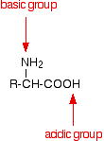
Amino acids as zwitterions Zwitterions in simple amino acid solutions An amino acid has both a basic amine group and an acidic carboxylic acid group. There is an internal transfer of a hydrogen ion from the -COOH group to the -NH₂ group to leave an ion with both a negative charge and a positive charge. This is called a zwitterion.

Slide 18
Basic Side Chains: If the side chain contains an amine functional group, the amino acid produces a basic solution because the extra amine group is not neutralized by the acid group. Amino acids which have basic side chains include: lysine, arginine, and histidine. Amino acids with an amide on the side chain do not produce basic solutions i.e. asparagine and glutamine.

Slide 19
Neutral Side Chains: The amino acid is neutral unless there is an extra acid or base on the side chain. If neither is present then the whole amino acid is neutral. Amino acids with an amide on the side chain do not produce basic solutions i.e. asparagine and glutamine. Even though tryptophan has an amine group as part of a five member ring, the electron withdrawing effects of the two ring systems do not allow nitrogen to act as a base by attracting hydrogen ions.

Slide 20
Question 1
Rank the following amino acids by increasing polarity. i.e. 1 = more non-polar. ser ; glu ; asp ; lys ; ala ; gln
Answer:
1 = ala 4 = glu
2 = lys 5 = asp
3 = ser 6 = gln

Slide 21
Question 2
Which amino acid is most insoluble in water: isoleucine or alanine ?
Answer:
Isoleucine has more CHs, so more insoluble
than ala

Slide 22
Question 3
Which amino acid is most soluble in water: lys or ser?
Answer:
ser, alcohol group is more polar than amine in lys

Slide 23
Classification of Proteins
Primary structure
Secondary structure
Tertiary structure
Quaternary structure

Slide 24
PRIMARY STRUCTURE
The numbers of amino acids vary (e.g. insulin 51, lysozyme 129, haemoglobin 574, gamma globulin 1250)
The primary structure determines the folding of the polypeptide to give a functional protein
Polar amino acids (acidic, basic and neutral) are hydrophilic and tend to be placed on the outside of the protein.
Non-polar (hydrophobic) amino acids tend to be placed on the inside of the protein

Slide 25
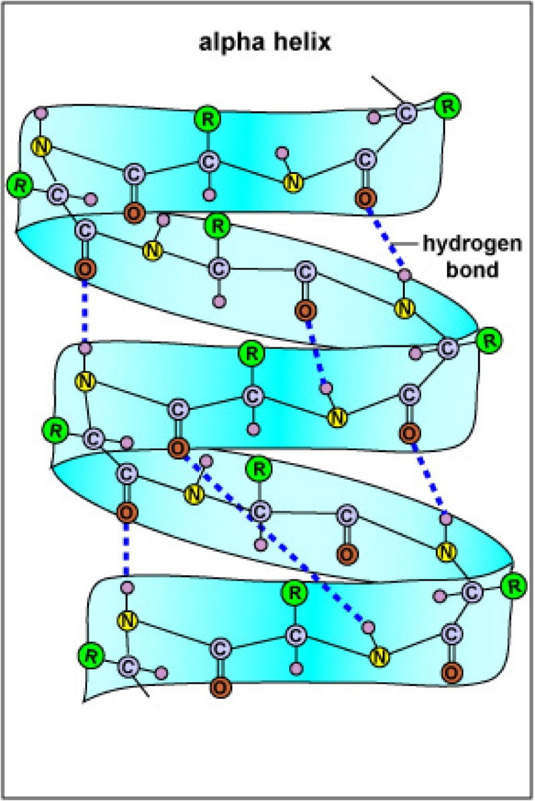
SECONDARY STRUCTURE
The folding of the N-C-C backbone of the polypeptide chain using weak hydrogen bonds

Slide 26
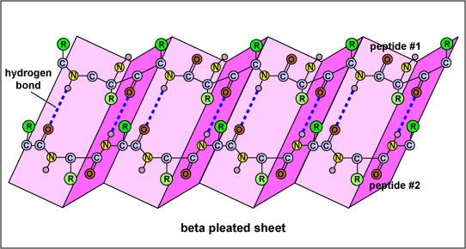
SECONDARY STRUCTURE
This produces the alpha helix and beta pleating
The length of the helix or pleat is determined by certain amino acids that will not participate in these structures (e.g. proline)

Slide 27
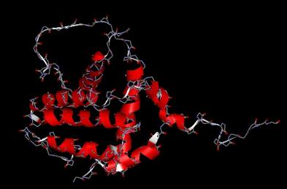
TERTIARY STRUCTURE
The folding of the polypeptide into domains whose chemical properties are determined by the amino acids in the chain

Slide 28
TERTIARY STRUCTURE
This folding is sometimes held together by strong covalent bonds (e.g. cysteine-cysteine disulphide bridge)
Bending of the chain takes place at certain amino acids (e.g. proline)
Hydrophobic amino acids tend to arrange themselves inside the molecule
Hydrophilic amino acids arrange themselves on the outside

Slide 29
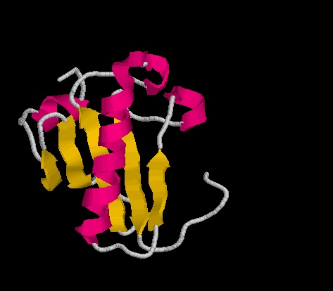
Chain B of Protein Kinase C

Slide 30
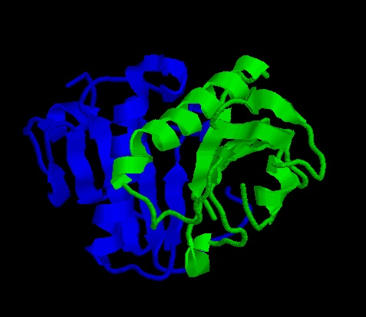
QUATERNARY STRUCTURE
Some proteins are made of several polypeptide subunits (e.g. haemoglobin has four)

Slide 31
QUATERNARY STRUCTURE
These subunits fit together to form the functional protein
Therefore, the sequence of the amino acids in the primary structure will influence the protein's structure at two, three or more levels

Slide 32
PROTEIN FUNCTIONS
Protein structure determines protein function
Denaturation or inhibition which may change protein structure will change its function
Coenzymes and cofactors in general may enhance the protein's structure

Slide 33
Fibrous proteins
Involved in structure: tendons ligaments blood clots (e.g. collagen and keratin)
Contractile proteins in movement: muscle, microtubules (cytoskelton, mitotic spindle, cilia, flagella)

Slide 34
Globular proteins
most proteins which move around (e.g. albumen, casein in milk)
Proteins with binding sites (e.g. enzymes, haemoglobin, immunoglobulins )

Slide 35
Proteins classified by function
CATALYTIC: enzymes
STORAGE: ovalbumen (in eggs), casein (in milk), zein (in maize)
TRANSPORT: haemoglobin
COMMUNICATION: hormones (eg insulin) and neurotransmitters
CONTRACTILE: actin, myosin, dynein (in microtubules)
PROTECTIVE: Immunoglobulin, fibrinogen, blood clotting factors
TOXINS: snake venom
STRUCTURAL: cell membrane proteins, keratin (hair), collagen

Slide 36
Protein synthesis
DNA unwinds
mRNA copy is made of one of the DNA strands.
mRNA copy moves out of nucleus into cytoplasm.
tRNA molecules are activated as their complementary amino acids are attached to them.
mRNA copy attaches to the small subunit of the ribosomes in cytoplasm. 6 of the bases in the mRNA are exposed in the ribosome.
A tRNA bonds complementarily with the mRNA via its anticodon.
A second tRNA bonds with the next three bases of the mRNA, the amino acid joins onto the amino acid of the first tRNA via a peptide bond.
The ribosome moves along. The first tRNA leaves the ribosome.
A third tRNA brings a third amino acid
Eventually a stop codon is reached on the mRNA. The newly synthesised polypeptide leaves the ribosome.

