Slide 1
Feature: Encumbrance SSRS Report
Why it is cool
Picture it
Learn it
Created by: Jennifer Ranz, Jason Cross, Steve Thompson & Katie Traynor
© 2013 Microsoft Corporation. All rights reserved. Microsoft, Windows, Windows Vista and other product names are or may be registered trademarks and/or trademarks in the U.S. and/or other countries.
The information herein is for informational purposes only and represents the current view of Microsoft Corporation as of the date of this presentation. Because Microsoft must respond to changing market conditions, it should not be interpreted to be a commitment on the part of Microsoft, and Microsoft cannot guarantee the accuracy of any information provided after the date of this presentation. MICROSOFT MAKES NO WARRANTIES, EXPRESS, IMPLIED OR STATUTORY, AS TO THE INFORMATION IN THIS PRESENTATION.

Slide 2
Feature: Encumbrance SSRS Report
Why this feature is cool!
We have added the Encumbrance Summary and Detail reports to the existing list of SRS Reports. This report can be printed from the users Reporting Services Report Manager location or Microsoft Dynamics GP.
This feature will allow the user to print the report using the standard report writer reports or print the SRS Reports using the existing Printing SSRS Report from Forms feature added in Microsoft Dynamics GP 2013.
Go Back

Slide 3
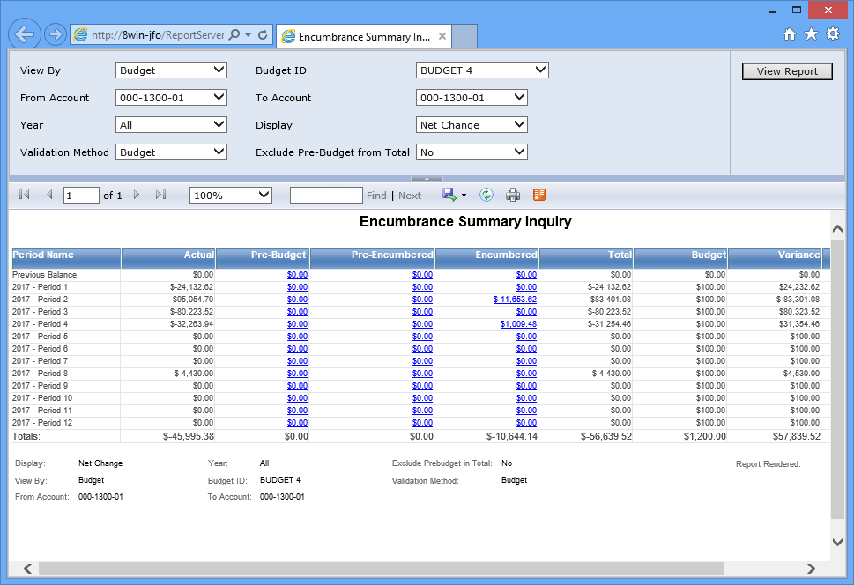
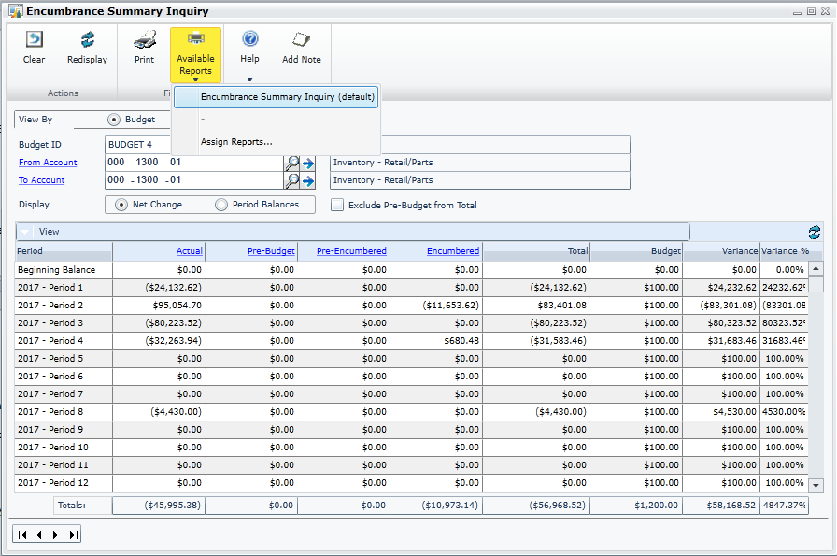
Feature: Encumbrance SSRS Report
Summary
Go Back

Slide 4
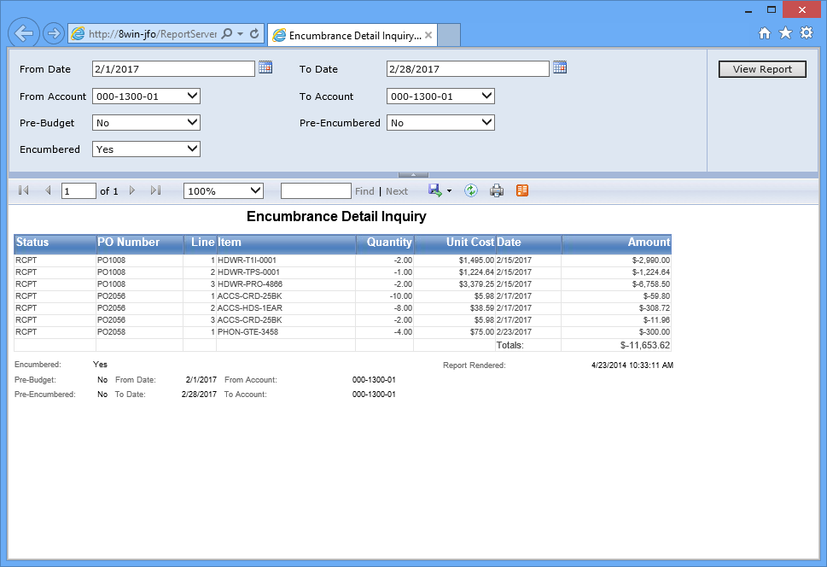
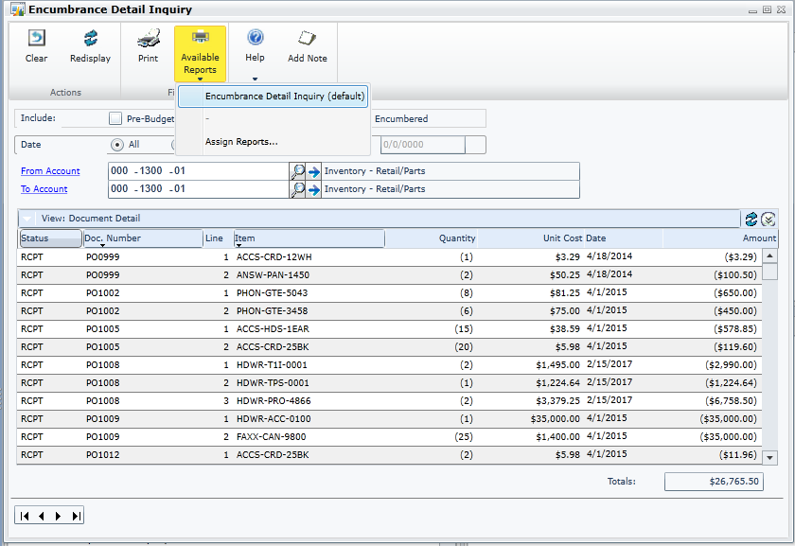
Feature: Encumbrance SSRS Report
Detail
Go Back

Slide 5
Feature: Encumbrance SSRS Report
Targeted Roles:
rpt_power user
rpt_executive rpt_accounting manager rpt_purchasing manager
Go Back

