Slide 1
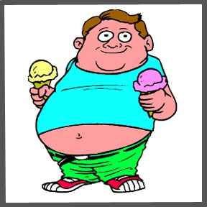
Obesity

Slide 2
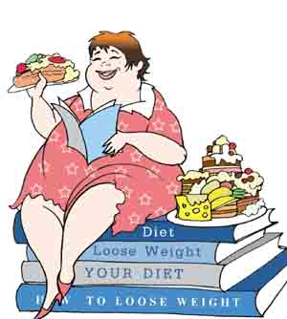
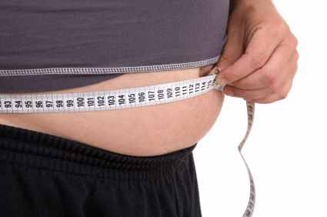
What Is an obesity??
obesity
-excessive collections of body fat.
-Obesity is a very serious health problem rather than a problem of appearance.
-People are considered obese when their body mass index (BMI), a measurement obtained by dividing a person's weight in kilograms by the square of the person's height in meters, exceeds 30 kg/m^{2.}

Slide 3
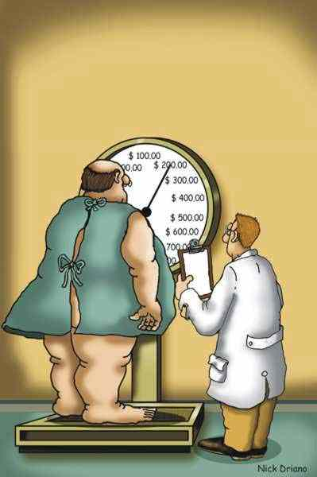
What is the difference between an overweight and an obese patient?
the terms ‘overweight’ and ‘obese’ seem to be synonymous, there is a significant difference between them.
Health professionals can determine whether a person is overweight or obese by combining their age and gender with the anthropometric parameters of their
body weight, body mass index (BMI) and body fat mass.
An adult who has
BMI of 25–29.9 kg/m2 is said to be overweight,
while an adult with a BMI in
excess of 30 kg/m2 is said to be obese.

Slide 4
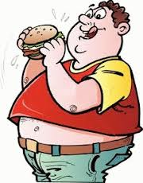
What role does dietary fat intake play in the development of obesit
The increase in fat intake of the modern diet and reduced physical activity are the two main causes of the development of obesity in industrialised countries.
Fat is the most energy-dense nutrient in our diet, producing nine calories per gram
Over-consumption and the extra amount of dietary fat intake can lead to its storage in fat tissue

Slide 5
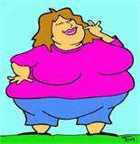
Is the overconsumption of calories responsible for the
development of obesity?
There are different causes for the development of obesity, which are related to genetics, human biology, hormones and environmental factors.
An imbalance between energy intake and energy expenditure is consider the most important.
When we consume more calories than we need this extra energy is stored in the body , mainly as fat stored in fat tissue, in order to be used later as an energy fuel the body

Slide 6
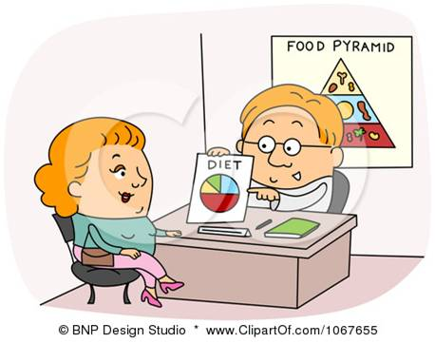
What are the characteristics of an ideal weight-loss diet?
Weight-reducing diet programmes must contain all the food groups
adequate intake of vitamins and minerals
according to their age, gender,
resting metabolic rate, health status, level of physical activity and their
lifestyle.

Slide 7
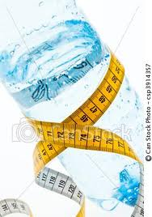
Is water beneficial for the treatment of obesity?
water intake can play a role in the
treatment of obesity, especially in the case of childhood obesity.
it is essential for
the preservation of life ,regulation of the body’s temperature and metabolism
help to fill the stomach, decrease appetite and determine the total amount of food intake.
The intake of water can influence the amount of fat burned by the body,
increase the metabolic rate

Slide 8
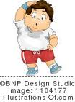
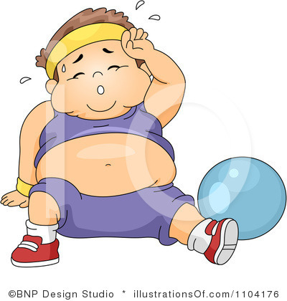
What is the role of exercise in the treatment of obesity?
Body weight is determined by the balance between
energy intake and energy expenditure
The American Heart Association recommends at least 30–45 minutes of
moderate/intense physical activity per day

Slide 9
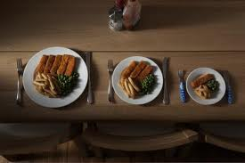
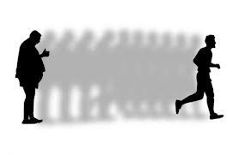
What are the lower levels of calorie intake for men and women?
2500 calories a day for men
2000 calories a day for women (2,500 in third trimester of pregnancy)
It is widely accepted that in order to achieve the best weight reduction a reduction in calorie intake of 500–1000 kcal

Slide 10
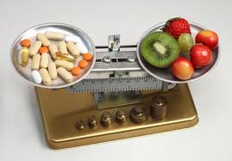
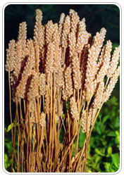
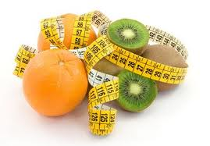
Are there nutritional supplements appropriate for weight loss?
nutritional supplements claim to promote weight low-:
increased energy consumption: supplements such as bitter orange
increased satiety: guar gum, psyllium
increased lipid oxidation:, green tea, vitamin fatty acid, which is found in meat, cheese and dairy products
decreased lipid absorption: chitosan
supplements there are role in lipid oxidation, total energy consumption and the feeling of fullness, it is generally accepted that none of them can playa dramatic role in total weight reduction and for this reason they are not considered essential in weight-reducing Program

Slide 11
Dietary management of patients after bariatric surgery
Bariatric surgery: Surgery on the stomach and/or intestines to help a person with extreme obesity lose weight. by changing the digestive system's anatomy, limiting the amount of food that can be eaten and digested.

Slide 12
When is bariatric surgery recommended for treating obesity?
bariatric surgery treatment, which is very popular nowadays, is not the proper solution for all cases of obesity.
The indications of bariatric surgery can be summarised as follows:
BMI ≥ 40 kg/m2
Surgery is also an option for people with a body mass index between 35 and 40 who have health problems like type 2 diabetes or heart disease
exercise and lifestyle modifications, i.e. anyone with a BMI of between 35 and 40 kg/m2.

Slide 13
What is the main dietary advice for a patient after ring insertion?
The most frequent nutritional problems that appear after bariatric surgery
are : dehydration, protein malnutrition and vitamin/mineral deficiency.
Fluids : Dehydration is often present after almost all types of surgery.
Especially in this cases of surgery , patients have
difficulty in getting the appropriate amount of fluid because of the limited
content of the stomach.
The symptoms of sweating, diarrhoea and vomiting,
in parallel with greater faecal production, enhance fluid loss. There are no
specific recommendations for fluid intake, but patients are advised to drink
plenty of fluid, using the sense of thirst and the quantity and colour of urine as
markers of sufficient hydration.
Nutritional fluids (e.g. juices, low-fat milk) they provide energy and protein apart from hydration, while
non-nutritional fluids are best avoided or at least restricted to between meals.

Slide 14
Protein:According to recent research, the most important macronutrient to take after bariatric surgery is protein.
it is essential for tissue repair and growth after a major surgical procedure.
a high-protein diet contributes to the faster healing of the trauma,
A protein intake of 60–90 g/day is recommended for the postoperative period through the consumption of high-protein which provide all the adequate essential amino acids.

Slide 15
Thank you

