Slide 1
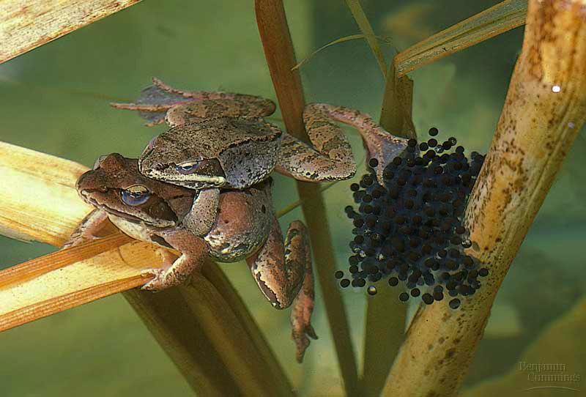
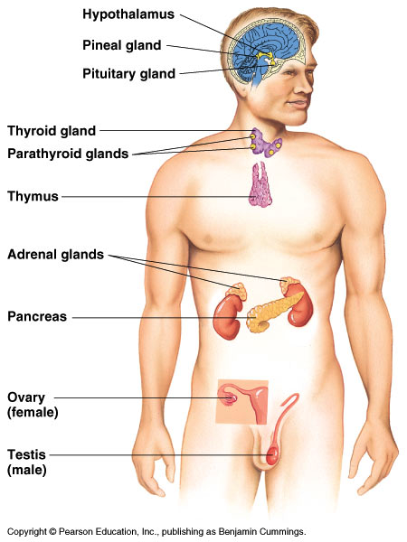
Endocrine System
Hormones & Homeostasis

Slide 2
Homeostasis
Homeostasis
maintaining internal balance in the body
organism must keep internal conditions stable even if environment changes
also called “dynamic equilibrium”
example: body temperature
humans:
too cold = shiver
too warm = sweat

Slide 3
Regulation
How we maintain homeostasis
Nervous system
nerve signals control body functions
Endocrine system
hormones
chemical signals control body functions

Slide 4
The endocrine system is made up of ductless glands called endocrine glands that secrete chemical messengers called hormones into the bloodstream or in the extracellular fluid.
A hormone is a chemical substance made and secreted by one cell that travels through the circulatory system or the extracellular fluid to affect the activities of cells in another part of the body or another nearby cell.

Slide 5
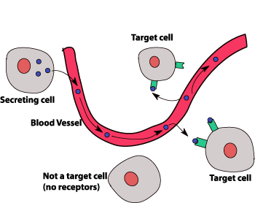
Hormones travel via the bloodstream to target cells
The endocrine system broadcasts its hormonal messages to essentially all cells by secretion into blood and extracellular fluid
Each hormone acts on a certain type of tissue called its target tissue.
Like a radio broadcast, it requires a receiver to get the message - in the case of endocrine messages, cells must bear a receptor for the hormone being broadcast in order to respond.

Slide 6
Principal functions of the endocrine system
Maintenance of the internal environment in the body (maintaining the optimum biochemical environment).
Influences metabolic activities.
Stimulation and regulation of growth and development.
Control, maintenance and initiation of sexual reproduction, including gametogenesis, coitus, fertilization, fetal growth and development and nourishment of the newborn.

Slide 7
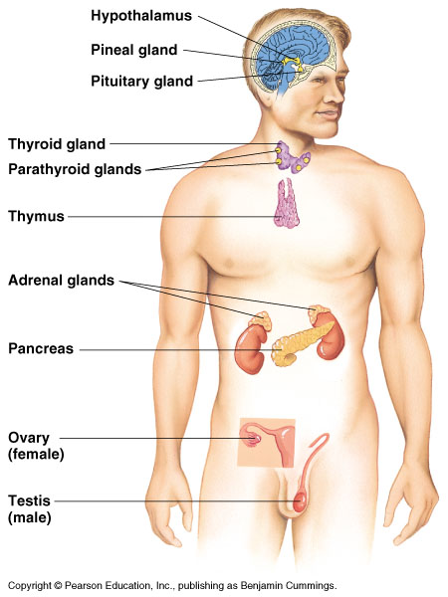
Glands
Pineal
melatonin
Pituitary
many hormones: master gland
Thyroid
thyroxine
Adrenal
adrenaline
Pancreas
insulin, glucagon
Ovary
estrogen
Testes
testosterone

Slide 8
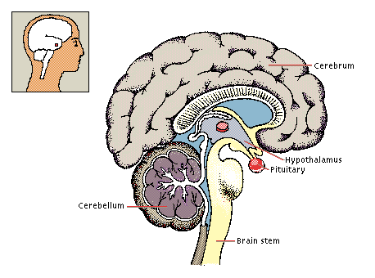
Endocrine Glands
Hypothalamus (has both neural functions and releases hormones)
Pancreas (produces both hormones and exocrine products)
Gonads (produce both hormones and exocrine products)
Other tissues and organs also produce hormones – adipose cells, cells of the small intestine, stomach, kidneys, and heart

Slide 9
1. Neurotransmitters are released by axon terminals of neurons into the synaptic junctions and act locally to control nerve cell functions
2. Endocrine hormones are released by glands into the circulating blood and influence the function of cells at another location in the body.

Slide 10
3. Neuroendocrine hormones are secreted by neurons into the circulating blood and influence the function of cells at another location in the body.
4. Paracrines are secreted by cells into the extracellular fluid and affect neighboring cells of a different type.
5. Autocrines are secreted by cells into the extracellular fluid and affect the function of the same cells that produced them by binding to cell surface receptors.
6. Cytokines are peptides secreted by cells into the extracellular fluid and can function as autocrines, paracrines, or endocrine hormones.
Examples of cytokines include the interleukins and other lymphokines that are secreted by helper cells and act on other cells of the immune system.

Slide 11
Endocrine vs. Nervous System
Nervous System | Endocrine System
Neurons release neurotransmitters | Endocrine cells release hormones
A neurotransmitter acts on specific cell right next to it. | Hormones travel to another nearby cell or act on cell in another part of the body.
Neurotransmitters have their effects within milliseconds. | Hormones take minutes or days to have their effects.
The effects of neurotransmitters are short-lived. | The effects of hormones can last hours, days, or years.
Performs short term crisis management | Regulates long term ongoing metabolic function
Neurotransmitter acts on specific cell right next to it. | Hormone can travel to another nearby cell or it can act on another part of the body.

Slide 12
Types of humoral signalization
Endocrine
from gland via blood to a distance
Neurocrine
via axonal transport and then via blood
Paracrine
neighboring cells of different types
Autocrine
neighboring cells of the same type or the secreting cell itself

Slide 13
Types of cell-to-cell signaling

Slide 14
Hormone
Substance produced by a specific cell type usually accumulated in one (small) organ
Transport by blood to target tissues
Stereotypical response (receptors)

Slide 15
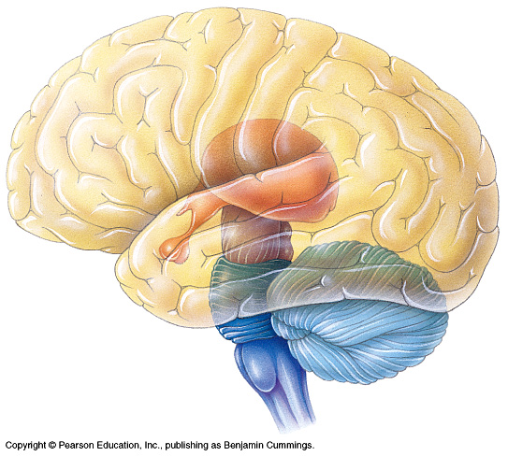
Major hormones and systems
Top down organization of endocrine system are:
Hypothalamus produces releasing factors that stimulate production of anterior pituitary hormone which act on peripheral endocrine gland to stimulate release of third hormone
Thyroid hormones (T3 & T4)
Posterior pituitary hormones are synthesized in neuronal cell bodies in the hypothalamus and are released via synapses in posterior pituitary.
Oxytocin and antidiuretic hormone (ADH)

Slide 16
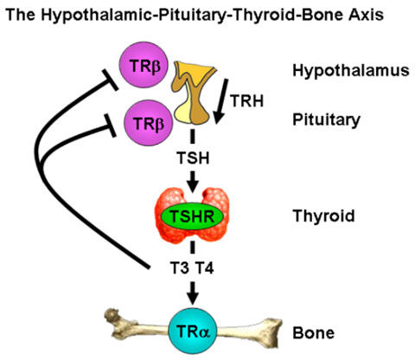

Slide 17
Chemical Structure and Synthesis of Hormones
Hormones are categorized into three structural groups, with members of each group having many properties in common:
Types of hormones
Peptides and proteins
Steroids
Amino acid derivatives

Slide 18
Peptide/protein hormones
Most of the hormones in the body are polypeptides and proteins.
Range from 3 amino acids (peptides) to hundreds of amino acids in size (proteins).
They are usually synthesized first as larger proteins that are not biologically active (prohormones)
Prohormone is processed into active hormone and packaged into secretory vessicles.
Secretory vesicles move to plasma membrane where they await a signal. Then they are exocytosed and secreted into blood stream
Peptide/protein hormones are water soluble.

Slide 19
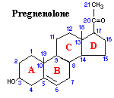
Steroid hormones
Are all derived from the same parent compound: Cholesterol.
Are not packaged, but synthesized and immediately released.
Steroids are lipid soluble and thus are freely permeable to membranes so are not stored in cells

Slide 20
Types of steroid hormones
Glucocorticoids: cortisol is the major representative in most mammals .
Mineralocorticoids: aldosterone being most prominent .
Androgens such as testosterone
Estrogens, including estradiol and estrone
Progesterone (also known a progestins) such as

Slide 21
Steroid hormones
Steroid hormones are not water soluble so have to be carried in the blood complexed to specific binding globulins.
Corticosteroid binding globulin carries cortisol
Sex steroid binding globulin carries testosterone and estradiol.

Slide 22
Amine hormones
There are two groups of hormones derived from the amino acid tyrosine
Thyroid hormones
Catecholamines

Slide 23
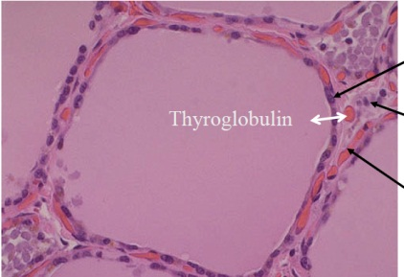
Thyroid Hormone
Thyroid hormones are basically a "double" tyrosine with the critical incorporation of 3 or 4 iodine atoms.
Thyroid hormone is produced by the thyroid gland and is lipid soluble
The thyroid hormones are synthesized and stored in large follicles in the thyroid gland (thyroglobulin),.
Hormone secretion occurs when the amines are split from thyroglobulin, and the free hormones (T3 & T4) are then released into the blood stream.
T3 and T4 then bind to thyroxin binding globulin for transport in the blood which slowly releases the hormones to the target tissues.

Slide 24
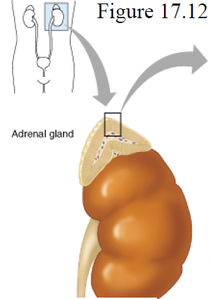
Catecholamine hormones
Catecholamines are both neurohormones and neurotransmitters.
These include epinephrine, and norepinephrine
Epinephrine and norepinephrine are produced by the adrenal medulla which normally secretes about four times more epinephrine than norepinephrine.
Both are water soluble
Secreted like peptide hormones

Slide 25
Transport of Hormones in the Blood
Water-soluble hormones (peptides and catecholamines) are dissolved in the plasma and transported from their sites of synthesis to target tissues, where they diffuse out of the capillaries, into the interstitial fluid, and ultimately to target cells.
Lipid-soluble hormones: (Steroid and thyroid), in contrast circulate in the blood mainly bound to plasma proteins.
However, protein-bound hormones cannot easily diffuse across the capillaries and gain access to their target cells and are therefore biologically inactive until they dissociate from plasma proteins.

Slide 26
Transport of hormones
Freely in blood:
Catecholamines
Most peptides
Specific transport globulins (from liver):
Steroids
Thyroid hormones

Slide 27
Onset of Hormone Secretion After a Stimulus, and Duration of Action of Different Hormones
Onset of action is the duration of time it takes for a hormone’s effects to come to prominence upon stimulation.
Duration of action: The length of time that a particular hormone is effective.
Some hormones, such as norepinephrine and epinephrine, are secreted within seconds after the gland is stimulated, and they may develop full action within another few seconds to minutes.
While others, such as thyroxine or growth hormone, may require months for full effect.
Thus, each of the different hormones has its own characteristic onset and duration of action to perform its specific control function.

Slide 28
Concentrations of Hormones in the Circulating Blood, and Hormonal Secretion Rates.
The concentrations of hormones required to control most metabolic and endocrine functions are incredibly small.
Their concentrations in the blood range from as little as 1 picogram to microgram in each milliliter of blood.
Similarly, the rates of secretion of the various hormones are extremely small, usually measured in micrograms or milligrams per day.

Slide 29
Control of Endocrine Activity
The physiologic effects of hormones depend largely on their concentration in blood and extracellular fluid.
Almost inevitably, disease results when hormone concentrations are either too high or too low, and precise control over circulating concentrations of hormones is therefore crucial.

Slide 30
Control of Endocrine Activity
The concentration of hormone as seen by target cells is determined by three factors:
Rate of production: Synthesis and secretion of hormones are the most highly regulated aspect of endocrine control. Such control is mediated by positive and negative feedback circuits.
Rate of delivery: An example of this effect is blood flow to a target organ or group of target cells - high blood flow delivers more hormone than low blood flow.
Rate of degradation and elimination

Slide 31
Control of Endocrine Activity
Rate of degradation and elimination: Hormones, like all biomolecules, have characteristic rates of decay, and are metabolized and excreted from the body through several routes.
Half-life is the period of time it takes for a substance undergoing decay to decrease by half.
Shutting off secretion of a hormone that has a very short half-life causes circulating hormone concentration to be very low, but if a hormone's biological half-life is long, effective concentrations persist for some time after secretion ceases.

Slide 32
Endocrine gland stimuli
Hormonal stimuli.
Humoral stimuli
Neural stimuli.

Slide 33
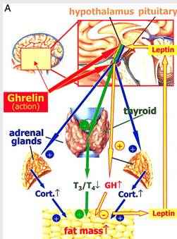
Hormonal stimuli
The most common stimulus.
The endocrine organs came into action by other hormones.
Example, hypothalamic hormones stimulate the anterior pituitary gland to secrete its hormones, and many anterior pitutary hormones stimulate other glands to release their hormones.

Slide 34
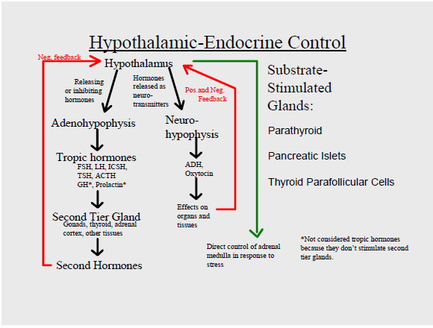

Slide 35
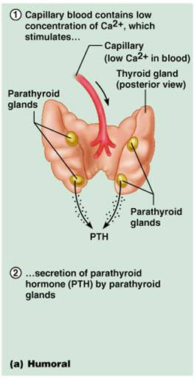
Humoral stimuli
Changing blood levels of certain ions and nutrients may also stimulate hormone release.
Example, Release of PTH by parathyroid glands is initiated by decreasing blood calcium levels.
Also other hormones released in response to that stimuli are:
Calcitonin secreted by thyroid gland and
Insulin by pancreas.

Slide 36
Neural stimuli
This occurs in rare cases.
Nerve fibers stimulate hormone release.
Example, sympathatic nervous system stimulation of the adrenal medulla to release norepinephrine and epinephrine during periods of stress.

Slide 37
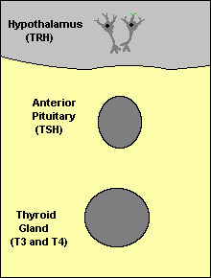
Feedback Control of Hormone Production
Feedback loops are used extensively to regulate secretion of hormones in the hypothalamic-pituitary axis. An important example of a negative feedback loop is seen in control of thyroid hormone secretion

Slide 38
Feedback control
Negative feedback is most common: for example, LH from pituitary stimulates the testis to produce testosterone which in turn feeds back and inhibits LH secretion. The hormone (or one of its products) has a negative feedback effect to prevent oversecretion of the hormone or overactivity at the target tissue.
Positive feedback is less common: examples include LH stimulation of estrogen which stimulates LH surge at ovulation. The secreted LH then acts on the ovaries to stimulate additional secretion of estrogen, which in turn causes more secretion of LH.
Eventually, LH reaches an appropriate concentration, and typical negative feedback control of hormone secretion is then exerted.

Slide 39
Cyclical Variations Occur in Hormone Release.
There is periodic variations in hormone release that are influenced by seasonal changes, various stages of development and aging, the diurnal (daily) cycle, and sleep.
For example, the secretion of growth hormone is markedly increased during the early period of sleep but is reduced during the later stages of sleep.
In many cases, these cyclical variations in hormone secretion are due to changes in activity of neural pathways involved in controlling hormone release.

Slide 40
Clearance” of Hormones from the Blood
The metabolic clearance rate is the rate of removal of the hormone from the blood.
Hormones are “cleared” from the plasma in several ways, including
(1) Metabolic destruction by the tissues,
(2) Binding with the tissues,
(3) Excretion by the liver into the bile, and
(4) Excretion by the kidneys into the urine.

Slide 41
A decreased metabolic clearance rate may cause an excessively high concentration of the hormone in the circulating body fluids.
For example steroid hormones when the liver is diseased, because these hormones are conjugated mainly in the liver and then “cleared” into the bile.
Most of the peptide hormones and catecholamines are water soluble and circulate freely in the blood.
They are usually degraded by enzymes in the blood and tissues and rapidly excreted by the kidneys and, thus remaining in the blood for only a short time.

Slide 42
Mechanism of hormone action
Body’s hormone just arouse the body’s cells.
By altering cellular activity; increasing or decreasing the rate of a normal or usual metabolic process rather than by stimulating a new one. Either by
Change in plasma membrane permeability or electrical state.
Synthesis of proteins or certain regulatory molecules (enzyme) in the cell.
Activation or inactivation of enzymes.
Stimulation of mitosis.
Promotion of secretory activity.

Slide 43
Magnitude of response
Activation depends on
Blood levels of the hormone
Relative number of receptors on the target cell
Affinity of those receptors for the hormone
Up-regulation – target cells form more receptors in response to the hormone
Down-regulation – target cells lose receptors in response to the hormone

Slide 44
Measuring hormones
Immunoassay (pM)
Bioassay (biol. activity can differ from concentration or immunoreactivity - e.g. mutation of the gene for the hormone)

Slide 45
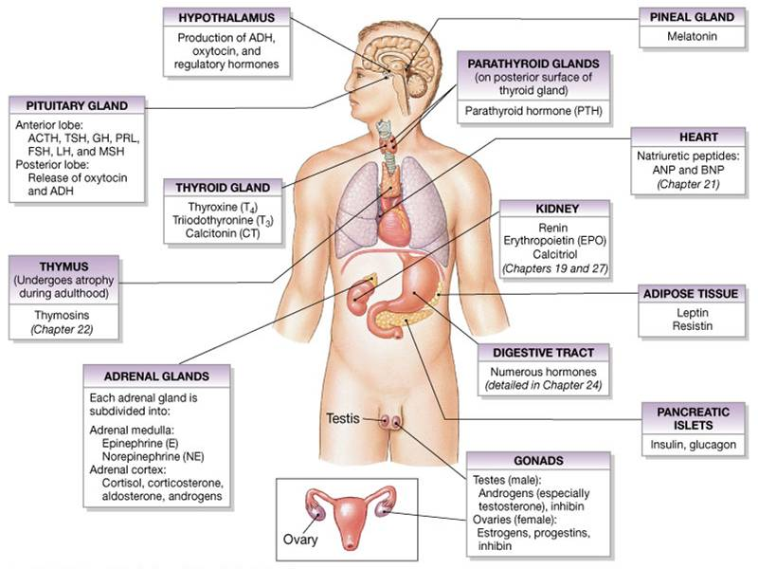

Slide 46
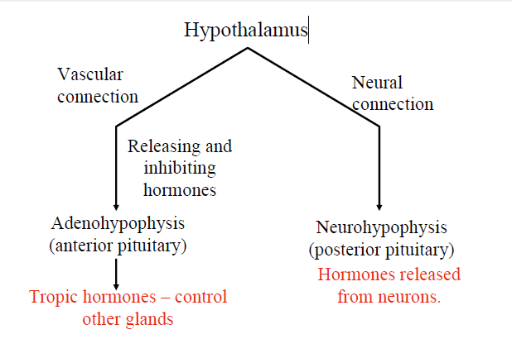
Hypothalamus
Is a part of the brain located inferior to the thalamus.
Is made up of neurons and neuroglial cells.
Produces several different hormones:
1. Releasing Hormones
These stimulate the anterior pituitary gland to release a specific hormone (e.g. GRH-GH)
2. Inhibiting Hormones
These stimulate the anterior pituitary gland to not release a specific hormone (e.g. GRIH-GH)

Slide 47
3. Antidiuretic Hormone (ADH) (also called vasopressin)
Antidiuretic hormone conserves body water by reducing the loss of water in urine.
This hormone signals the collecting ducts of the kidneys to reabsorb more water and constrict blood vessels, which leads to higher blood pressure and thus counters the blood pressure drop caused by dehydration
4. Oxytocin
Stimulates the smooth muscle of the uterus to contract, inducing labor.
Stimulates the myoepithelial cells of the breasts to contract which releases milk from breasts when nursing.
Stimulates maternal behavior.
In males it stimulates muscle contractions in the prostate gland to release semen during sexual activity

Slide 48
The releasing and inhibiting hormones made by the hypothalamus reach the anterior lobe of the pituitary gland DIRECTLY by a special set of blood vessels called the hypophyseal portal system.
The hypothalamus makes antidiuretic hormone (ADH) and oxytocin in the cell bodies of neurons and then the hormones are transported down the axons which extend into the posterior pituitary gland.
The posterior pituitary gland stores and later releases the hormones as needed.

Slide 49
Pituitary (also called Hypophysis)
Is a two-lobed organ that secretes nine major hormones
Neurohypophysis – posterior lobe (neural tissue) receives, stores, and releases hormones (oxytocin and antidiuretic hormone) made in the hypothalamus and transported to the posterior pituitary via axons.
Adenohypophysis – anterior lobe, made up of glandular tissue. Synthesizes and secretes a number of hormones.
The hypothalamus sends releasing hormones to the anterior pituitary that stimulates the synthesis and release of hormones from the anterior pituitary gland
The hypothalamus also sends inhibiting hormones that shut off the synthesis and release of hormones from the anterior pituitary gland
The pituitary gland releases nine important peptide (protein) hormones
All nine peptide hormones bind to membrane receptors and use cyclic AMP as a second messenger

Slide 50
Hormones of the Anterior Pituitary Gland (Adenohypophysis)
1. Growth Hormone (GH or somatotropin)
GH produced by somatotropic cells of the anterior lobe
Stimulates most cells, but target bone and skeletal muscle
Stimulates the liver and other tissues to secrete insulin-like growth factor I (IGF-I or somatomedin)
IGF-I stimulates proliferation of chondrocytes (cartilage cells), resulting in bone growth.
GH stimulates cell growth, replication, and protein synthesis through release of IGF-I.
Direct action promotes lipolysis to encourage the use of fats for fuel and inhibits glucose uptake
Antagonistic hypothalamic hormones regulate GH
Growth hormone–releasing hormone (GHRH) stimulates GH release
Growth hormone–inhibiting hormone (GHIH or somatostatin ) inhibits GH release

Slide 51
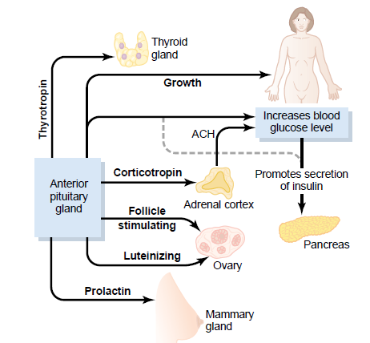

Slide 52
Disorders Associated with Growth Hormone
Dwarfism – hyposecretion in children
Gigantism – hypersecretion in children
Acromegaly – hypersecretion or abuse in adults.
Results in exaggerated features, especially facial bones.
Pituitary diabetes – produced by anti-insulin effects of excessive growth hormone.

Slide 53
2. Thyroid Stimulating Hormone (TSH or Thryotropin):
Travels to the THYROID GLAND (target cells) where it stimulates the release of thyroid hormones in response to low temperatures, stress, and pregnancy.
Thyrotropin releasing hormone (TRH) from the hypothalamus promotes the release of TSH
Rising blood levels of thyroid hormones act on the pituitary and hypothalamus to block the release of TSH
3. Adrenocorticotropic Hormone (ACTH or Corticotropin):
Travels to the ADRENAL GLAND (target cells) where it stimulates the release of corticosteroids (such as cortisol) in the adrenal cortex.
Corticotropin-releasing hormone (CRH) from the hypothalamus promotes the release of ACTH in a daily rhythm.
Internal and external factors such as fever, hypoglycemia, and stressors can trigger the release of CRH

Slide 54
4. Follicle Stimulating Hormone (FSH)
Travels to THE GONADS (target cells) and stimulates sperm or egg cell production and maturation and estrogen secretion
Gonadotropin-releasing hormone (GnRH) from the hypothalamus promotes the release of FSH during and after puberty
5. Leutinizing Hormone (LH)
Travels to the OVARIES in females (target cells) and stimulates ovulation, maturation of follicles (together with FSH) and stimulates the corpus luteum to secrete progesterone.
In males LH travels to THE TESTES (target cells) to stimulate secretion of testosterone.
LH is also referred to as interstitial cell-stimulating hormone (ICSH)

Slide 55
6. Prolactin (PL)
Travels to the MAMMARY GLANDS (target cells) and stimulates the development of mammary glands to produce milk.
Prolactin-releasing hormone (PRH) from the hypothalamus stimulates the release of prolactin
Prolactin-inhibiting hormone (PIH) from the hypothalamus inhibits the release of prolactin
Blood levels rise toward the end of pregnancy, suckling stimulates PRH release and encourages continued milk production

Slide 56
Hormones of the Posterior Pituitary Gland (Neurohypophysis)
The neurohypophysis contains axons from neurons in the hypothalmu
1. Antidiuretic Hormone (ADH or vasopressin)
Made by neurons of the supraoptic nucleus in the hypothalamus
Signals THE COLLECTING DUCTS OF THE KIDNEYS to reabsorb more water and constrict blood vessels, which leads to higher blood pressure and thus counters the blood pressure drop caused by dehydration or other reasons

Slide 57
2. Oxytocin
Made by neurons of the paraventricular nucleus of the hypothalmus
Stimulates THE SMOOTH MUSCLE of the uterus to contract, inducing labor
Stimulates the MYOEPITHELIAL CELLS OF THE BREASTS to contract which releases milk from breasts when nursing.
Stimulates maternal behavior.
In males it stimulates muscle contractions in the prostate gland to release semen during sexual activity.

Slide 58
Thyroid Glands
The thyroid gland contains numerous thyroid follicles that release 2 hormones: thyroxine (T4) and triiodothyronine (T3)
Thyroid hormones are held in storage but eventually attach to thyroid binding globulins (TBG).
Thyroid hormones regulate metabolism.
Thyroid hormones increase protein synthesis, and promote glycolysis, gluconeogenesis, and glucose uptake
Thyroid hormones are necessary for normal growth as they stimulate release of GH from the anterior pituitary
Thyroid hormones are very important for brain development
C Cells in between the thyroid follicles produce calcitonin.
Calcitonin decreases the concentration of calcium in the blood where most of it is stored in the bones; it stimulates osteoblast activity and inhibits osteoclast activity, resulting in new bone matrix formation.
which help regulate calcium concentration in body fluids

Slide 59
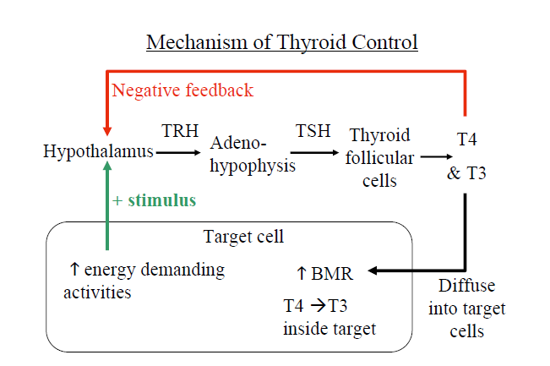

Slide 60
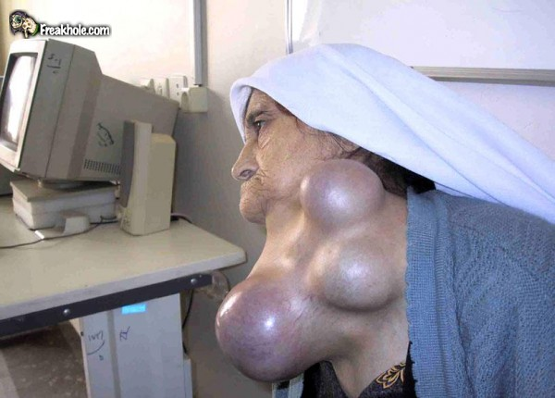
Disorders of the Thyroid
Hypothyroidism – can be due to deficiency in TSH or iodine; autoimmunity.
Produces cretinism in children, myxedema in adults.
Hyperthyroidism – caused by tumors of the thyroid or pituitary and autoimmunity (Grave’s Disease).

Slide 61
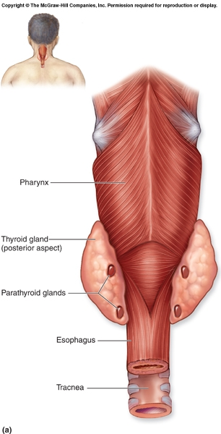
Parathyroid Glands
The parathyroid glands are four or so masses of tissue embedded posteriorly in each lateral mass of the thyroid gland
Parathyroid hormone (PTH) is the most important endocrine regulator of calcium and phosphorus concentration in extracellular fluid
PTH has the opposite effect of calcitonin.
PTH stimulates OSTEOCLASTS which increases blood calcium levels.
PTH causes reabsorption of Ca+2 from KIDNEYS so it is not excreted in the urine
PTH stimulates synthesis of calcitriol (hormone made in the kidney which the active form of Vitamin D which increases Ca+2 absorption from SMALL INTESTINE

Slide 62
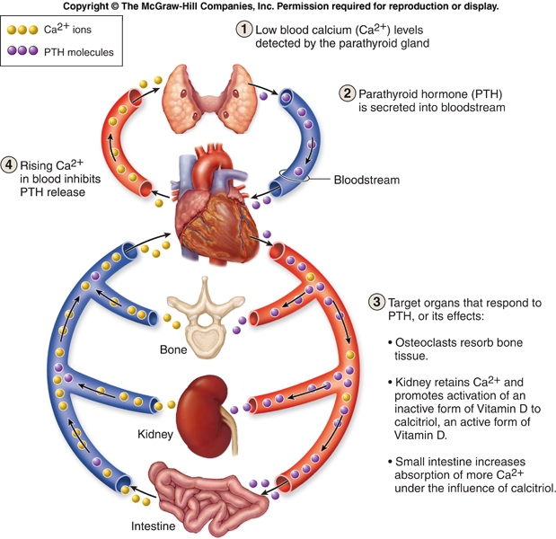

Slide 63
Adrenal Glands
The adrenal glands are located superior to each kidney.
Each adrenal gland has a pyramid shape.
Each adrenal gland has an inner medulla and outer cortex: Adrenal Cortex Adrenal Medulla

Slide 64
Adrenal Cortex
Makes and secretes over 30 different steroid hormones (collectively called corticosteroids)
The adrenal cortex has 3 regions (zones) that each make a major type of hormones:
1. Mineralocorticoids (e.g. aldosterone)
Stimulates THE KIDNEYS to reabsorb sodium if blood pressure drops
It also secretes (eliminates) potassium
2. Glucocorticoids (e.g. cortisol)
These hormones help you to cope with stress
Cortisol increases the level of sugar in the blood by stimulating the production of glucose from FATS AND PROTEINS (gluconeogenesis)
It also reduces swelling
In large doses, cortisol inhibits the immune system.
It stimulates gluconeogenesis, mobilization of free fatty acids, glucose sparing. Also acts as an anti-inflammatory agent
3. Gonadocorticoids (e.g.testosterone, estrogens, and progesterone )The adrenal gland also makes small amts of the sex hormones (mostly androgens (testosterone) and lesser amounts of estrogens and progesterone)
Scientists not certain what role these hormones play; but know that when over secreted they can cause problems

Slide 65
Adrenal Medulla
Secretes the hormones epinephrine and norepinephrine when stimulated by sympathetic neurons of the autonomic nervous system (ANS)
Both epinephrine and norepinephrine contribute to the bodies' "fight or flight" response, just like the sympathetic nervous system.
They have the same effects as direct stimulation by the sympathetic NS (increase heart rate, breathing rate, blood flow to skeletal muscles, and concentration of glucose in the blood), but their effects are longer lasting
Norepinpehrine is similar to epinephrine, but it is less effective in the conversion of glycogen to glucose.
~75 - 80% epinephrine
~25-30% norepinephrine

Slide 66
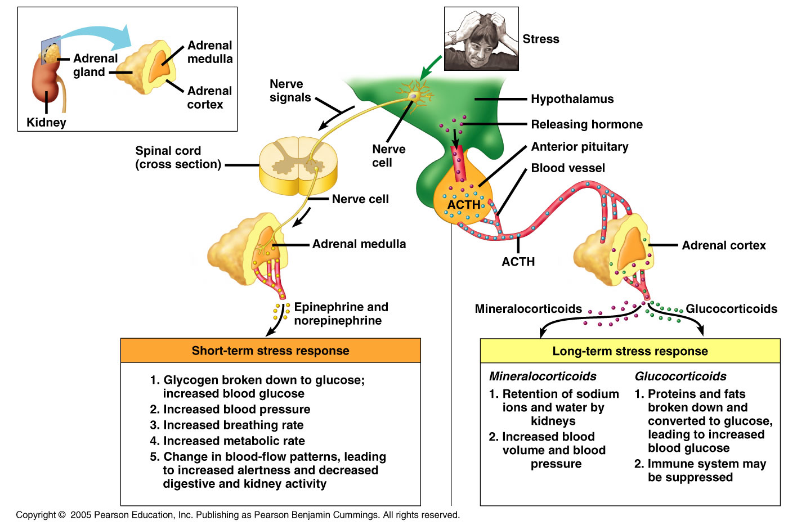

Slide 67
Pancreas
Located along the lower curvature of the small intestine (duodenum)
The pancreas contains both exocrine and endocrine cells
The exocrine portion secretes digestive enzymes into the duodenum via the pancreatic duct
The endocrine portion has clusters of endocrine cells within the pancreas called pancreatic islets or Islets of Langerhans
Alpha cells secrete glucagon
Beta cells secrete insulin
Glucagon increases the levels of glucose in the blood by stimulating the liver to breakdown glycogen into glucose during fasting or starvation
Insulin lowers blood glucose by increasing the rate of glucose uptake and utilization. Glucagon raises blood glucose by increasing the rates of glycogen breakdown and glucose manufacture by the liver

Slide 68
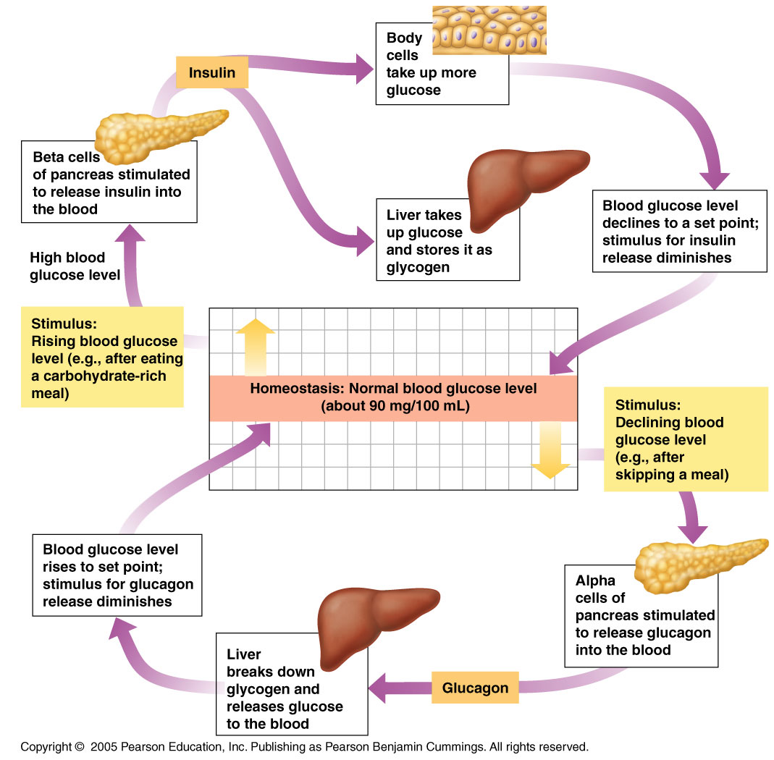

Slide 69
The gonads - secretion of the male and female sex hormones occurs in
Response to gonadotropin control.
The only item to mention here is that these hormones are important, in addition to their sexual functions, in producing the secondary sex characteristics of bone and muscle growth and maintenance, distribution of fat and body hair, breast development, etc.

Slide 70
Diabetes Mellitus Type I - insulin dependent diabetes mellitus IDDM
usually childhood onset - < 30 yrs. old.
β cells unable to secrete insulin due to damage by:
Congenital,
Damage due to toxins or radiation,
Autoimmunity,
Secondary to other disorders.Because of this the individual is unable to maintain normal plasma glucose concentration, and is unable to uptake and use glucose in metabolism.
Because of this the individual is unable to maintain normal plasma glucose concentration, and is unable to uptake and use glucose in metabolism.
Managed with insulin injections, oral insulin. The amount of insulin must correspond to the amount of carbohydrate intake.
Damage to tissues caused by hyperglycemia.
Life threatening acidosis when unmanaged.

Slide 71
Type I, Insulin Dependent Diabetes Mellitus, IDDM
Complications include:
1) hypoglycemia from overdose of insulin - this results in weakness, sometimes fainting, and, in the extreme, coma, all reversible with administration of glucose.
2) ketoacidosis from fat metabolism when insulin is under-administered. This complication can be life threatening.
3) Hyperglycemia when insulin administration is imprecise. Hyperglycemia damages cells and tissues

Slide 72
Type II – Non Insulin dependent diabetes mellitus - NIDDM
“adult onset” – usually over 30 yrs old
Due to insulin resistance of receptors on target cells.
Insulin resistance can be the result of:
1) abnormal insulin - this might result from mutation to the beta cells.
2) insulin antagonists - this can be the result of adaptation to hypersecretion of insulin.
3) receptor defect - this can be: a) the result of an inherited mutation. b) due to abnormal or deficient receptor proteins.
Insulin secretion may be normal or overabundant.
Many early Type II diabetics hypersecrete insulin.
Often associated with poor diet, obesity and lack of exercise.
Hyperglycemia is most damaging effect.

Slide 73
Type II - Non Insulin Dependent Diabetes Mellitus, NIDDM
Receptors to hormones and other chemical messengers are not stable in number or position.
They move in the membrane matrix and they increase or decrease in number (called down regulation) in order to modulate the response, i.e. with the object of maintaining the response within a normal range.
When the insulin stimulus increases tremendously, as it does in Type II diabetics, the receptors decrease in number and the receptor proteins may be deficient or abnormal.
Treatment of Type II – NIDDM
Insulin analogs – stimulate receptors better than insulin
Drugs which increase insulin binding and glucose utilization in muscles.
Coordinate with diet (reduced carbohydrates) and exercise (significantly improves effectiveness).

Slide 74
Keto acidosis is not usually a risk in NIDDM because these individuals do not rely solely on fats for metabolism, even when untreated.
However it may occur in NIDDM when insulin secretion has been eliminated by burnout of the beta Islet cells.
More likely it is a complication of kidney or liver failure in these patients.

Slide 75
Effects of Hyperglycemia
Increases blood osmolarity – which causes dehydration of tissues.
This interferes with electrolyte and water transport and ultimately transport of nutrients and wastes.
Cells and tissues break down.
Among the first to show damage are the small vessels in the retina. These can be easily visualized with an ophthalmoscope, and this technique, together with urinalysis, remains one of the most important diagnostic tools for diabetes.
Vessels in other tissues break down as well, and this destruction of vasculature leads to hypoxia and ischemia of body tissues including the retina, kidneys, limbs

Slide 76
Hypoglycemia - low blood glucose level can result from:
1) Hyposecretion of glucagon. The alpha cells may also be damaged and insufficient
This leads to hypoglycemia during the early post-absorptive phase.
But this condition is transitory because reversal will occur as the declining blood glucose stimulates the hypothalamus to cause adrenal medullary release of epinephrine.
Epinephrine will bring glucose levels back up through glycogenolysis.

Slide 77
2) Reactive hypoglycemia.
This is a condition often preceding and presaging NIDDM.
In individuals said to be "carbohydrate sensitive" the pancreas exhibits an exaggerated response to rising blood glucose after a carbohydrate-rich meal.
This will produce hypersecretion of insulin causing the plasma glucose level to plummet.
These individuals feel weak and may faint due to the hypoglycemia which results, about an hour after the meal.
The usual response is to quickly eat some sugar-rich food, which does reverse the hypoglycemia. But this only compounds the problem over the long term.
The solution is to reduce the carbohydrate in the meal, replacing it with protein. And to exercise before or after the meal.
This releases epinephrine which helps to keep the plasma glucose level up.
Many of us experience hunger about an hour after a sugar-rich meal.
But individuals with reactive hypoglycemia this is in the extreme with weakness, shaking, and even blackouts occurring.

