Slide 1
Culture media By Dr.Ebtisam Eid ,M.D.,

Slide 2
Culture media:
Growing of bacteria in the laboratory requires knowledge of their nutritional needs .
Many nutrients must be supplied to each of many different organisms
Many organisms can be grown in one or more types of media .

Slide 3
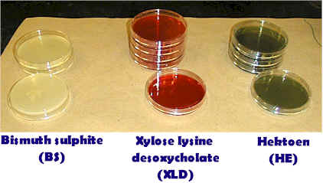
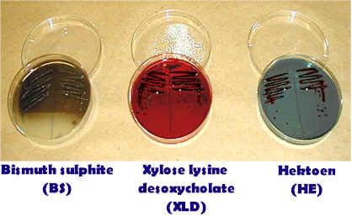
Salmonella culture media

Slide 4
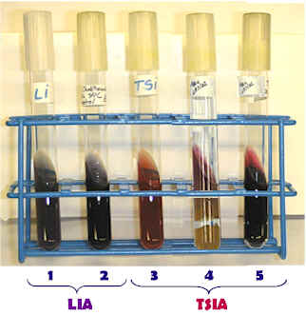
Salmonella diagnostic media

Slide 5
E.Coli , vibrio ,

Slide 8
Salmonella identification[ TSI ,LIA media ]

Slide 9
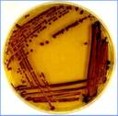

Slide 10
Types of Media :
1- Defined synthetic medium :
- It contains known specific kinds and amounts of chemical substances
2-Complex medium :
-It contains materials varies in chemical composition from batch to batch
-A common ingredient is peptone ,enzyme digestion of proteins [digested meat ] ,yeast-extract, casein ,serum ,whole blood or heated blood .

Slide 11
Diagnostic media :
1-Selective media :
-Encourage growth of some organisms and inhibit growth of others e.g. antibiotics are added to culture media
2-Differential media :
-The constituent causes an observable change [color change or change in PH ]
-They allow different kinds of colonies on the same plate to be distinguished from one another e.g. MacConkey agar contains crystal violet and bile salts ,which inhibit growth of gram positive bacteria while allowing growth of gram negative bacteria , it also contains sugar latose and PH indicator that that turns colonies of lactose fermenters red ,and leaves non fermenters colonies colorless

Slide 12
3-Enrichment media :
-They provide a nutrients that faster the growth of a particular organism to be isolated and identified ,but does not suppress other organisms , e.g. [XLD ] media which contain selenium element that supports growth of [salmonella typhi ]
Maintaining cultures [stock culture ] :
-Used after the organisms has been isolated to maintain a pure culture
-It is never used for laboratory studies
-It maintained by making subcultures in fresh medium at frequent intervals to keep the organisms growing ,by using Aseptic techniques .

Slide 13
Preserved and Reference cultures:
-Stock culture organisms should be kept in a preserved culture ,a culture in which organisms are maintain in a dormant state by lyophilization technique [freeze-drying ] ,the cells dehydrated while frozen ,in vials under vacuum ,at room temperature .

