Slide 1
management of child with respiratory system disorders part2
Prepared by / Amira Ali

Slide 2
General Objective
By the end of this session each student should understand the common respiratory diseases & nursing care of such case.

Slide 3
Specific Objective
By the end of this session each student will be able to:
Recognize factors affecting type of illness.
Recognize the etiology & characteristics of acute upper & lower respiratory infections.
Apply Ng. Process for the common types of acute upper respiratory infections e.g: nasopharyngitis, pharyngitis, tonsilitis, otitis media, & croup syndrome (acute spasmodic laryngitis).

Slide 4
Specific Objective
Apply Ng. Process for the common types of acute lower respiratory infections e.g:
Bronchitis, bronchiolitis, & pneumonia.
5. Apply Ng. Process for other respiratory tract infection e.g: pulmonary tuberculosis.
6. Apply Ng. Process for long-term respiratory dysfunction e.g: bronchial asthma.

Slide 5
The Child’s Respiratory System
The differences between adult and children’s respiratory

Slide 6
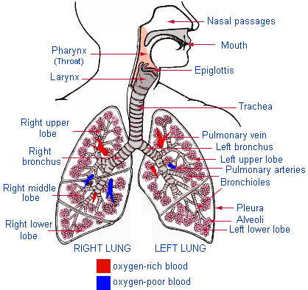
Anatomy of the Respiratory system

Slide 7
Introduction
Since the system is undergoing a process of development during childhood, the child is more prone to develop respiratory problems. In addition, the child does not have the immunity that adults have to many infectious agents. Respiratory infections are especially frequent during the years of growth

Slide 8
the nares are much smaller more easily occluded than in adults
The epiglottis in a younger (usually age 8 and under) child is longer making it more susceptible to swelling which may lead to airway occlusion.
larynx and the glottis are higher in the younger child’s neck makes the child more prone to aspiration

Slide 9
thyroid, cricoid, and tracheal cartilages are immature easily collapsible with flexion of the neck
Lung tissue is also immature at birth and continues to grow and develop until about the age of 12
The alveoli also increase in number from 25 to 300 million

Slide 10
Congenital Respiratory Conditions and Structural Anomalies
CHOANAL ATRESIA: is a congenital malformation of the nose in which there is blockage of the posterior side of the nose
Choanal atresia occurs in approximately one in 7000 live births.
Signs and Symptoms
After 4 weeks of age, neonates have the ability to breathe
through their mouths so that symptoms may not be
apparent at birth.

Slide 11
unilateral cases, the neonate may be
asymptomatic until signs of respiratory infection with bilateral cases develop cyanosis
Newborn who is pink in color when crying, yet turns bluish when quiet
choke or regurgitate
Slow weight gain

Slide 12
Diagnosis
Inability to pass a firm catheter through each nostril 3–4 cm into the nasopharynx.
Computerized tomography (CT) scan narrowing of the posterior side of the nose

Slide 13
Nursing Care
inserting an oral airway
starting gavage feeding to prevent aspiration and malnutrition
teach the parents to keep the child’s nostrils clean by gently cleansing
child may have difficulty with feeding, aspiration precautions must be observed
The baby is fed in a semi-upright
position with periods of rest to facilitate breathing

Slide 14
nurse must also communicate to parents to keep the child away from densely populated public places
encourage the parents to opt for early treatment, especially if the condition is bilateral.

Slide 15
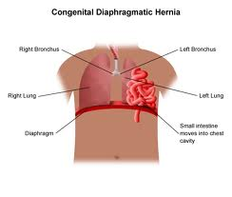
CONGENITAL DIAPHRAGMATIC HERNIA
pulmonary hypoplasia associated with a decrease in cross sectional area of the pulmonary vasculature and dysfunction
of the surfactant system
Signs and Symptoms: Newborns with CDH usually have severe respiratory distress.
Diagnosis: -- prenatal period through ultrasonography
--- chest x-ray exam

Slide 16
Treatment
Immediate medical management is aimed at
-stabilizing the patient, optimizing oxygenation, and preventing further trauma
- endotracheal intubation
surgical approach after stabilization

Slide 17
Nursing care
cautious monitoring of oxygenation, blood pressure
Maintaining the principle of minimal handling
Before surgery
- Continuous pulse oxymetry is essential
- or gastric or nasogastric suctioning (to prevent abdominal distention

Slide 18
child is turned on the affected side so that the unaffected lung may expand to the fullest
Postoperatively
- The nurse must perform vigilant assessments on all body systems to any detect complications or new problems
Gavage feeding may be initiated by the second or third postoperative day to maintain adequate feeding

Slide 19
Respiratory distress syndrome (RDS)
ESOPHAGEAL ATRESIA AND TRACHEOESOPHAGEAL FISTULA

Slide 20
BRONCHOPULMONARY DYSPLASIA(BPD) chronic lung disease (CLD),
is a chronic obstructive disease of the lungs that occurs as a complication of prolonged oxygen therapy, especially in preterm infants who are on assisted ventilation.
RISK FACTORS :
more than solely lung injury related to oxygen toxicity and trauma from mechanical ventilation

Slide 21
Signs and Symptoms
tachypnea,
wheezing,
Rales
retractions
episodes of cyanosis.

Slide 22
Diagnosis
Neonates are diagnosed based on signs, symptoms
Radiographic examination shows thickened and fibrotic changes in the airways and alveoli

Slide 23
Treatment and nursing care
The aim of management provide supportive care and minimize additional injury to the respiratory system
Pulse oximetry to monitor fluctuation in oxygen saturation
arterial blood sample can be drawn to monitor hypoxemia in the tissue
monitoring and maintaining fluid intake because infants with BPD are at high risk for developing pulmonary edema.

Slide 24
proper nutritional plan to promote recovery, growth, and development
If the infant can tolerate sucking, breast feeding is encouraged
The nurse can also observe the mother or both parents during feeding time to promote support and increase the mother’s confidence in caring for the child

Slide 25
Acute Respiratory Infections in Children
Introduction:
Respiratory tract infections are described according to the areas of involvement.
The upper respiratory tract or upper airway consists of primarily the nose & pharynx.
The lower respiratory tract consists of bronchi & bronchioles.

Slide 26
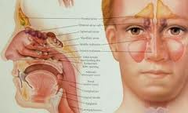
Upper Airway Disorders SINUSITIS
Normally, mucus collects in the sinuses and
drains into the nasal passages. When children have a cold or an allergy attack, the sinuses become inflamed and drainage is difficult.
If sinusitis persists
for more than 3 months is it called chronic sinusitis

Slide 27
Sign and symptoms
A cold lasting more than 10 to 14 days, sometimes with low-grade fever
• Thick yellow-green nasal discharge
• Postnasal drip leading to sore throat, cough, bad breath, nausea, and vomiting
• Headaches (usually not before age 6)
• Irritability and fatigue
• Swelling around the eyes

Slide 28
Diagnosis
physical examination
Sinus aspirate culture is the only accurate method of diagnosis but is not practical for routine use

Slide 29
Treatment & Nursing Care
Prescription of antibiotics
oral or nasal spray or drop decongestant also may be used to relieve congestion
saline nasal sprays
Surgery is sometimes necessary to remove a physical obstruction
The nurse can teach the
child and parents the importance of how to avoid sinusitis during a cold or allergy attack

Slide 30
Ensure that the child drinks plenty of fluids to keep nasal discharges thin.
◆ Apply heat via warm compresses or heating pad(on low heat) over the inflamed area.
◆ Use a cool mist humidifier in the same room or area occupied by the child
Avoiding air travel during the symptomatic period is recommended.
Avoiding contact with known allergens is important

Slide 31
Acute Upper Respiratory Tract Infections in Children:
Naso-pharyngitis: = Common cold.
Def:
Viral infection of the nose & throat.
Assessment (S &S):
1. Younger child
Fever, sneezing, irritability, vomiting & diarrhea
2. Older child
Dryness & irritation of nose & throat, sneezing, & muscular aches.

Slide 32
Acute Upper Respiratory Tract Infections in Children:
Complications of nasopharyngitis:
Otitis media
Lower respiratory tract infection
Older child may develop sinusitis
® Medication: Acetaminophen

Slide 33
Acute Upper Respiratory Tract Infections in Children:
Pharyngitis: = Sore throat including tonsils.
Uncommon in children under 1 yr. The peak incidence occurring between 4 & 7 yrs of age.
Causative organism: viruses or bacterial (group A beta-hemolytic streptococcus).

Slide 34
Acute Upper Respiratory Tract Infections in Children:
Assessment (S &S) of pharyngitis:
1. Younger child
Fever, anorexia, general malaise, & dysphagia (difficult to swallow)
2. Older child
Fever (40 c), anorexia, abdominal pain, vomiting, & dysphagia.

Slide 35
Acute Upper Respiratory Tract Infections in Children:
Complications of pharyngitis:
Retro pharyngeal abscess.
Otitis media.
Lower respiratory tract infection.
Peritonsillar abscess; occurs in fewer than 1% of patients treated with antibiotics that leads to rheumatic fever, or acute glomerulonephritis.

Slide 36
Acute Upper Respiratory Tract Infections in Children:
Management of pharyngitis:
A throat culture: This test that may help the pediatrician to learn which type of germ is causing the sore throat.
Antibiotic medicine is needed if a germ called streptococcus found to be the causative organism.
No special treatment is needed if your child's sore throat is caused by a virus. Antibiotic medicine will not help a sore throat caused by a virus.

Slide 37
Acute Upper Respiratory Tract Infections in Children:
Management of pharyngitis:
Help the child to rest as much as possible. Do not smoke around this child.
If the child's throat is very sore, he may not feel like eating or drinking very much. Introduce soft foods or warm soups. These foods may feel good going down the child's throat while it is very sore. Give this child 6 to 8 glasses of liquids like water and fruit juices each day.
Run a cool moist humidifier in the child's room.
If this child is 8 years or older, have him gargle(throat washing ) with a mixture of 1 teaspoon salt in 1 cup warm water.

Slide 38
Acute Upper Respiratory Tract Infections in Children:
Tonsillitis:
What is tonsillitis?
Tonsillitis is a viral or bacterial infection in the throat that causes inflammation of the tonsils. Tonsils are small glands (lymphoid tissue) in the pharyngeal cavity.
In the first six months of life tonsils provide a useful defense against infections. Tonsillitis is one of the most common ailments in pre-school children, but it can also occur at any age.

Slide 39
Acute Upper Respiratory Tract Infections in Children:
Tonsillitis:
Children are most often affected from around the age of three or four, when they start nursery or school and come into contact with many new infections.
A child may have tonsillitis if he/she has a sore throat, a fever and is off food.

Slide 40
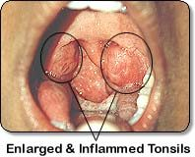
Tonsillitis
Palatine tonsils
(Visible during oral examination)

Slide 41
Acute Upper Respiratory Tract Infections in Children:
Tonsillitis:
What causes tonsillitis?
Tonsillitis is caused by a variety of contagious (infected) viral and bacterial infections. It is spread by close contact with other individuals and occurs more during winter periods. The most common bacterium causing tonsillitis is streptococcus.

Slide 42
Acute Upper Respiratory Tract Infections in Children:
Advice and treatment:
Encourage bed rest.
Introduce soft liquid diet according to the child's preferences.
Provide cool mist atmosphere to keep the mucous membranes moist during periods of mouth breathing.
Warm saline gargles & Paracetamol are useful to promote comfort.
If antibiotics are prescribed, counsel the child's parents regarding the necessity of completing the treatment period.

Slide 43
Acute Upper Respiratory Tract Infections in Children:
Management:
The controversy of tonsillectomy (see):
Generally, tonsils should not removed before 3 or 4 years of age, because of the problem of excessive blood loss & the possibility of re-growth or hypertrophy of lymphoid tissue, in young children.

Slide 44
Acute Upper Respiratory Tract Infections in Children:
Management (Tonsillectomy):
If a child has severe tonsillitis that is recurrent, persistent and troublesome, i.e; in cases where the child is subjected to around 4 attacks a year for two years or more, then surgery should be considered as an option.
Surgery might also be considered if the tonsils were so large that they are causing breathing problems at night.

Slide 45
Acute Upper Respiratory Tract Infections in Children:
Otitis media:
Background:
Otitis media (OM) is the second most common disease of childhood, after upper respiratory infection (URI).
Definition:
Otitis media is an inflammation of the middle ear.

Slide 46
Acute Upper Respiratory Tract Infections in Children:
Pathophysiology:
Otitis media is the result of dysfunctioning Eustachian tube.
The Eustachian tube, which connects the middle ear to the naso-pharynx, is normally closed, narrow &, directed downward, preventing organisms from the pharyngeal cavity from entering the middle ear.
It opens to allow drainage of secretions produced by middle ear mucosa & to equalize air pressure between the middle ear & outside environment.
Impaired drainage causes the pathological condition due to retention of secretion in the middle ear.

Slide 47
Acute Upper Respiratory Tract Infections in Children:
Acute Otitis media:
Predisposing factors of developing otitis media in children:
In children, developmental alterations of the Eustachian tube (short, wide, & straight), an immature immune system, and frequent infections of the upper respiratory mucosa all play major roles in AOM development.
Furthermore, the usual lying-down position of infants favors the pooling of fluids, such as formula.

Slide 48
Acute Upper Respiratory Tract Infections in Children:
Otitis media:
Otitis media can be classified into many variants on the basis of etiology, duration, symptomatology, and physical findings as the following:
Acute Otitis media: implies rapid onset of disease associated with 1 or more of the following symptoms:
Otalgia, Fever, Otorrhea, Recent onset of anorexia, Irritability, Vomiting, & Diarrhea

Slide 49
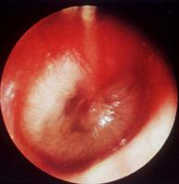
Acute Upper Respiratory Tract Infections in Children:
Acute Otitis media (AOM):
These symptoms are accompanied by abnormal otoscopic findings of the tympanic membrane (TM), which may include the following:
- Opacity
- Bulging
- Erythema

Slide 50
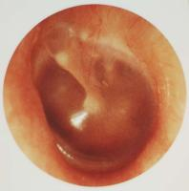
Otitis media
Healthy Tympanic Membrane

Slide 51
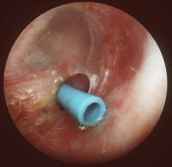
Otitis media
Tympanostomy tube in place.
Chronic OM
Acute Otitis media with purulent effusion behind a bulging tympanic membrane.

Slide 52
Otitis media
Therapeutic management:
Administration of antibiotic (Ambicillin or Amoxicillin) & anti-inflammatory (analgesic & antipyretic).
Nursing care:
Apply hot water bag over the ear with the child lying on the affected side may reduce the discomfort (applied during the attack of pain).
Put ice bag over the affected ear may also be beneficial to reduce edema (between pain attacks).

Slide 53
Otitis media
Nursing care:
3. For drained ear; the external canal may be frequently cleaned using sterile cotton swabs (dry or soaked in hydrogen peroxide).
4. Excoriation of the outer ear should be prevented by frequent cleansing & application of zinc oxide to the area of oxidate.
5. Give special attention to the tympanostomy tube i.e., avoid water entering the middle ear and introducing bacteria.

Slide 54
Otitis media
Nursing care:
6. Educate family about care of child, & keep them aware with the potential complications of acute otitis media e.g., conductive hearing loss.
7. Provide emotional support to the child & his family.

Slide 55
Lower Respiratory Tract Infections in Children:
Croup Syndrome:
Acute infection of the larynx characterized by severe involvement of voice & breathing appears in the following clinical pictures: hoarseness of voice ,resonant cough, & varying degrees of respiratory distress.
Croup syndromes are usually described according to primary anatomic area affected e.g., laryngitis, laryngotracheobronchitis (LTB).

Slide 56
Lower Respiratory Tract Infections in Children:
Croup Syndrome:
Nursing assessment:
Recurrent periods of fever, normothermia, & hypothermia.
Initially, there is mild brassy(hard) cough .
Later on, there is hypoxemia & hypercapnia (increased depth of respiration).
Dyspnea, nasal flaring, using accessory muscles of respiration (supsternal, & intercostals retractions).

Slide 57
Lower Respiratory Tract Infections in Children:
Therapeutic management:
Hospitalization for continuous observation & for possible tracheostomy or endotracheal intubation.
Provide cool mist oxygen.
Patients may respond to corticosteroid therapy.
The disease is usually self limited.

Slide 58
Lower Respiratory Tract Infections in Children:
Home care:
Encourage bed rest.
Provide warm, high humidity atmosphere, especially during periods of coughing & during sleep.
Encourage inhalation of warm steam to prevent recurrence.
Keep the child calm most of time (avoid crying, & excessive talking).

Slide 59
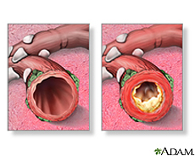
Lower Respiratory Tract Infections in Children:
Acute Bronchitis:
- Definition:
is an inflammation of the
lining of the bronchial
tubes, the airways that
connect the trachea
to the lungs i.e., the
Organs and tissues involved in breathing.

Slide 60
Lower Respiratory Tract Infections in Children:
Acute Bronchitis:
- Pathophysiology:
When a person has bronchitis, it may be harder for air to pass in and out of the lungs than it normally would, the tissues become irritated, inflamed and more mucus is produced.
Furthermore among children the condition becomes worse due to lack of cartilaginous support of the smooth muscle which is not fully developed until the adolescent years leading to more constriction .

Slide 61
Lower Respiratory Tract Infections in Children:
Acute Bronchitis:
Causes:
Acute bronchitis is usually caused by viruses, and it may occur together with or following
a common cold or other respiratory infection. Germs such as viruses can be spread from person to person by coughing.

Slide 62
Lower Respiratory Tract Infections in Children:
Acute Bronchitis:
- Nursing Assessment (S & S):
The most common symptom of bronchitis is a productive cough that may bring up thick white, yellow, or greenish mucus.
Anterior chest pain, that increased by cough.
Fever (usually mild) = low grade fever.
Shortness of breath
A feeling of tightness in the chest.
wheezing

Slide 63
Lower Respiratory Tract Infections in Children:
Acute Bronchitis:
Therapeutic management:
Bronchitis is a mild self limiting disease that requires only symptomatic treatment including:
Analgesics.
Antipyretics.
Humidified oxygen.
Cough suppressants.
Antibiotics are not used to treat viral illness or reduce the incidence of complications.

Slide 64
Lower Respiratory Tract Infections in Children:
Acute Bronchitis:
Nursing care:
Provide well balanced diet.
Encourage adequate fluid intake, provide small frequent amount to prevent nausea & vomiting.
Ensure warm atmosphere, encourage the child to inhale steam to liquefy secretions.
Change position (postural drainage) to facilitate the drainage of mucous.

Slide 65
Lower Respiratory Tract Infections in Children:
Acute Bronchitis:
Nursing care:
5. Administer oxygen according to doctor order (flow rate).
6. Reassure the child & his parents especially during oxygen administration & postural drainage.

Slide 66
Lower Respiratory Tract Infections in Children:
Bronchiolitis:
Bronchiolitis is a common illness of the respiratory tract usually caused by viral infection. It affects the tiny airways, called the bronchioles, that lead to the lungs. As these airways become inflamed, they swell and fill with mucus, making breathing difficult.
The variable degrees of obstruction produced in air passage by these changes lead to hyperpnoea & progressive emphysema.

Slide 67
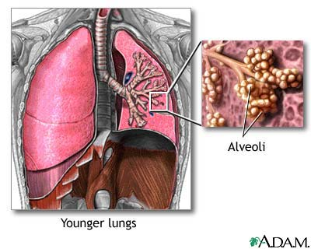
Lower Respiratory Tract Infections in Children:
Normal lungs & alveoli

Slide 68
Lower Respiratory Tract Infections in Children:

Slide 69
Lower Respiratory Tract Infections in Children:
Bronchiolitis:
Incidence:
Typically occurs during the first 2 years of life, with peak occurrence at about 3 to 6 months of age.
Is more common in males, children who have not been breastfed, and those who live in crowded conditions.
Day-care attendance and exposure to cigarette smoke .

Slide 70
Lower Respiratory Tract Infections in Children:
Bronchiolitis:
Nursing Assessment (S & S):
The first symptoms of bronchiolitis are usually the same as those of a common cold:
Stuffiness ( chest tightness), runny nose, mild cough, & mild fever
These symptoms last a day or two and are followed by worsening of the cough and the appearance of wheezes (high-pitched whistling noises when exhaling).

Slide 71
Lower Respiratory Tract Infections in Children:
Bronchiolitis:
Nursing Assessment (S & S):
Sometimes more severe respiratory difficulties gradually develop, marked by:
Rapid, shallow breathing.
Sup sternal retractions.
Flaring of the nostrils.
Irritability, with difficulty sleeping and signs of fatigue or lethargy.
The child may also have a poor appetite and may vomit after coughing.

Slide 72
Lower Respiratory Tract Infections in Children:
Bronchiolitis:
Nursing Assessment (S & S):
In severe cases, symptoms may worsen quickly with the child becomes cyanotic.
The child also can become dehydrated from working harder to breathe, vomiting, and taking in less during feedings.

Slide 73
Lower Respiratory Tract Infections in Children:
Bronchiolitis:
Diagnostic evaluation:
Chest X-ray.
Culture from respiratory secretions.

Slide 74
Lower Respiratory Tract Infections in Children:
Bronchiolitis:
- Therapeutic management:
Fortunately, most cases of bronchiolitis are mild and require no specific treatment. Antibiotics aren't useful because bronchiolitis is caused by a viral infection.
Medication may sometimes be given to help open a child's airways e.g., bronchodilators, corticosteroids.
Cough suppressants.
Encourage bed rest.

Slide 75
Lower Respiratory Tract Infections in Children:
Bronchiolitis:
Therapeutic management:
Offer fluids in small amounts at more frequent intervals than usual.
Those who are moderately or severely ill may need to be hospitalized, watched closely, and given fluids and humidified oxygen.
Rarely, in very severe cases, some babies are intubated & placed on ventilators to help them breathe until they start to get better.

Slide 76
Lower Respiratory Tract Infections in Children:
Bronchiolitis:
Nursing care:
Follow strict precautions to prevent spread of infection.
Administer high humidified oxygen.
Clear nasal congestion, try a bulb syringe and saline (saltwater) nose drops.
Provide adequate Ng. Care for vomiting, fever, & diarrhea.
Small frequent diet, & increase fluid intake.

Slide 77
Lower Respiratory Tract Infections in Children:
Bronchiolitis:
Prognosis:
Is generally good among healthy children.
Malnourished children may develop otitis media, sinusitis, or pneumonia.
Infants with preexisting cardiopulmonary disease have an increased incidence of death.

Slide 78
Pneumonia
Definition:
Pneumonia is an inflammation with consolidation (stiff ) of the lung tissue.
Exudates consolidate material replaces air in the lung so the density (thickness )of the lung increases, and leads to increase sound heard on auscultation & dullness of the lung area on percussion.

Slide 79
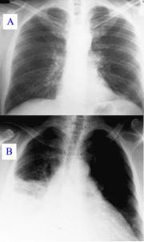
Pneumonia
Image (A): Normal chest x-ray
Image (B): Lobar pneumonia

Slide 80
Pneumonia
Anatomical forms of Pneumonia:
Lobar Pneumonia
Bronchopneumonia: Begins in the terminal bronchioles which become clogged (occluded )with mucopurulent exudates to form patches in affected lobules.
Interstitial pneumonia: in which the inflammatory process is confined within the alveolar walls, peribronchial & interlobular tissues.

Slide 81
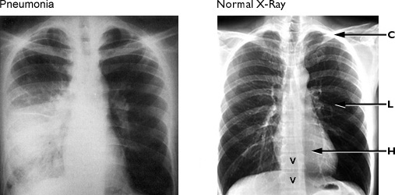
Pneumonia

Slide 82
Pneumonia
Causative organism:
Bacterial – viral– others e.g: mycoplasmic pneumonia.
Pathologic changes in tissue:
Pneumococci Consolidation
H. Influenza extensive destruction of the epithelium of small airway & hemorrhagic edema.
Mycoplastic pneumonia ulceration & sloughing of mucosal lining.

Slide 83
Pneumonia
General Signs of Pneumonia: Fever, respiratory, Behavior, & gastrointestinal.
Therapeutic management: Bed rest, oral fluid intake, antipyretic, & antitussive for dry hacking cough

Slide 84
Pneumonia
Nursing Assessment:
Pneumonia: Fever, malaise, cough, chills, rapid & shallow respiration
Severe Pneumonia: The previous signs + chest picture
Very severe Pneumonia: The previous signs + Grunting, inability to drink, sleep difficulties, severe dehydration & malnutrition.

Slide 85
Pneumonia
Nursing Management: is primarily supportive & symptomatic

Slide 86
Tuberculosis
Introduction:
its incidence in developed & underdeveloped countries.
Causative organism:
Mycobacterium tuberculosis.
Mode of transmission:
Droplet infection (inhalation) or
By direct contact with infected person.

Slide 87
Tuberculosis
Primary infection:
it occurs when the causative organism enters the lung tissue the invaded tissue react by inflammation & calcification (later on) = primary focus which heals spontaneously if the child's resistance is good.
The primary complex includes the initial lesion & lesions in the the regional lymph nodes.

Slide 88
Tuberculosis
The disease process may spread to other parts inside the lung & to the GIT because of swallowed infected sputum.
NB: when wide spread infection occurs, the child is said to have miliary tuberculosis.
Later because of lowered resistance, the latent lesion may again become active.

Slide 89
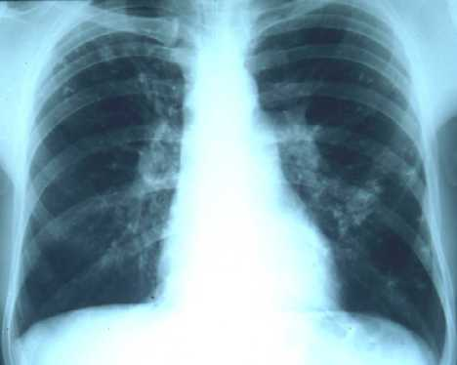
Tuberculosis
Chest X-ray film. Presence of numerous miliary opacities to middle and upper field of right and to middle and lower field of left.

Slide 90
Tuberculosis
Secondary infection:
Usually occurs during adolescence from the original focus (becomes active) or re-infection.
Secondary infection may include extensive inflammatory reaction with tissue destruction & cavitations healing by means of scar or fibrosis.

Slide 91
Tuberculosis
Nursing assessment (S & S):
Many times the affected child appears a symptomatic or has a broad range of symptoms.

Slide 92
Tuberculosis
Diagnostic evaluation:
Mantoux test = skin test is the most important test to diagnose TB.
About 6 weeks after infection an antigen ( Purified Protein Derivative) is injected intracutaneously. The presence of allergy or hypersensitivity to tuberculo-protein is observed within 48 to 72 hrs and then interpreted in relation to induration not erythema (redness) in centimeters.

Slide 93
Tuberculosis
Interpretation:
A reaction of less than 5cm in diameter is considered –ve.
Induration of 5 to 9cm is considered doubtful and should be repeated.
A lesion of 10cm or more is considered +ve.
. Other diagnostic tests include chest x-ray & bacterial culture (sputum in older children or gastric lavage in infants & young children as they cannot thorough sputum instead they swallow it).

Slide 94
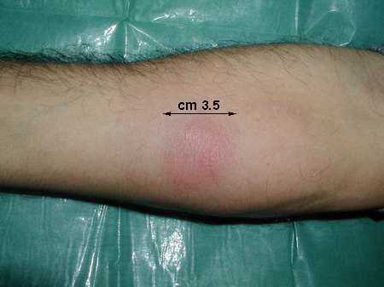
Mantoux test
Negative reaction

Slide 95
Tuberculosis
Therapeutic management:
With +ve mantoux test; the nurse is responsible for making sure that the entire family is screened.
- If a child has a +ve test but no sign of tuberculosis, we recommend that you take preventive medicine now before your TB infection becomes active TB disease. This medicine, taken every day for six or nine months, & will kill the TB germs in your body so that you will not develop active TB disease.

Slide 96
Tuberculosis
Children with active disease can be cared at home taking the required precautions.
With appropriate antituberculosis therapy:
¤ The child can attend school & without any activity limitation (encourage the child to practice normal life style as possible).
¤ The usual childhood immunization may be given according to the schedule.

Slide 97
Tuberculosis
Outcome:
Most of cases are usually recover from primary TB.
Death usually occurs only from tuberculous meningitis.

Slide 98
Tuberculosis
Prevention:
3 methods for effective prevention:
Isolation of infected cases.
Immunization with B.C.G.
Prophylactic treatment. For infants & children who must live a household with an infectious adult.

Slide 99
Bronchial Asthma
Asthma trigger
7. Strong emotions: e.g: fear, laughing.
8. Food: e.g: Nuts, chocolate, milk.
9. Medication: e.g: Aspirin.

Slide 100
Bronchial Asthma
Pathophysiology:
Asthma trigger
Inflammation & edema of the mucous membranes.
Accumulation of tenacious secretions from mucous glands.
Spasm of the smooth muscle of the bronchi & bronchioles decreases the caliber(space ) of the bronchioles.

Slide 101
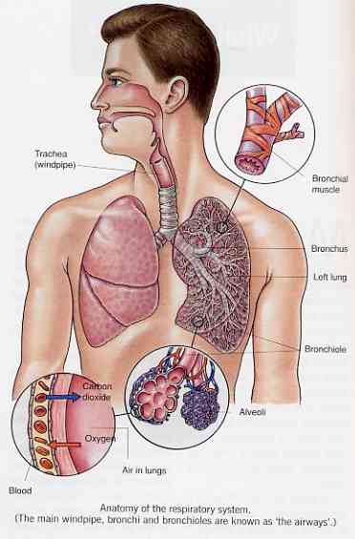
Bronchial Asthma

Slide 102
Bronchial Asthma
Clinical manifestations:
A) General manifestations:
The classical manifestations are: dyspnea, wheezing, & cough.
The episode of asthma is usually begins with the child feeling irritable & increasing restless. Asthmatic child may complain headache, feeling tired, & chest tightness.

Slide 103
Bronchial Asthma
Clinical manifestations:
B) Respiratory symptoms:
paroxysmal attack of irritating and non productive cough due to bronchial edema.
Accumulation of secretion stimulate cough that becomes rattling& productive (frothy, clear, sputum).
- Shortness of breath, prolonged expiration, wheezy chest, cyanosed nail beds, & dark red color lips that may progress by time to blue.

Slide 104
Bronchial Asthma
C) On chest examination:
Inspection reveals major changes in the form of supraclavicular, intercostals, subcostal, & sternal retractions due to the frequent use of accessory muscles of respiration.
With repeated episodes: chest shape is changed to barrel chest, & elevated shoulder.
Auscultation reveals loud breath sounds in the form of course crackle, grunting, wheezes throughout the lung region.

Slide 105
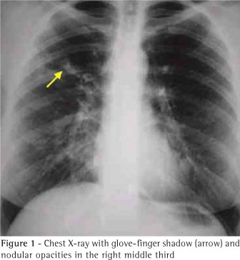
Bronchial Asthma
Barrel chest

Slide 106
Bronchial Asthma
Diagnostic evaluation:
Clinical manifestations, history, physical examination, & Lab tests.
Radiographic examination.
Pulmonary function tests provide an objective method of evaluating the degree of lung disease.

Slide 107
Bronchial Asthma
Therapeutic management:
Allergic control to prevent attacks.
Drug therapy:
B- adrenergic, Theophyllin, & corticosteroids preparations + chest physiotherapy (only in between attacks).

Slide 108
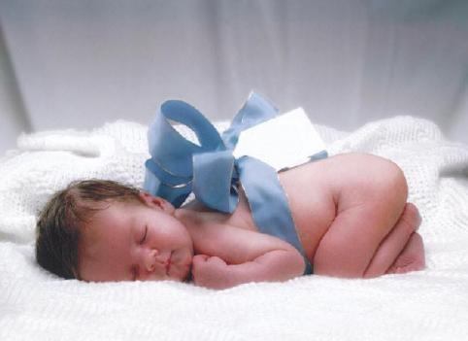
THANK YOU
Thank you

