Slide 1
Female Reproductive system
By Dr/ Reda Hassan

Slide 2
The Female Genital Organs
The female genital organs consist of an internal and an external group. The internal organs are situated within the pelvis, and consist of the ovaries, the uterine tubes, the uterus, and the vagina. The external organs are mons pubis, the labia majora and minora, the clitoris, the vestibuli, and the greater vestibular glands.

Slide 3
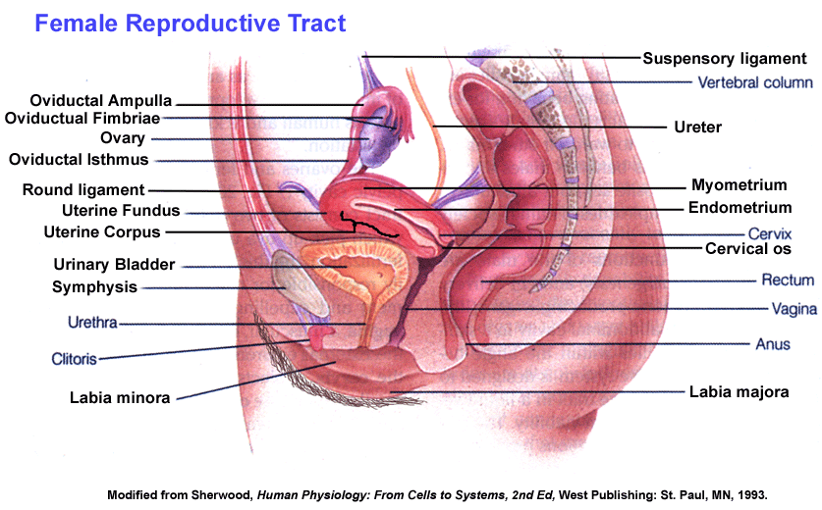

Slide 4
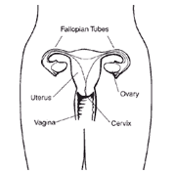
The female reproductive system consists of:
1- Primary sex organs:
two ovaries.
2- Secondary sex organs:
a- Two oviducts
b- Uterus
c- vagina
d- external genitalia
e- mammary glands

Slide 5
Function of the female reproductive system are:
1- Production of ova (female germ cells) Through the process of oogenesis.
2- Promote fertilization by facilitating the meeting of the female germ cells and spermatozoa.
3- Hold a fertilized oocytes during its complete development embryonic and fetal stages until birth.
4- Production of female sexual hormones.

Slide 6
The Ovaries
Are small, almond-shaped organs:
near lateral walls of pelvic cavity
FUNCTION
Production of female gametes .
Secretion of female sex hormones (estrogens, progesterone)

Slide 7
They are two nodular bodies, situated one on either side of the uterus in relation to the lateral wall of the pelvis, and attached to the back of the broad ligament of the uterus, behind and below the uterine tubes. The ovaries are of a grayish-pink color. They are each about 4 cm. in length, 2 cm. in width, and about 8 mm. in thickness, and weigh from 2 to 3.5 gm..

Slide 8
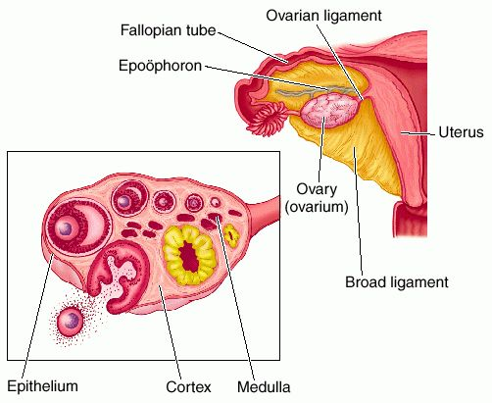
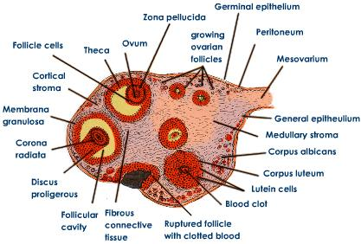

Slide 9
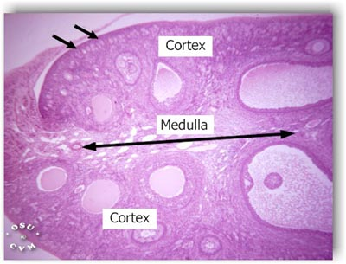
The tubal extremity is attached the ovarian fimbria of the uterine tube and a fold of peritoneum, the suspensory ligament of the ovary, The uterine end is directed downward toward the pelvic floor
. The ovary consists of a number of vesicular ovarian follicles imbedded in the stroma.
Parenchyma of the ovary:
1- Cortex:, the wide outer region containing ovarian follicles at various stages of development and degeneration.
2- Medulla:

Slide 10
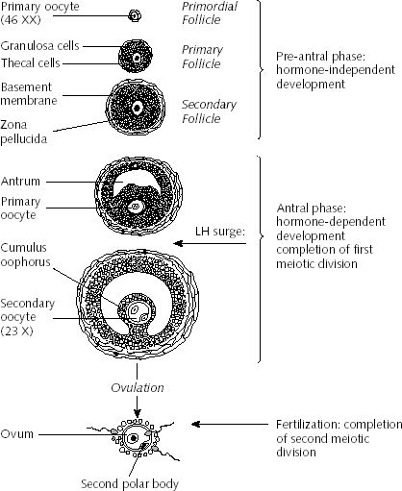
Ovarian follicles
Generally one oocytes is liberated by the ovaries in each menstrual cycle (average duration, 28 days) and the reproductive life of a women lasts about 30-40 years.
A follicle consists of an oocytes surrounded by one or more layers of follicular cells (The granulosa cells)

Slide 11
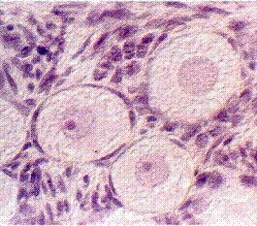
There are several stages of follicular development.
Primordial follicles:
The follicles that are formed during fetal life.
- It consists of a primary oocytes surrounded by a single layer of flattened follicular cells.
-

Slide 12
B) Growing follicles:
Beginning in puberty, the FSH of the pituitary gland stimulates the primordial follicle to grow
1- Unilaminar primary follicles
2- Multilaminar primary or preantral follicles
3- Secondary (vesicular) or antral follicles

Slide 13
3- Secondary (vesicular or antral) follicles:
The oocytes reach its maximum diameter (125-150 μm) with large nucleus.
The follicle grows due to the increase in size and number of follicular cells.
Theca folliculi differentiated into:
1- Theca intarna (cells).
2-Theca externa (C.T.).
These cells are secreting cells ( estrogen).
C) Mature (Graaffian) follicles:
It reaches 2.5 cm in diameter

Slide 14
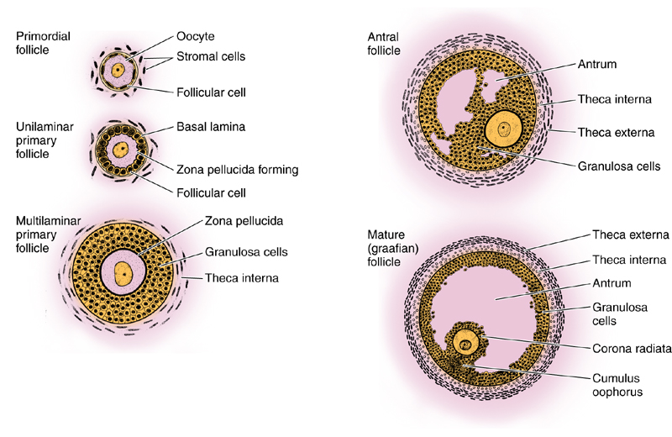
There are several stages of follicular development.

Slide 15
Ovulation:
The process of ovulation involves the rupture of a mature follicle and the liberation of the ovum.
It usually takes place in the middle of the menstrual cycle (14 ^{th} day).
The stimulus for ovulation is probably LH hormone secreted by the anterior pituitary in response to high levels of estrogen produced by the growing follicles.
The secondary oocyte, enclosed by the crona radiata, is released from the ovary and is then quickly drown into the oviduct (uterine tube) where the oocyte may be fertilized.
If fertilization dose not occur within 24 hours after ovulation, the ovum begins to degenerate.

Slide 16
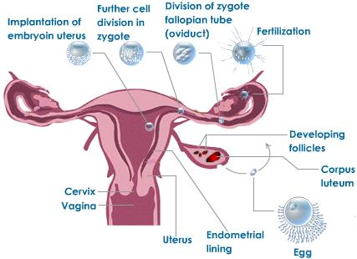
Ovulation

Slide 17
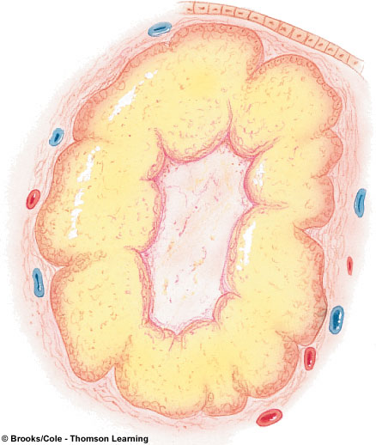
Corpus luteum:
.
There are two type of corpus luteum:
1- Corpus luteum of menstruation:
- If pregnancy dose not occur, corpus luteum lasts only 10-14 days and then degenerates
2- Corpus luteum of pregnancy:
- If pregnancy occur, the chorionic gonadotropins of the trophoblastic cells of implanting embryo stimulate the corpus luteum which increase in size and lasts for 6 month after which it starts to degenerate.

Slide 18
Fallopian Tube; Oviduct)
convey the ova from the ovaries to the cavity of the uterus. They are two in number, one on either side, situated in the upper margin of the broad ligament, and extending from the superior angle of the uterus to the side of the pelvis. Each tube is about 10 cm. long, and is described as consisting of three portions:
1- The infundibulum: Funnel-shaped opening close to the ovary and has a fingure-like folds called fimbriae.
2- The ampulla: intermediate segment.
3- The isthmus: narrow segment adjacent to the uterine wall.
4- The intramural region: The part of the tube embedded in the uterine wall.

Slide 19
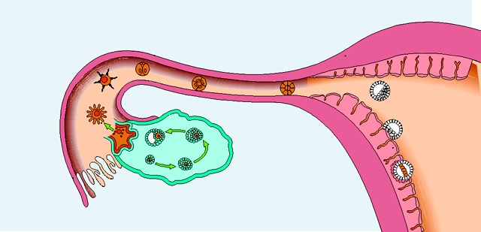

Slide 20
The Uterus
is a hollow, thick-walled, muscular organ situated deeply in the pelvic cavity between the bladder and rectum. Into its upper part the uterine tubes open, one on either side, while below, its cavity communicates with that of the vagina.
In the virgin state the uterus is flattened antero-posteriorly and is pyriform in shape, with the apex directed downward and backward.

Slide 21
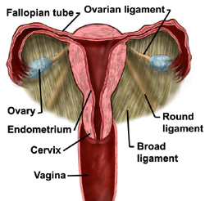

Slide 22
The uterus measures about 7.5 cm. in length, 5 cm. in breadth, at its upper part, and nearly 2.5 cm. in thickness; it weighs from 30 to 40 gm. It is divisible into two portions.
1- Body: the rounded upper part , above the internal os, and the dome part of which is called fundus.
2- Cervix: a lower cylindrical part that project into the vagina.
The cervix encloses the cervical canal which has two opening:
A- Internal os
B- External os

Slide 23
structure:
I- Endometrium II- Myometrium III- Perimetrium
I- Myometrium:
It is the thickest layer of the uterine wall.
It is composed of bundles of smooth muscle separated by C.T.
The bundle of muscle form 4 layer which are poorly defined:
1- The inner and outer layers : longitudinal.
2- The middle layers: they enclose between them large blood vessels.

Slide 24
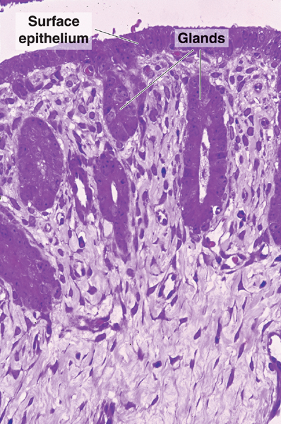
II- Endometrium
Consists of :
1- Epithelium:
2- Lamina propria: composed of loose connective tissue rich in fibroblasts, reticular fibers and blood vessels.
It also contains simple tubular glands (uterine glands) that invaginate from the epithelium and may branch in their deep portions.

Slide 25
The endometrium can be divided into 2 zones:
1- Functional zone (stratum functionalis):
It is the superficial, outer portion which is sloughed off during menstruation.
2- Basal zone (stratum basalis):
It is the deep portion which is retained after menstruation. It proliferates and regenerates new epithelium and lamina propria (new functional zone) for the renewal of endometrium. The basalis remains mostly unchanged.

Slide 26
III- Perimetrium:
Formed of C.T. which is, in some parts, lined by mesothelium (serosa) and in other parts have no methothelium (adventitia)
Cervix (cervix uteri; neck).—The cervix is the lower constricted segment of the uterus. It is somewhat conical in shape, with its truncated apex directed downward and backward Owing to its relationships, it is less freely movable than the body
.

Slide 27
The supravaginal portion is separated in front from the bladder by fibrous tissue (parametrium), which extends also on to its sides and lateral ward between the layers of the broad ligaments. The uterine arteries reach the margins of the cervix in this fibrous tissue, while on either side the ureter runs downward and forward in it at a distance of about 2 cm. from the cervix.
Posteriorly, the supravaginal cervix is covered by peritoneum, which is prolonged below on to the posterior vaginal wall.
The vaginal portion of the cervix projects free into the anterior wall of the vagina between the anterior and posterior fornices. On its rounded extremity is a small, depressed, somewhat circular aperture, the external orifice of the uterus, through which the cavity of the cervix communicates with that of the vagina. The external orifice is bounded by two lips, an anterior and a posterior

Slide 28
The ligaments of the uterus are eight in number: one anterior; one posterior; two lateral or broad; two uterosacral; and two round ligaments. The anterior ligament consists of the vesicouterine fold of peritoneum, which is reflected on to the bladder from the front of the uterus, at the junction of the cervix and body.
Uterine cycle
Repeating series of changes in the endometrium
Continues from menarche to menopause
Menstrual phase:
Degeneration of the endometrium
Menstruation
Proliferative phase :
Restoration of the endometrium
Secretory phase:
Endometrial glands enlarge and accelerate their rates of secretion

Slide 29
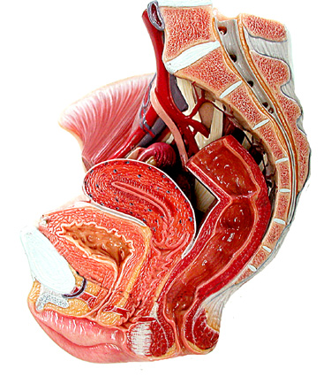

Slide 30
The vagina: is a fibro-muscular tube
extends from the vestibule to the uterus, and is situated behind the bladder and in front of the rectum; it is directed upward and backward. Its length is 6 to 7.5 cm. along its anterior wall, and 9 cm. along its posterior wall. it surrounds the vaginal portion of the cervix uteri. To the recess behind the cervix the term posterior fornix is applied, while the smaller recesses in front and at the sides are called the anterior and lateral fornices
It is devoid of glands and the mucus found in the lumen of the vagina comes from the glands of the uterine cervix.
It consists of:
1- Mucosa 2- Muscle layer 3- Adventitia
Relations.
The anterior surface of the vagina is in relation with the fundus of the bladder, and with the urethra. Its posterior surface is separated from the rectum by the rectouterine excavation in its upper fourth, and by the rectovesical fascia in its middle two-fourths; the lower fourth is separated from the anal canal by the perineal body. Its sides are enclosed between the Levatores ani muscles.

Slide 31
The External Organs
The external genital organs of the female are: the mons pubis, the labia majora and minora the clitoris, the vestibule of the vagina, and the greater vestibular glands.
The Mons Pubis the rounded eminence in front of the pubic symphysis, is formed by a collection of fatty tissue beneath the integument. It becomes covered with hair at the time of puberty.
The Labia Majora are two prominent longitudinal cutaneous folds which extend downward and backward from the mons pubis and form the lateral boundaries of a fissure, into which the vagina and urethra open. Each labium has two surfaces, an outer, pigmented and covered with strong, crisp hairs; and an inner, smooth and beset with large sebaceous follicles. The labia are thicker in front, where they form by their meeting the anterior labial commissure. Posteriorly they are not really joined, but appear to become lost in the neighboring integument, ending close to, and nearly parallel with, each other. Together with the connecting skin between them, they form the posterior labial commissure. The interval between the posterior commissure and the anus, from 2.5 to 3 cm. in length, constitutes the perineum. The labia majora correspond to the scrotum in the male.

Slide 32
The Labia Minora :are two small cutaneous folds, situated between the labia majora, and extending from the clitoris obliquely downward, lateralward, and backward for about 4 cm. on either side of the orifice of the vagina, between which and the labia majora they end
The Clitoris is an erectile structure, homologous with the penis. It is situated beneath the anterior labial commissure, partially hidden between the anterior ends of the labia minora
The Vestibule.—The cleft between the labia minora and behind the glans clitoridis is named the vestibule of the vagina: in it are seen the urethral and vaginal orifices and the openings of the ducts of the greater vestibular glands
The external urethral orifice is placed about 2.5 cm. behind the glans clitoridis and immediately in front of that of the vagina; it usually assumes the form of a short, sagittal cleft with slightly raised margins
The vaginal orifice is a median slit below and behind the opening of the urethra; its size varies inversely with that of the hymen.

Slide 33
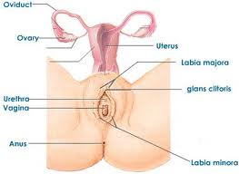
The Greater Vestibular: are the homologues of the bulbo-urethral glands in the male. They consist of two small, roundish bodies of a reddish-yellow color, situated one on either side of the vaginal orifice in contact with the posterior end of each lateral mass of the bulb of the vestibule. Each gland opens by means of a duct, about 2 cm. long, immediately lateral to the hymen, in the groove between it and the labium minus

Slide 34
Mammary gland . In the female they are two large hemispherical eminences lying within the superficial fascia and situated on the front and sides of the chest; each extends from the second rib above to the sixth rib below, and from the side of the sternum to near the midaxillary line. Their weight and dimensions differ at different periods of life, and in different individuals. Before puberty they are of small size, but enlarge as the generative organs become more completely developed. They increase during pregnancy and especially after delivery, and become atrophied in old age. The left mamma is generally a little larger than the right. The deep surface of each is nearly circular, flattened, or slightly concave, and has its long diameter directed upward and lateralward toward the axilla; it is separated from the fascia covering the Pectoralis major, Serratus anterior, and Obliquus externus abdominis by loose connective tissue.

Slide 35
Each mammary gland consists of 15-25 lobes of compound tubulo-alveolar type.
Each lobe can be considered as a gland, separated from the other lobes by dense connective tissue and adipose tissue. It has its own excretory lactiferous duct and these ducts open into the nipple.
The nipple:
It has a conical shape, brown or pink in color and is covered by stratified squamous keratinized epithelium.
The skin around the nipple constitutes the areola whose color is light brown and darkens during pregnancy.
The epithelium of the nipple rests on a layer of connective tissue rich in circular smooth muscle fibers around the lactiferous ducts.

Slide 36
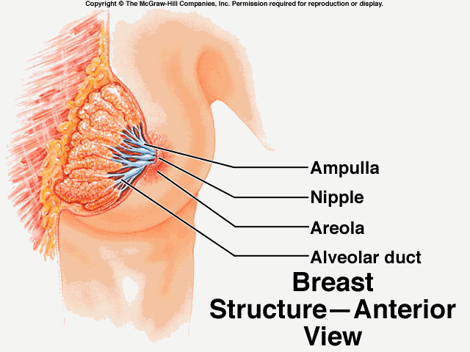

Slide 37
The histological structure of the mammary gland varies according to sex, age and physiologic conditions.
Before puperty:
- In both sexes, the mammary gland is flattened and consists of several lactiferous ducts with their dilated portions (lactiferous sinuses). These are embedded in the dermis of skin under the nipple.

Slide 38
During puberty:
In female, under the effect of ovarian estrogen, the breast increase in size (accumulation of adipose tissue and C.T.) with increase the growth and branching of lactiferous ducts.
In male, the breasts remain flattened.

Slide 39
Thank You

