Slide 1
Toddler growth and development

Slide 2
Normal toddler:
Toddler stage is between 1 to 3 years of age. During this period, growth slows considerably.

Slide 3
Physical growth
Weight:
The toddler's average weight gain is 1.8 to 2.7 kg/year.
Formula to calculate normal weight of children over 1 year of age is
Age in years X 2+8 = ….. kg.
e.g., The weight of a child aging 4 years
= 4 X 2 + 8 = 16 kg

Slide 4
Height:
During 1–2 years, the child's height increases by 1cm/month.
The toddler's height increases about 10 to 12.5cm/year.

Slide 5
Formula to calculate normal height
Age in years X 5 + 80 = cm.
e.g., the length of 2 years old child
= 2 X 5 + 80 = 90cm

Slide 6
Head and chest circumference:
The head increases 10 cm only from the age of 1 year to adult age.
During toddler years, chest circumference continues to increase in size and exceeds head circumference.

Slide 7
Teething:
By 2 years of age, the toddler has 16 temporary teeth.
By the age of 30 months (2.5 years), the toddler has 20 teeth

Slide 8
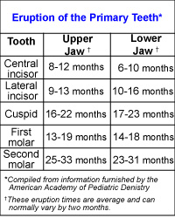

Slide 9
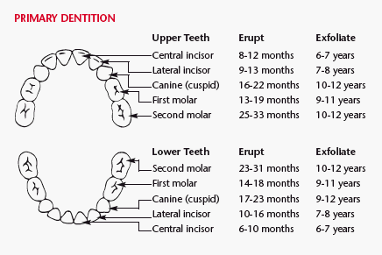

Slide 10
Physiological growth:
Pulse: 80–130 beats/min (average 110/min).
Respiration: 20–30C/min.
Bowel and bladder control:
Daytime control of bladder and bowel control by 24–30 months.

Slide 11
Fine Motor - toddler
1 year old: transfer objects from hand to hand
2 year old: can hold a crayon and color vertical strokes
Turn the page of a book
Build a tower of six blocks
3 year old: copy a circle and a cross – build using small blocks

Slide 12
Gross - Motor of toddler
At 15 months, the toddler can:
Walk alone.
Creep upstairs.
Assume standing position without falling.
Hold a cup with all fingers grasped around it.
At 18 months:
Hold cup with both hands.
Transfer objects hand-to hand at will.

Slide 13
Continuous
At 24 months:
Go up and down stairs alone with two feet on each step.
Hold a cup with one hand.
Remove most of own clothes.
Drink well from a small glass held in one hand.

Slide 14
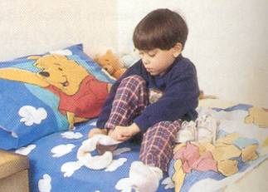
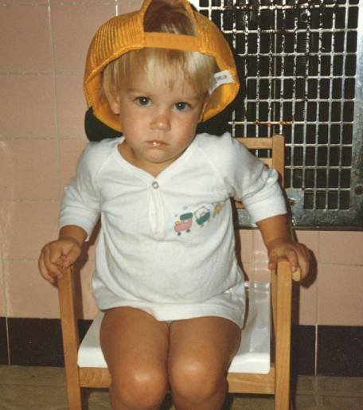
Toddlers

Slide 15
At 30 months: the toddler can:
Jump with both feet.
Jump from chair or step.
Walk up and downstairs, one foot on a step.
Drink without assistance.

Slide 16
Issues in parenting – toddler (emotional development)
Stranger anxiety – should dissipate by age 2 ½ to 3 years
Temper tantrums: occur weekly in 50 to 80% of children – peak incidence 18 months – most disappear by age 3
Sibling rivalry: aggressive behavior towards new infant: peak between 1 to 2 years but may be prolonged indefinitely
Thumb sucking
Toilet Training

Slide 17
Cognitive development:
Up to 2 years, the toddler uses his senses and motor development to different self from objects.
The toddler from 2 to 3 years will be in the pre-conceptual phase of cognitive development (2-4 years), where he is still egocentric and can not take the point of view of other people.

Slide 18
Social development:
The toddler is very social being but still egocentric.
He imitates parents.
Notice sex differences and know own sex.
According to Erikson,
The development of autonomy during this period is centered around toddlers increasing abilities to control their bodies, themselves and their environment i.e., "I can do it myself".

Slide 19
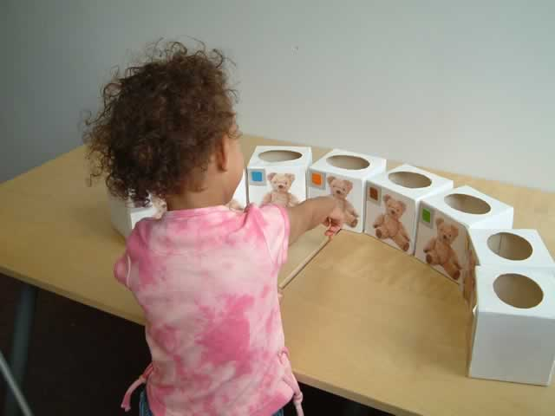
Vision in toddler age

Slide 20
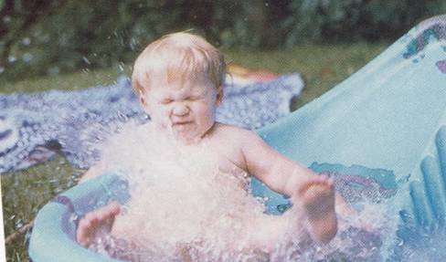
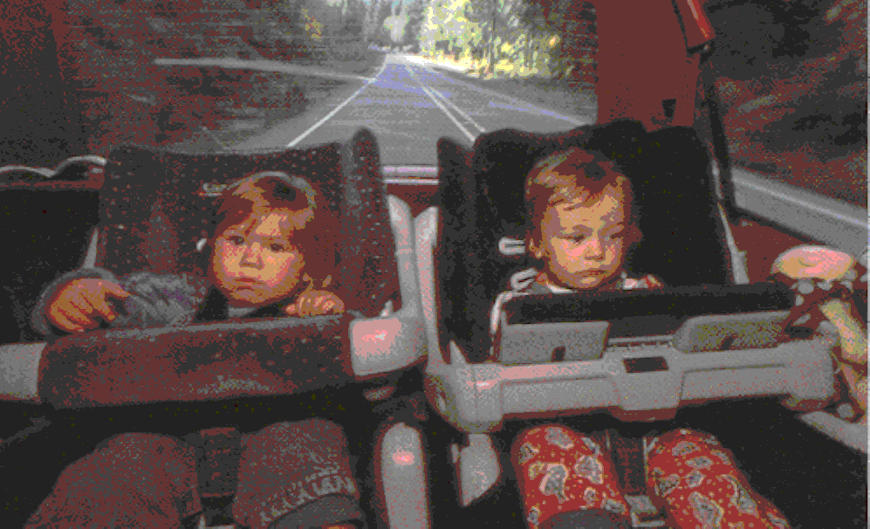
Toddler
Safety becomes a problem as
the toddler becomes more
mobile.
Pilliterri, Lippincott

Slide 21
Table (3): Recent schedule for Vaccination of Newborns in Saudi Arabia. Starting January 2008.
 | Age at visit | Vaccines
 | At birth | BCG HepB
 | 2 - Months | IPV [ DTP, HepB , Hib ]
 | 4 - Months | OPV [ DTP, HepB, Hib ]
 | 6 - Months | OPV, [ DTP, HepB , Hib ]
 | 9 - Months | Measles ( mono )
 | 12 - Months | OPV ,MMR Varicella
 | 18 - Months | OPV DTP, Hib Hepatitis (A)
 | 24 - Months | Hepatitis (A)
 | 4 - 6 Years | OPV,DTP, MMR, Varicella.

Slide 22
Table 4: Certain available vaccines and their routes of administration.
Vaccine | Type | Route
BCG | Live Bacteria | Intradermal (preferred) or subcutaneous
DTP | D&T = Toxoids P = inactivated bacteria | Intramuscular
Hepatitis B(HBV) | Inactivated viral antigen | Intramuscular
Haemophilus Influenza b (Hib) | Polysaccharide | Intramuscular
MMR | Live attenuated viruses | Subcutaneous
OPV | Live attenuated virus | Oral
BCG = Bacillus Calmette – Guerin vaccine (tuberculosis).
DPT = Diphtheria, pertussis and tetanus vaccine.
MMR = Live measles, mumps and rubella viruses in a combined vaccine.
OPV = Oral Poliovirus vaccines containing attenuated poliovirus types 1,2 and 3.

