Slide 1
LRC student staff workshop
Fall 2012, tplagwit

Slide 2
Orientation
Maps of the LRC: http://plagwitz.wordpress.com/tag/maps/
Layout of the LRC: goo.gl/id48a
Opening hours: goo.gl/PylB3 → Calendar training

Slide 3
Collaborate with NINERMAIL Calendars
LRCs Calendar listed here;
Asst: go goo.gl/gZxSG , look at green = new (not yet visible)
Tut:Check your timezone, Send meeting request, as described goo.gl/hw4v2, to your lrctutor##@uncc.edu, as listed here, put language level “up to” in subject
Asst:Switch from shared to subscribed LRCAssistant
Delete subscribed lrc assistant in calendar / right-click
Tut/Asst/Coord: in Ninermail, Accept sharing email to lrcassistant/lrctutor##/all tutors
Subscribing
Asst: View your Moodle course deadlines in NINERMAIL: go: goo.gl/EyZvy , do this: goo.gl/JVQ2E
Cancel: go goo.gl/NkWqo and test-cancel 1 appointment from last week by right-click, “delete”, “this occurrence”, “send update”
Check-in/out: open your Ninermail calendar appointment (“series”, not “occurrence”) at the reception desk, LRC assistant will paste in a code, “send update”)

Slide 4
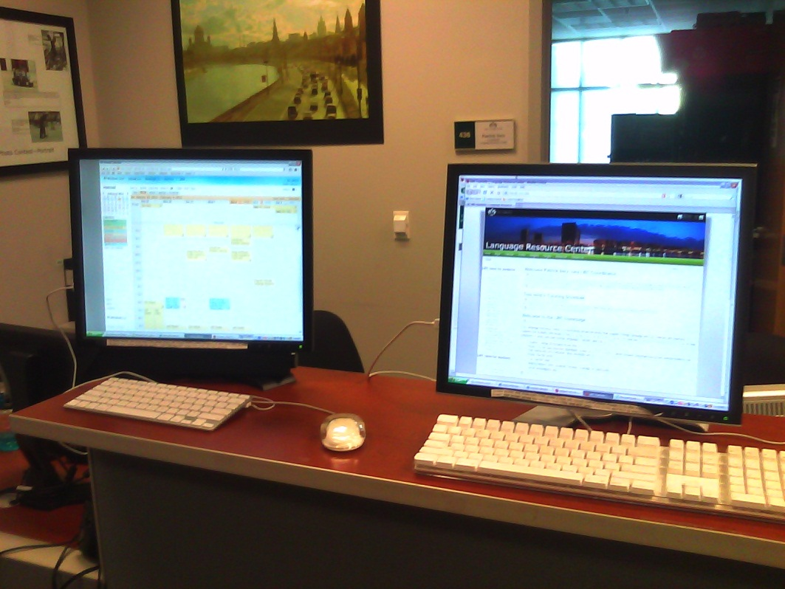
Reception Desk for LRC Assistants
Using
your print handout
the online checklist goo.gl/vjHe1
Hands-on
Log in , share screen, go through tabs, show the client screen, draw on screen
Answer FAQs (tutor,placement): use Calendar & LRC home page
Check out over weekend tripod light, mics boom, camera mini-dv, using parts – check time-zone under options
Find a film or an audio file

Slide 5
Student PC for Japanese Tutors Group
This document: goo.gl/pHRc8
Writing: goo.gl/iWRCa
IMEs
Handwriting IME for Drawing tablet goo.gl/P7Bo9
Reading: goo.gl/i5EYP
→ Dictionaries
Tools you can advertise and “blend in with”: goo.gl/Wbf3r
Speaking: goo.gl/U9Wu1
Listening: goo.gl/21NMV
TTS example video: goo.gl/bsThR
sample language links
Dictionaries: goo.gl/cNrbG
Other language learning links: goo.gl/OzF4p

Slide 6
Student PC for Chinese Tutors Group
This document: goo.gl/pHRc8
Writing: goo.gl/iWRCa
Pinyin Keyboard Layout (under Language: “English” goo.gl/JV1VY), goo.gl/dZY5f
IMEs
Handwriting IME for Drawing tablet goo.gl/P7Bo9
LRC stroke order animated gifs: goo.gl/IEU8H
Reading: goo.gl/grpc0
→ Dictionaries
Tools you can advertise and “blend in with”: goo.gl/Wbf3r
Speaking: goo.gl/tQfXi
Listening: goo.gl/ypNcu
sample language links
Dictionaries: goo.gl/OtQHN
Other language learning links: goo.gl/N6vDa

Slide 7
Student PC for German Tutors Group
This document: goo.gl/pHRc8
Writing: goo.gl/1QdQD
US international keyboard layout, goo.gl/6R0nJ
Proofing Tools
Reading: goo.gl/IT6fC
→ Dictionaries
Tools you can advertise and “blend in with”: goo.gl/Wbf3r
Speaking: goo.gl/JBn6g
Listening: goo.gl/Ii4mw
TTS example video JP: goo.gl/bsThR
sample language links
Dictionaries: goo.gl/e0Rki
Other language learning links: goo.gl/mL27j

Slide 8
Student PC for Russian Tutors Group
This document: goo.gl/pHRc8
Writing: goo.gl/LI1Fq
Keyboard layouts, 1. language, 2. keyboard
Physical keyboard vs on screen keyboard
Translate.google.com
Proofing
Reading: goo.gl/uadP6
→ Dictionaries
Tools you can advertise and “blend in with”: goo.gl/Wbf3r
Speaking: goo.gl/4WAi4
Listening: goo.gl/YwlKC
TTS example video: goo.gl/sc1sL
sample language links
Dictionaries: goo.gl/RNrbb
Other language learning links: goo.gl/5sLUb

Slide 9
Student PC for Arabic Tutors Group
This document: goo.gl/pHRc8
Writing: goo.gl/HWNXN
Keyboard layouts, 1. language, 2. keyboard
Physical keyboard vs on screen keyboard
Translate.google.com
Proofing
Reading: goo.gl/lpzS3 → Dictionaries
Tools you can advertise and “blend in with”: goo.gl/Wbf3r
Speaking: goo.gl/t9g2Z
Listening: goo.gl/xwjMi
sample language links
Dictionaries: goo.gl/ROi2Q
Other language learning links: goo.gl/5b1Mh

Slide 10
Student PC for Italian Tutors
This document: goo.gl/pHRc8
Writing goo.gl/SDOFl
US international keyboard layout, goo.gl/6R0nJ
Proofing Tools
Reading: goo.gl/s6UxS
→ Dictionaries
Tools you can advertise and “blend in with”: goo.gl/Wbf3r
Speaking: goo.gl/aTxis
Listening: goo.gl/zhpjD
TTS example video (student using): goo.gl/6rvLj
sample language links
Dictionaries: goo.gl/cNrbG
Other language learning links: goo.gl/IwsCE

