Slide 1
Nursing pharmacology Drugs Affecting Cardiovascular System lecture 8

Slide 2
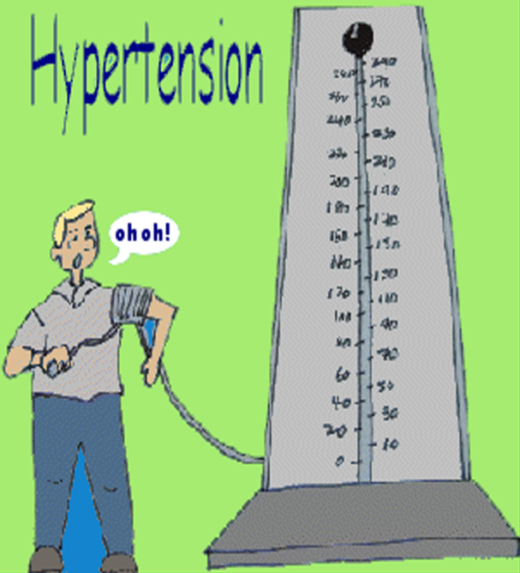
Hypertension
Hypertension→↑high blood pressure result from → increased sympathetic output to the heart and blood vessels→ resulting in vasoconstriction and increased cardiac output. These changes result in rise in blood pressure.
Therapeutic strategy:-
*Reducing cardiac output →
by decrease force of contraction.
*Decreasing peripheral resistance
(vasoconstriction) using vasodilators

Slide 3
Types of hypertension
1. White Coat hypertension
Due to stress associated with office/hospital visit
Need 3-6 independent measures of high blood pressure for diagnosis
2. Secondary Hypertension-
Increased blood pressure secondary to a known pathology
3. Essential (Primary) Hypertension
Chronically increased blood pressure with no known cause

Slide 4
General Treatment Strategy of Hypertension
1. Diagnosis- 3- 6 independent measurements.
2. Determination of primary or secondary hypertension.
3. If secondary, treat underlying pathology.
4. If primary, initiate lifestyle changes
smoking cessation
weight loss
diet
stress reduction
less alcohol
etc.
5. Pharmacological treatment.
Goal- normalize pressure- decrease CO and/or TPR

Slide 5
Summary of antihypertensive drugs
1-Drugs decrease cardiac out put | 2- Drugs decrease vasoconstriction (Vasodilators)
1-Diuretics (Loop; thiazide; K-sparing) | 1-Angiotensin converting enzyme inhibitors (ACEIs) (Captopril; Lisinopril)
2- β blockers (Propranolol; atenolol) | 2-Direct Vasodilators (Minioxidil; Hydralazine)
3-Calcium channel blockers (CCBs) (Selective on heart →verapamil)

Slide 6
1. Diuretics
Mechanism of Action:
They decrease sodium reabsorption→ Urinary Na+ excretion→ water excretion.
Water always follow Na
Effect on cardiovascular system:
Blood volume➔ CO, TPR➔ blood pressure

Slide 7
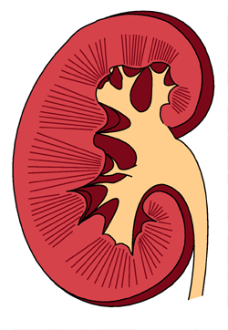
Diuretic Site of Action
.
Distal
tubule
proximal
tubule
Collecting
duct
loop of Henle

Slide 8
Classification of diuretics :-
Drugs | uses | Main Side effect
1-Loop diuretic/most potent diuretics *furosemide | 1-Hypertension 2-CHF 3-Edematous states | *ototoxicity *electrolyte disturbance →hyponatraemia →Hypokalaemia →Hypocalcaemia
2-Thiazid diuretic *hydrochlorothiazide |  | *electrolyte disturbance
3- K-sparing diuretic *Spironolactone *triamterene | *As loop *Spironolactone used in hyperaldosteronism → e.g. liver cirrhosis | *Hyperkalemia * Spironolactone has anti-androgen effect (e.g. gynecomastia)

Slide 9
Classification of diuretics :-
Drug | uses
4-Osmotic diuretic *Mannitol (IV) | Glaucoma (↓intraocular pressure)
5-Carbonic anhydrase inhibitors *Acetazolamide | Glaucoma (↓intraocular pressure)

Slide 10
2. Sympathetic blockers
Beta-blocking agents and adrenergic-inhibiting agents
Beta-blockers
Treatment of
suspected myocardial infarction,
angina
hypertension
Atenolol (Tenormin), metoprolol (Lopressor)
Labetalol (Normodyne, trandate), nadolol (Corgard)
Contraindications
Asthma; diabetes; bradycardia; hypersensitivity

Slide 11
Adrenergic inhibitors
1. Centrally acting adrenergic inhibitors
Clonidine hydrochloride (Catapres)
Methyl dopa(Aldomet)
generally not 1st line drugs.
Methyldopa drug of choice for pregnancy.
Sudden stop of medication ➔ risk of hypertensive crises
2. Peripheral adrenergic inhibitors ( alpha blocker)
Doxazosin (Cardura)
Adverse effects
1st dose hypotension due in part to no or minimum reflex tachycardia

Slide 12
3. Vasodilators
Act directly on the smooth muscle walls of arterioles, veins, or both
peripheral resistance and blood pressure
1. Arteriolar dilator drugs
Hydralazine (Apresoline)
Minoxidil
2. Arteriolar and venous dilator drugs
Nitroglycerin sublingual tablet (Nitrostat)

Slide 13
4. Angiotensin converting enzyme inhibitors (ACEI)
Conversion of angiotensinogen to angiotensin I, which is converted in turn to angiotensin II in the presence of angiotensin-converting enzyme (ACE).
Angiotensin II is the body's most potent circulating vasoconstrictor, constricting both arterioles and veins, causing an increase in blood pressure .

Slide 14
Effects of Angiotensin II
Raises blood pressure
Causes the release of aldosterone
Contributes to sodium and water retention
Drugs (ACEI) Inhibits conversion of angiotensin I to angiotensin II➔Renin-angiotensin-aldosterone system is suppressed➔Blood pressure is lowered
Captopril (Capoten)
Enalapril
Side effect: dry cough, skin rash, hypotension.

Slide 15
5. Angiotensin II receptor antagonist
Selectively inhibit angiotensin II receptors
Examples:
Candesartan (Atacand)
Losartan (Cozaar )
Decrease the nephrotoxicity of diabetes, making them an attractive therapy in hypertensive diabetics.
Lower risk of producing cough.

Slide 16
6. Calcium channel blockers
Inhibit contractility of vascular smooth muscle➔Reduce peripheral vascular resistance
Dilate coronary vessels so useful in angina.
Examples:
Verapamil (Isoptin)
Diltiazem (Cardizem)
Nefidipine
Main side effect: constipation

Slide 17
Which one of the following drugs may cause hypotension and fainting on initial administration?
A. Atenolol.
B. Hydrochlorothiazide.
C. Nifedipine.
D. Prazosin.
E. Verapamil.
Which one of the following antihypertensive drugs can precipitate a hypertensive crisis following abrupt cessation of therapy?
A. Clonidine.
B. Diltiazem.
C. Enalapril.
D. Losartan

Slide 18
A 45-year-old man has recently been diagnosed with hypertension and started on monotherapy designed to reduce peripheral resistance and prevent NaCl and water retention. He has developed a persistent cough.
Which of the following drugs would have the same benefits but would not cause cough?
A. Losartan.
B. Nifedipine.
C. Prazosin.
D. Propranolol.

Slide 19
antiarrhythmics
Arrhythmias result from disturbances in impulse formation or impulse conduction or both.
Arrhythmias Cause heart to beat too slowly (bradycardia) or to beat too rapidly (tachycardia) or irregularly (atrial fibrillation)
Antiarrhythmic agents act to restore a normal cardiac rhythm. Restoring of rhythm may occur through various drug actions.
Antiarrhythmic drugs are classified by their mechanism of action to four classes:
class 1, class II, class III, and class IV.

Slide 20
Summary of antiarrhythmic drugs.
Class I (Na channel blockers) | Class II (β blockers) | Class III (K channel blockers) | Class IV (Ca channel blockers)
* Quinidine * Lidocaine | * propranolol | *Amiodarone | *Verapamil * Diltiazem
Slow conduction (Negative dromotropic) | Decrease adrenergic stimulation | Increase contractility (Positive inotropic) | Decrease contractility (Negative inotropic)

Slide 21
Drugs for CHF
Congestive heart failure (CHF):
Disorder in which the heart is unable to pump sufficient blood to meet the needs of the body
Symptoms are dyspnea, fatigue, and fluid retention.
Therapeutic strategies in HF
↑ Contraction force of cardiac muscle→↑ increase cardiac out put.
Vasodilatation→ ↓decrease blood volume this result in ↑ increase cardiac out put.

Slide 22
Drugs for CHF
Cardiac Glycosides
Digoxin (Lanoxin), Digitoxin
Main use : Heart failure, cardiac arrhythmias
Effects:
*Positive inotropic effect → Increase contractility
*Negative chronotropic effect → Slow heart rate
*Negative dromotropic effect →Slow conduction velocity

Slide 23
Drugs for CHF
law therapeutic index →need monitoring
Toxicity enhanced by hypokalemia caused by diuretics
Toxicity : some symptoms are similar to viral flu symptoms (nausea, vomiting) and bradycardia
In renal impairment Digitoxin is preferred than Digoxin because it has hepatic elimination not renal.

Slide 24
Drugs for CHF
Drugs are used according to the severity of the case:
1. Loop Diuretics (Furosmide)
2. ACEI (Captopril, Enalapril)
3. Angitensin II antagonist( Losartan, Candesartan)
4. B blockers (only Carvedilol, or Metoprolol)
5. Digoxin / Digitoxin
6. Vasodilators( Nitrats OR Hydralazine)
7. Spironolactone ; reserved for most advanced cases.

Slide 25
Drugs for Angina
Angina pectoris: - acute chest pain radiating to the neck, jaw, back, and arms caused by coronary blood flow that is insufficient to supply oxygen required by the heart.
Therapeutic strategy:-
↓decrease oxygen requirement
↑ increase oxygen supply

Slide 26
Drugs for Angina
Summary of drugs used in treating angina.
Three classes of drugs, used either alone or in combination, are effective in treating patients with stable angina
1. Organic nitrates: (Nitroglycerine; Isosorbid)→ dilate veins and arteries
Available as sublingual, short acting for acute angina
oral, intermediate acting for prophylaxis
transdermal, long acting for prophylaxis
2. Beta (β)blockers (Atenolol; propranolol)→↓decrease heart rate ; contractility
3. calcium-channel blockers (Amlodipine; Diltiazem) →as(β)blockers
These agents lower the oxygen demand of the heart by affecting blood pressure, venous return, heart rate, and contractility.

Slide 27
Drugs For Coagulation Disorders
Blood Clotting due to platelet activation in response to vascular injury, cut or puncture.
Clotting leads to thrombus formation➔ stroke,MI
Clot formation could be pathological due to:
Atherosclerosis
Hypertension
Defect in the normal clotting mechanism.
Patients at risk of thrombus formation are :
Patients with MI, stroke,or vulvular heart diseases
Major side effect of these drugs is bleeding

Slide 29
Drugs affecting blood
Anticoagulants: inhibit the formation and enlargement of blood clots→ prevent thrombosis
Indications:
Prevention of enlargement of existing clots .
Prevention of thrombus formation in postoperative patients .
*Anticoagulants don’t dissolve existing clots.

Slide 30
Anticoagulants
Heparin : natural anticoagulant found in the liver and lungs.
It is drug of choice when immediate action is required.
Given IV, SC injections.
Measured in units .
Effect antagonized by protamine

Slide 31
Anticoagulants
Warfarin : oral anticoagulant derived form coumarin,affect the synthesis of vitamin K dependant clotting factors
Vitamin K antagonist.
Narrow therapeutic index.
Effect antagonized by Vitamin K
LMWH {Enoxaparin} synthetic preparations that need one time daily administration.

Slide 32
Anticoagulants

Slide 33
Thrombolytics
Thrombolytics or fibrinolytics:lyse or dissolve clot by promoting digestion of fibrin
The treatment of choice for acute MI , stroke , pulmonary embolism or DVT
Given IV
Common Thrombolytics
1 .Streptokinase ( Streptase )
2. Urokinase (Abbokinase )
3.AltepIase (Tissue type plasminogen activator,TPA).

Slide 34
Antiplatelets
Inhibit the step of platelet aggregation so no clot forms.
Used as prophylactic drugs to prevent clot formation in patients with angina or myocardial infarction .
Aspirin: a low daily dose of 75mg is used for prevention of thrombotic cerebrovascular or cardiovascular diseases
Dipyridamole
Ticlopidine
Abciximab

Slide 35
Drugs Used In Bleeding Disorders
Vitamin K: that is required for the synthesis of clotting factors, given oral or parenteral.
*Used in cases of vitamin K defeciency or in Warfarin toxicity.
Clotting factors: used in cases Hemophilia to supply with the deficient clotting factors.
Aminocaproic acid: inhibitor for plasminogen activation→ no clotting.

Slide 36
Antihyperlipidemic Drugs
Cholesterol important component in membranes and as hormone precursor
Insoluble in plasma (a type of lipid)Must have transport mechanism
Lipids are surrounded by protein coat to ‘hide’ hydrophobic fatty core ( lipoproteins)
Lipoproteins described by density VLDL, LDL, HDL, VHDL
LDL contain most cholesterol in body
“Bad” Transport cholesterol from liver to tissues for use
HDL move cholesterol back to liver
“Good” remove cholesterol from circulation

Slide 37
LDLs are deposited under endothelial surface and initiate several mechanisms ,that lead to the occlusion of the arteries.

Slide 38
Antihyperlipidemic Drugs
Hyperlipidemia: Excess lipids in plasma, mainly cholesterol and triglycerides
Drugs are used in conjunction with diet and exercise to control serum lipid levels.
Examples:
Statins :Atorvastatin (Lipitor)
Gemfibrozil (Lopid)
They don’t reverse existing atherosclerosis.

