Slide 1
Nutrition
Process by which organisms obtain and utilize their food.
There are two parts to Nutrition:
1. Ingestion- process of taking food into the digestive system so that it may be digested.
2. Digestion- the breakdown of food (either chemically or mechanically) in order to utilize nutrients

Slide 2
Function
Digestion
Breakdown of ingested food
Absorption of nutrients into the blood
Once the nutrients are absorbed by the digestive system they are transported by the blood to the tissues for metabolism.
Production of cellular energy (ATP)
Constructive and degradative cellular activities

Slide 3
Types of Digestion
Digestion is a catabolic process in which large complex molecules (carbohydrates, lipids, proteins, nucleic acids) are broken down into simpler monomers (monosaccharides, glycerol and fatty acids, amino acids, and nucleotides) which can be absorbed by the body.
There are two forms of digestion
a) Mechanical:
b) Chemical

Slide 4
There are two forms of digestion:
a) Mechanical:
In mechanical there is no chemical change in the food.
The food is simply broken down into smaller pieces and mixed with digestive juices secreted in the body. Ex. Mastication (chewing)
b) Chemical:
In chemical digestion there is a chemical change in the food.
The polymers are broken down into monomers commonly by hydrolysis reactions carried out by enzymes contained within the digestive juices.

Slide 5
Six Processes of Digestion
Ingestion – getting food into the mouth
Propulsion – moving foods from one region of the digestive system to another
Mechanical digestion
Mixing of food in the mouth by the tongue
Churning of food in the stomach
Segmentation in the small intestine
Chemical Digestion
Enzymes break down food molecules into their building blocks
Each major food group uses different enzymes
Carbohydrates are broken to simple sugars
Proteins are broken to amino acids
Fats are broken to fatty acids and alcohols
Absorption
End products of digestion are absorbed in the blood or lymph
Food must enter mucosal cells and then into blood or lymph capillaries
Defecation
Elimination of indigestible substances as feces

Slide 6
Digestive Processes

Slide 7
Divisions of Digestive System Organs
Two main groups
Alimentary canal – continuous coiled hollow tube that runs from the mouth to the anus
Accessory digestive organs- secrete digestive juices by ducts (exocrine glands) into the alimentary canal.

Slide 8
Organs of the Alimentary Canal
Mouth
Pharynx
Esophagus
Stomach
Small intestine
Large intestine
Anus

Slide 9
Accessory Digestive Organs
Salivary glands
Teeth
Pancreas
Liver
Gall Bladder

Slide 10
Mouth Oral Cavity (Alimentary Canal)
Mastication (chewing) of food
Mixing masticated food with saliva
Initiation of swallowing by the tongue.
A bolus (lump) is formed with saliva and the tongue.
Allowing for the sense of taste

Slide 11
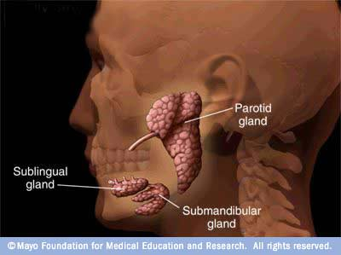
Salivary Glands (Accessory Organs)
Salivary Glands:
Saliva-producing glands
Parotid glands – located anterior to ears
Submandibular glands
Sublingual glands
Saliva:
amylase
enzyme digests starch
mucin
slippery protein (mucus)
protects soft lining of digestive system
lubricates food for easier swallowing
buffers
neutralizes acid to prevent tooth decay
anti-bacterial chemicals
kill bacteria that enter mouth with food
Mixture of mucus and serous fluids
Helps to form a food bolus

Slide 12
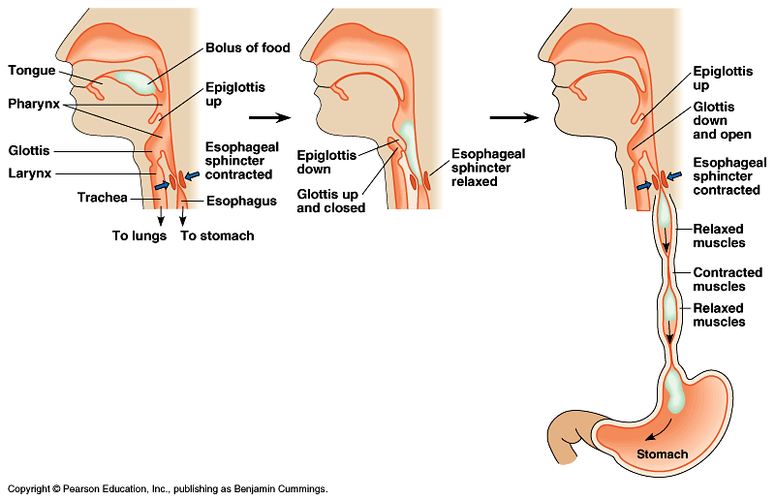
Swallowing (& not choking)
Epiglottis
flap of cartilage
closes trachea (windpipe) when swallowing
food travels down esophagus
Peristalsis
involuntary muscle contractions to move food along

Slide 13
Pharynx (Alimentary Canal)
Serves as a passageway for air and food
Food is propelled to the esophagus by alternating contractions of the muscle layers (peristalsis)

Slide 14
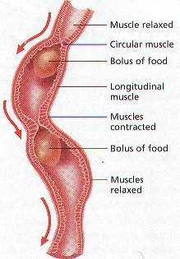
Esophagus (Alimentary Canal)
Runs from pharynx to stomach through the diaphragm
Conducts food by peristalsis (series of involuntary wave-like muscle contractions slow rhythmic squeezing)
Passageway for food only

Slide 15
Alimentary Canal Organ Structure and Tissue Arrangement
Mucosa
Innermost layer
Moist membrane
Surface epithelium
Small amount of connective tissue (lamina propria)
Small smooth muscle layer
Submucosa
Just beneath the mucosa
Soft connective tissue with blood vessels, nerve endings, and lymphatics
Muscularis externa – smooth muscle
Inner circular layer
Outer longitudinal layer
Serosa
Outermost layer – visceral peritoneum
Layer of serous fluid-producing cells

Slide 16
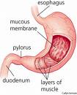
Stomach (Alimentary Canal)
Located on the left side of the abdominal cavity
Food enters at the cardioesophageal sphincter
Regions of the stomach
Cardiac region – near the heart
Fundus
Body
Pylorus – funnel-shaped terminal end
Food empties into the small intestine at the pyloric sphincter
Rugae – internal folds of the mucosa
External regions
Lesser curvature
Greater curvature

Slide 17
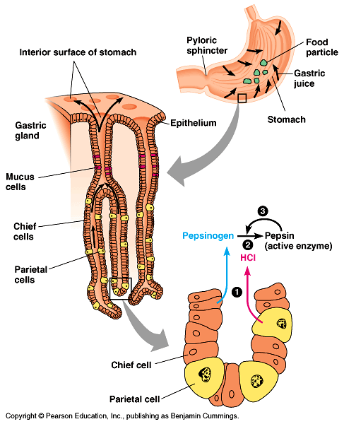
Stomach
Functions
food storage
can stretch to fit ~2L food
disinfect food
HCl = pH 2
kills bacteria
chemical digestion
pepsin
Chemical breakdown of protein begins
Delivers chyme (processed food) to the small intestine
But the stomach is made out of protein!
What stops the stomach from digesting itself?
mucus secreted by stomach cells protects stomach lining
Notes:
Still, the epithelium is continually eroded, and the epithelium is completely replaced by mitosis every three days.
Gastric ulcers, lesions in the stomach lining, are caused by the acid-tolerant bacterium Heliobacter pylori.
Ulcers are often treated with antibiotics.
Pepsin is secreted in an inactive form, called pepsinogen by specialized chief cells in gastric pits.
Parietal cells, also in the pits, secrete hydrochloric acid which converts pepsinogen to the active pepsin only when both reach the lumen of the stomach, minimizing self-digestion.
Also, in a positive-feedback system, activated pepsin can activate more pepsinogen molecules.

Slide 18
Stomach: Mucosal Layer
Simple columnar epithelium
Mucous neck cells (goblet cells) – produce a sticky alkaline mucus
Gastric glands – secrete gastric juice
Chief cells – produce protein-digesting enzymes (pepsinogens)
Parietal cells – produce hydrochloric acid
Endocrine cells – produce gastrin
Glands and specialized cells are in the gastric gland region

Slide 19
The gastric juices produced consist of, pepsinogen, made inactive to prevent autolysis and when added to HCl become active and is called pepsin used to convert proteins.
Hydrochloric acid (HCl) and mucus are also part of these gastric juices.

Slide 20
Small Intestine (Alimentary Canal)
The body’s major digestive organ all digestion of food is completed in this organ
Site of nutrient absorption into the blood
Muscular tube extending form the pyloric sphincter to the ileocecal valve
Suspended from the posterior abdominal wall by the mesentery
Duodenum (25cm = 10 inches) “12 finger widths long”
Attached to the stomach
Curves around the head of the pancreas
Where bile and pancreatic juices enter the alimentary canal
Jejunum (2.5m = 8 feet) “empty”
Attaches anteriorly to the duodenum
Ileum (3.6m = 12 feet) “twisted”
Extends from jejunum to large intestine

Slide 21
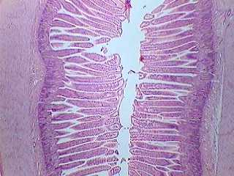
Small Intestine Internal Structure
Villi are small fingerlike structures formed by the mucosa
Give the small intestine more surface area for absorption
Duodenum :1st section of small intestines
acid food from stomach
mixes with digestive juices from:
pancreas
liver
gall bladder

Slide 22
Villi Internal Structure and Function
Absorptive cells are found on the surface epithelium which are simple columnar microvilliated epithelium
Blood capillaries are below the surface epithelium and this is where monosaccharides, amino acids, and nucleic acids enter into the blood stream and are taken to the liver for processing
Lacteals (specialized lymphatic capillaries) where lipids are absorbed and eventually re-enter the blood stream to be taken to the liver for processing.

Slide 23
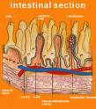
Small Intestine
Most chemical digestion takes place here.
Simple sugars and proteins are absorbed into the inner lining.
Fatty acids and glycerol go to lymphatic system.

Slide 24
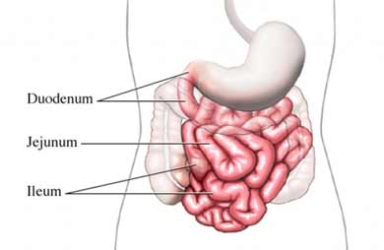
Small intestine
Function
chemical digestion
major organ of digestion & absorption
absorption through lining
over 6 meters!
small intestine has huge surface area = 300m² (~size of tennis court)
Structure
3 sections
duodenum = most digestion
jejunum = absorption of nutrients & water
ileum = absorption of nutrients & water
Notes:
About every 20 seconds, the stomach contents are mixed by the churning action of smooth muscles.
As a result of mixing and enzyme action, what begins in the stomach as a recently swallowed meal becomes a nutrient-rich broth known as acid chyme.
At the opening from the stomach to the small intestine is the pyloric sphincter, which helps regulate the passage of chyme into the intestine.
A squirt at a time, it takes about 2 to 6 hours after a meal for the stomach to empty.

Slide 25
Pancreas (Accessory Organ)
Produces a wide spectrum of digestive enzymes that break down all categories of food
Enzymes are secreted into the duodenum
Alkaline fluid introduced with enzymes neutralizes acidic chyme
Endocrine products of pancreas
Insulin
Glucagon

Slide 26
Pancreas
Produces pancreatic juices which contain pancreatic amylase, pancreatic lipase and trypsinogen (or trypsin in its active form).
Pancreatic amylase converts the remaining amylose (starch) into maltose.
Pancreatic lipase converts lipids into fatty acids and glycerol
Trypsinogen, is activeated and is called trypsin.
Trypsin then continues to break down proteins in digestion.
Buffers neutralizes acid from stomach

Slide 27
Liver and Gall Bladder (Accessory Organs)
Largest gland in the body
Located on the right side of the body under the diaphragm
Consists of four lobes suspended from the diaphragm and abdominal wall by the falciform ligament
Connected to the gall bladder via the common hepatic duct
Produced by cells in the liver
Composition
Bile salts
Bile pigment (mostly bilirubin from the breakdown of hemoglobin)
Cholesterol
Phospholipids
Electrolytes
Gall blader:
Sac found in hollow fossa of liver
Stores bile from the liver by way of the cystic duct
Bile is introduced into the duodenum in the presence of fatty food
Gallstones can cause blockages

Slide 28
Liver
Produces bile (stored in gall bladder, transported by the bile duct).
Bile made from bile salts and mineral salts.
Bile salts help with the digestion of fats by breaking them down from large globules to smaller globules, lowering surface tension and making a larger surface area.
Mineral salts neutralize the stomach acid (HCl) to around 7/8 pH in the small intestine.

Slide 29
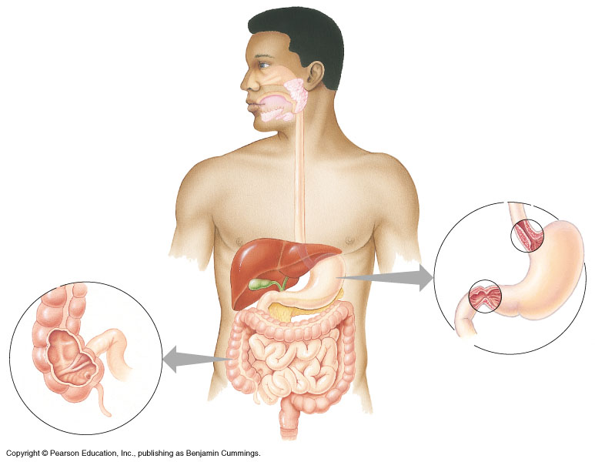
mouth
▪break up food
▪digest starch
▪kill germs
▪moisten food
stomach
▪kills germs
▪break up food
▪digest proteins
▪store food
liver
▪produces bile
- stored in gall bladder
▪break up fats
pancreas
▪produces enzymes to
digest proteins & starch

Slide 30
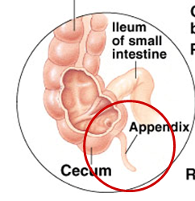
Large Intestine (Alimentary Canal)
Larger in diameter, but shorter than the small intestine
Frames the internal abdomen
Cecum – saclike first part of the large intestine
Appendix
Accumulation of lymphatic tissue that sometimes becomes inflamed (appendicitis)
Hangs from the cecum
Colon
Ascending
Transverse
Descending
S-shaped sigmoidal
Rectum
Anus – external body opening

Slide 31
Functions of Large Intestine
Absorption of water
Eliminates indigestible food from the body as feces
Does not participate in digestion or absorption of digested food
Goblet cells produce mucus to act as a lubricant
Site of production of Vitamin K by symbiotic bacteria which live off the remains of food that have not been digested or absorbed in the small intestine. These bacteria produce over 50% of fecal matter.
Chyme at the start of the large intestine consists of water, bile, mucus, dead cells, bacteria and undigested food.

Slide 32
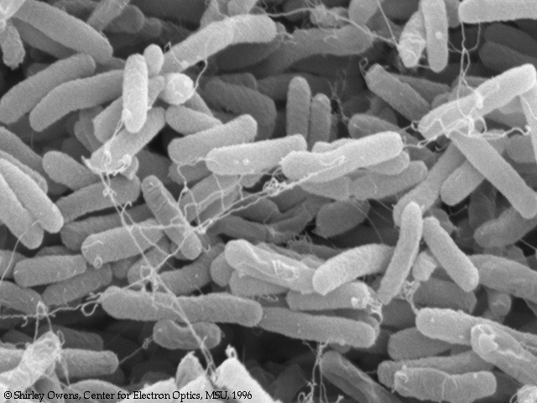
You’ve got company!
Living in the large intestine is a community of helpful bacteria
Escherichia coli (E. coli)
produce vitamins
vitamin K; B vitamins
generate gases
by-product of bacterial metabolism
methane, hydrogen sulfide

Slide 33
Tests of Gastrointestinal Functioning
Barium Contrast X-Ray Films: Upper and Lower Gastrointestinal Series
In these tests, a radiopaque solution is introduced into the upper or the lower GI tract, and then x-ray films are obtained to follow its progress.
This technique is able to identify the positions and sizes of the GI structures and any obstructions that are present; however, its ability to identify ulcers, fissures, or early-stage cancers is poor.

Slide 34
Endoscopy
Endoscopy is the process whereby a thin, rigid or flexible scope is passed into the GI tract to visualize the esophagus (esophagoscopy), stomach (gastroscopy), upper small intestine (duodenoscopy), large intestine (colonoscopy), or sigmoid colon (sigmoidoscopy).
With this instrument, the walls of the GI tract can be visualized, allowing identification of ulcerations, blockages, and other irregularities. Special tools at the end of the scope allow tissue to be sampled for biopsy and culture.

Slide 35
Ultrasound
Ultrasound is a procedure whereby sound waves are reflected from tissue to provide an image.
It is a highly sensitive technique and can be used to visualize the structure of the abdominal organs to identify abnormalities, abscesses, stones, and other structures.
Computed Tomography
The process whereby a computer integrates images from several x-ray projections to provide a vivid cross-sectional image is called computed tomography (CT). CT is used to image all GI organs and to identify structural and other abnormalities.
Magnetic Resonance Imaging
Magnetic resonance imaging (MRI) is the process whereby shifts in the magnetic axis of atoms in response to externally applied electromagnetic fields are transformed by computer to produce a cross-sectional image of the structures of the GI tract. MRI is used extensively to identify structural abnormalities, alterations in blood flow, and vessel patency.

Slide 36
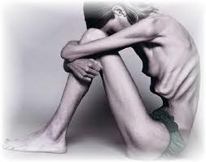
Pathophysiologic Concepts
Anorexia
Defined as a loss of appetite or desire for food, anorexia often occurs as a symptom with other GI alterations, including nausea, vomiting, and diarrhea.
It can also be present with conditions not associated with the GI tract, such as cancer.
Anorexia nervosa is a condition in which one chooses not to eat because of a morbid fear of being fat.
Nausea
Nausea is a subjective, unpleasant sensation that often precedes vomiting.
Nausea is caused by distention or irritation anywhere in the GI tract, but it can also be stimulated by higher brain centers.

Slide 37
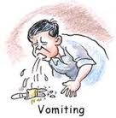
Vomiting
Vomiting is a complex reflex mediated through the vomiting center in the medulla oblongata of the brain.
Afferent impulses originate in the stomach or duodenum in response to excessive distention or irritation, or sometimes they originate in response to chemical stimulation by emetics (agents that cause vomiting), such as syrup of ipecac.
Hypoxia and pain can also stimulate vomiting by means of activation of the vomiting center.
Projectile vomiting occurs when the vomiting center is directly stimulated, frequently by increased ICP.
When the vomiting reflex is initiated in the vomiting center, it is carried out by activation of several cranial nerves to the face and throat, and spinal motor neurons to the diaphragm and abdominal muscles.
Certain symptoms generally precede vomiting, including nausea, tachycardia, and sweating.

Slide 38
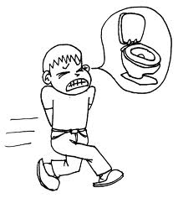
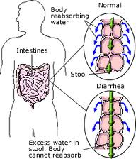
Diarrhea
Diarrhea is an increase in fluidity and frequency of stools.
It may be large or small volume and may or may not contain blood.
Irritation of the intestines by a pathogen affects the mucosal layer, leading to increased secretory products, including mucus.
Microbial irritation also affects the muscular layer, leading to increased motility.
Increased motility causes large amounts of water and electrolytes to be lost in the stool because the time available for their reabsorption in the colon is reduced.
An individual who has severe diarrhea can die from hypovolemic shock and electrolyte irregularities.

Slide 39
Pediatric Consideration
Infants and children are especially susceptible to the severe effects of diarrhea and should be monitored closely for early signs of dehydration.
Any child who has moderate or severe diarrhea should receive fluid replacement with osmotically balanced products.

Slide 40
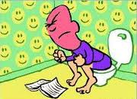
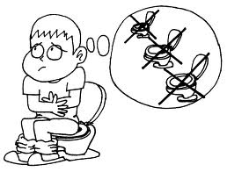
Constipation
Constipation is defined as difficult or infrequent defecation.
In general, however, bowel movements fewer than once every 3 days are considered to indicate constipation.
Defecation can become difficult if the stool is hard and compact.
This can occur when an individual is dehydrated or if a bowel movement is delayed, which allows more water to be absorbed out of the stool as it sits in the large intestine.
Bulk or high-fiber diets keep stools moist by osmotically drawing water into the stool and by stimulating peristalsis of the colon by distention.
Exercise promotes defecation by physical stimulation of the GI tract.

Slide 41
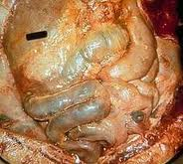
Peritonitis
Peritonitis usually occurs as a result of the passage of bacteria through the GI tract or abdominal organs into the peritoneal space as a result of perforation of the gut or rupture of an organ.
Peritonitis is characterized by pain, especially over the inflamed area. Pain may change in location, being centrally located at first, and then becoming more site-specific as the inflammation worsens.
Pain may be rebound in nature; that is, the person may complain of more pain when pressure on the abdomen is removed quickly.
Rebound pain is related to the sudden wave of movement that occurs through the peritoneal fluid when pressure is released.

Slide 42
Individuals who have peritonitis frequently demonstrate increased heart rate as a result of hypovolemia occurring from the movement of fluid into the peritoneum.
They also may experience nausea and vomiting, and demonstrate a rigid abdomen indicative of widespread inflammation.
In addition, general signs of inflammation such as fever, an increase in white blood cell count, and increased sedimentation rate are usually present.
Treatment usually includes surgery, antibiotics, and fluid and electrolyte replacement.

Slide 43
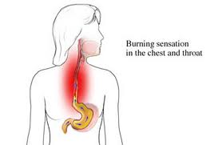
Conditions of Disease or Injury
Gastroesophageal Reflux Disease
The condition of gastroesophageal reflux disease (GERD) is caused by the reflux of stomach contents into the esophagus.
GERD is commonly called heartburn because of the pain that occurs when the acid, normally present only in the stomach, enters and burns or irritates the esophagus.

Slide 44
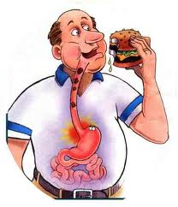
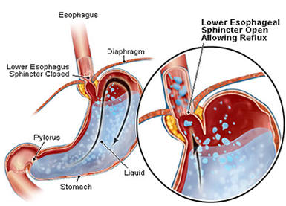
Causes of GERD
GERD usually occurs after a meal and results from conditions that either weaken the tone of the esophageal sphincter or increase the pressure in the stomach compared with the esophagus.
By either of these mechanisms, acidic stomach contents move into the esophagus.
The contents of the stomach are usually prevented from entering the esophagus by the esophageal sphincter

Slide 45
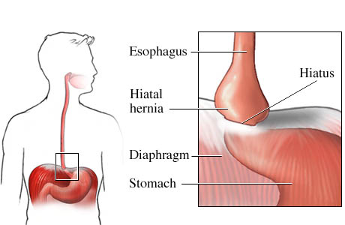
A hiatal hernia may also cause reflux.
A hiatal hernia is a protrusion of a part of the stomach through the opening in the diaphragm.
If this occurs, high pressure in that part of the stomach results in stomach contents being pushed into the esophagus.

Slide 46
Clinical Manifestations
Burning pain in the epigastric area, called dyspepsia, may occur, and may radiate to shoulders, back, or neck.
Belching and a sour taste may accompany the pain.
Pain usually occurs within 30 to 60 minutes after a meal or during sleep, when the individual is lying down.

Slide 47
Diagnostic Tools
A good history identifies many individuals at risk of GERD.
A pH probe passed into the lower esophageal area may reveal an abnormally low pH (below 4.0) in individuals who have GERD.

Slide 48
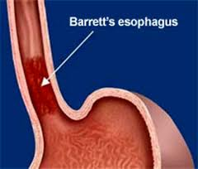
Complications
Barrett's esophagitis is an irritation of the lining of the esophagus characterized by cell changes that can result from chronic reflux. It is a pre-malignant condition that may lead to esophageal carcinoma.
Chronic irritation of the esophagus can cause chronic inflammation, spasm of the muscles, and scarring of the esophagus, all of which may lead to stricture development, thereby interfering with or blocking food passage.
Vomiting and dysphagia (difficulty swallowing) with eating may occur.

Slide 49
Treatment
Abdominal pressure can be reduced by eating more frequent small meals rather than large meals.
If obesity is a problem, nutritional and exercise counseling are advised.
Sitting up during and after eating, and sleeping with the head elevated, will reduce abdominal pressure on the esophageal sphincter.
Drinking extra fluids will help wash refluxed material out of the esophagus.
Histamine type-2 (H2) receptor antagonists are used to reduce acid secretion by the stomach, in combination with the behavioral changes described above.
Anti-reflux surgery may be considered if symptoms are resistant to treatment or are caused by hiatal hernia.
Antacids may be used to neutralize the acidic content of the stomach.

Slide 50
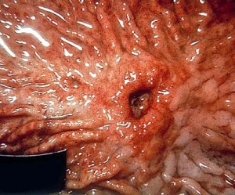
Peptic Ulcer
The term peptic ulcer refers to an erosion of the mucosal layer anywhere in the GI tract; however, it usually refers to erosions in the stomach or duodenum.
Gastric ulcer refers only to an ulcer in the stomach.

Slide 51
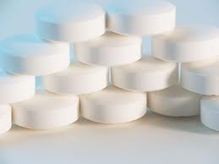
Causes of Peptic Ulcer
There are two main causes of ulcers:
(1) too little mucus production or
(2) too much acid being produced in the stomach or delivered to the intestine.

Slide 52
Decreased Mucus Production as a Cause of Ulcer
Ulcers most commonly develop when the mucosal cells of the gut do not produce adequate mucus to protect against acid digestion.
Causes of decreased mucus production can include anything that decreases blood flow to the gut, causing hypoxia of the mucosal layer and injury to or death of mucus-producing cells.
This type of ulcer is called an ischemic ulcer.
Decreased blood flow occurs with all types of shock.
A particular type of ischemic ulcer that develops after a severe burn is called a Curling ulcer.
The use of various drugs, especially non-steroidal anti-inflammatory drugs (NSAIDs), is also associated with an increased risk of ulcer development. Aspirin, especially, causes irritation of the mucosal wall, as do the other NSAIDs and glucocorticosteroids.

Slide 53
Excess Acid as a Cause of Ulcer
Acid production in the stomach is necessary for activation of stomach digestive enzymes.
Hydrochloric acid (HCl) is produced by the parietal cells in response to certain foods, drugs, hormones (including gastrin), histamine, and parasympathetic stimulation.
Foods and drugs such as caffeine and alcohol stimulate the parietal cells to produce acid.
Aspirin is an acid, which may directly irritate or erode the lining of the stomach.
Increased Delivery of Acid as a Cause of Duodenal Ulcer
Too rapid movement of stomach contents into the duodenum can overwhelm the protective mucus layer there.
This occurs with irritation of the stomach by certain foods or microorganisms, as well as by excess gastrin secretion or abnormal distention.

Slide 54
Clinical Manifestations
Burning abdominal pain (dyspepsia) often occurs at night.
The pain is usually located in the midline epigastric area.
Pain that occurs when the stomach is empty (for example, at night) often signifies a duodenal ulcer. This is most common.
Pain that occurs immediately after or during eating suggests a gastric ulcer. Occasionally, the pain may be referred to the back or shoulder as well.
The occurrence of pain often comes and goes
Weight loss is common with gastric ulcers.
Weight gain may occur with duodenal ulcers because eating relieves the discomfort.

Slide 55
Diagnostic Tools
Ulcers are diagnosed primarily by history and endoscopy.
With endoscopy, not only can the gut lining be viewed for ulcers, but tissue samples can also be taken for biopsy .

Slide 56
Helicobacter Pylori
Helicobacter pylori has been implicated in many gastrointestinal diseases including duodenal and gastric ulcer, gastritis, and possibly gastric cancer.
In asymptomatic individuals colonization by Helicobacter pylori increases with age up to 50% in the elderly.
A) Diagnostic tests
Biopsy
C-breath test

Slide 57
Complications of peptic ulcers
Perforation of the gut, this can lead to infection of the abdominal cavity. The pain of perforation is severe and radiating. It is unrelieved by eating or antacids.
Obstruction of the lumen of the GI tract may occur as a result of repeated episodes of injury, inflammation, and scarring. Obstruction is most often at the pylorus, the narrow passageway between the stomach and the small intestine. Obstruction causes feelings of stomach and epigastric distention, heaviness, nausea, and vomiting.
Hemorrhage may occur when the ulcer has eroded an artery or vein in the gut. This can result in hematemesis (vomiting of blood) or in melena (passage of upper GI blood in the stool).
If bleeding is extensive and sudden, symptoms of shock may occur.
If bleeding is slow and insidious, microcytic hypochromic anemia may develop.

Slide 58
Treatment
Identify and instruct patients to avoid foods that cause excess HCl secretion; doing so improves symptoms for some individuals.
Educate patients that avoidance of alcohol and caffeine improves symptoms and increases healing of a pre-existing ulcer.
Discontinue or reduce NSAID ingestion; this often relieves symptoms in mild cases.
Strongly urge individuals who smoke to quit because tobacco both irritates the gut and delays healing.
Prescribe antihistamines to neutralize stomach acid and to relieve symptoms of an ulcer.
Stress management, relaxation techniques, or sedatives can be used to relieve psychological influences.

Slide 59
MALABSORPTION/MALDIGESTION
A variety of diseases causes a disturbance in digestion and absorption.
Maldigestion: Dysfunction of the digestive process that can occur in a number of sites in the gastrointestinal tract.
Malabsorption: Dysfunction of the absorptive process by the gut caused by gluten, inflammation, infection, surgical resection, vitamin deficiency and other factors.
Both conditions lead to one common syndrome called malabsorption.
Thus, the diagnostic process is designed to:
Demonstrate the presence of malabsorption
Identify the type of disease process

Slide 60
Malabsorption syndromes
Failure of the small intestine to absorb certain foodstuffs is called malabsorption.
Inability to absorb can be
(1) of one type of amino acid, fat, sugar, or vitamin;
(2) of all amino acids, fats, sugars; or
(3) of all fat-soluble vitamins.
Malabsorption of everything absorbed in one segment of the small intestine can also occur, with other small-intestine segments being spared.

Slide 61
Causes of malabsorption
Pancreatic digestive enzyme deficiency;
microorganism infection;
damage to the mucosal layer of the gut; or, for fats and fat-soluble vitamins,
Liver disease: impairment of bile production or lymph function.
Genetic deficiencies in specific enzymes may also occur.
Celiac disease (Sprue), a disease characterized by injury to the villi that apparently is caused by a hypersensitivity to gluten, a product of wheat, barley, rye, and oats.

Slide 62
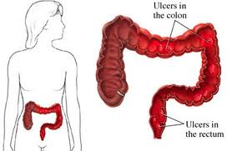
Ulcerative Colitis
Ulcerative colitis is an inflammatory disease of the rectum and colon that primarily affects the mucosal layer of the large intestine characterized by numerous ulcers, causing hemorrhage and abscess formation. Thickening of the wall of the bowel can occur.
Ulcerative colitis typically goes through stages of exacerbations and remissions.
Bloody diarrhea mixed with mucus is characteristic of each stage.

Slide 63
Diagnostic Tools
Sigmoidoscopy reveals hemorrhagic mucosa with ulceration.
Blood analysis demonstrates anemia and low serum potassium.
Complications
Perforation with peritonitis may occur.
There is an increased risk of colon cancer.
Systemic manifestations of ulcerative colitis include arthritis, skin lesions, and various blood disorders.
Children may experience growth retardation, resulting from the malabsorption and diarrhea, as well as from the anti-inflammatory drugs used to treat the disease.

Slide 64
Treatment
Anti-inflammatory drugs.
Nutritional supplementation.
Bulk-free diet to decrease stool frequency.
Psychological support.
Surgical resection of the bowel may be necessary.

Slide 65
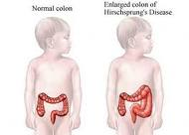
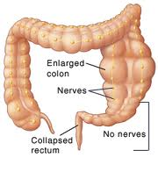
Hirschsprung's Disease
Hirschsprung's disease, also called congenital megacolon, results from the congenital absence of autonomic ganglia innervating the anorectal junction and some or most of the rectum and colon.
With Hirschsprung's, stool accumulates in the bowel.

Slide 66
Clinical Manifestations
Failure to pass the first stool within 48 hours of birth carries a high suspicion of Hirschsprung's.
A distended abdomen and/or vomiting may occur in an infant.
Chronic constipation in an older child or adult may signify the disorder.

Slide 67
Diagnostic Tools
Rectal biopsy that demonstrates an absence of ganglion cells confirms diagnosis.
Complications
Electrolyte disturbances and perforation of the bowel if distention is unrelieved.
Fecal impaction.
Treatment
Surgical resection of the affected area.

Slide 68
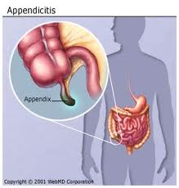
Appendicitis
May occur
(1) for no obvious reason,
(2) after obstruction of the appendix with stool, or
(3) from either the organ or its blood supply being twisted.
The inflammation results in a swollen, tender appendix, which can lead to gangrene of the organ as blood supply is compromised.
The appendix may also burst; this typically happens between 36 and 48 hours after the onset of symptoms.

Slide 69
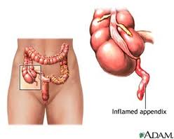
Clinical Manifestations
Abrupt or gradual onset of diffuse pain in the epigastric or periumbilical area is common.
Over the next few hours, the pain becomes more localized and may be described as a pinpoint tenderness in the lower right quadrant.
Rebound tenderness (pain that occurs when pressure is removed from the tender area) is a classic symptom of peritonitis and is common with appendicitis.
Guarding of the abdomen occurs.
Fever.
Nausea and vomiting.

Slide 70
Diagnostic Tools
Elevated white cell count greater than 10,000/mL.
Fever greater than 37.50آ°C (99.5آ°F).
The presence of pain in the right lower quadrant.
CT scanning is an excellent tool for the diagnosis of appendicitis. radiologists trained in its use. Ultrasound may also be effective.
Complications
Peritonitis can occur if the swollen appendix bursts. Peritonitis significantly increases the risk of postoperative complications.

Slide 71
Treatment
Surgical removal of the appendix.
If the appendix bursts before surgery, antibiotics are necessary to reduce the risk of peritonitis and sepsis.
Pediatric Consideration
The peak age of incidence of appendicitis in children is between ages 10 and 12.
In children, especially infants and toddlers, appendicitis is often misdiagnosed, with a perforation incidence greater than 90% in children less than 3 years of age.

Slide 72
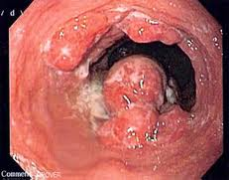
Esophageal Cancer
Clinical Manifestations
Dysphagia (difficulty swallowing) is the most common symptom.
Anorexia and weight loss follow.
Pain from bone metastases often is the first symptom that stimulates a person to seek care.

Slide 73
Diagnostic Tools
Endoscopy followed by tissue biopsy is used to diagnose esophageal cancer.
X-ray or other diagnostic tests may be used to identify the secondary tumors.
Treatment
Surgical resection, radiation, and chemotherapy.

Slide 74
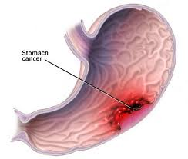
Stomach Cancer
Clinical Manifestations
Stomach cancer is frequently asymptomatic until advanced.
When symptoms are present they include the following:
Vague abdominal discomfort.
Indigestion.
Weight loss.
Anorexia.
Fatigue.
A palpable abdominal mass may be present.

Slide 75
Diagnostic Tools
A careful history and the use of endoscopy followed by tissue biopsy enable diagnosis.
Treatment
Partial or complete surgical resection of the stomach.
Chemotherapy and/or radiation therapy may be used.

Slide 76
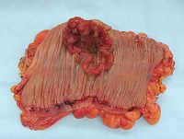
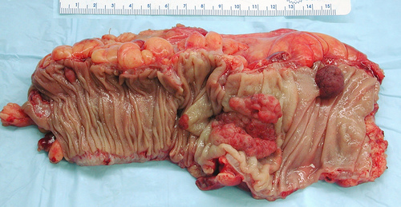
Colorectal Cancer
Clinical Manifestations
Changes in bowel habits resulting in diarrhea or constipation may occur.
Occult or frank blood in the stool is a strong warning sign.
Fatigue.

Slide 77
Diagnostic Tools
Anemia may show up in a complete blood count (CBC), prompting further evaluation.
A palpable mass may be felt by digital examination.
Tests for occult blood in the stool may indicate cancer.
Early identification of polyps with digital examination, sigmoidoscopy, or colonoscopy (examination of the entire rectum and colon with a fiber-optic lens), and surgical removal of any visualized polyps may prevent cancer from developing.
Blood tests for specific antigens associated with colorectal cancer, especially carcinoembryonic antigen (CEA), can be useful in the early identification of a recurring colorectal cancer.
DETECTION OF OCCULT BLOOD (HEME)

Slide 78
Treatment
Preventive measures are important and include dietary education on increasing roughage, fruits, vegetables, and grains to increase bulk, decrease fat, and provide protective antioxidants.
Staging of the disease based on dissemination of tumor cells to regional lymph nodes is important in determining the prognosis and treatment of the disease. Identification of even micrometastases can influence outcome.
If colorectal cancer is present, surgery is required with or without follow-up chemotherapy.

Slide 79
Geriatric Consideration
Colorectal cancer usually occurs in the elderly.
Recommendations for digital examination and tests for occult blood in the stool usually begin after the age of 40, and visualization of the rectum and colon is recommended after the age of 50.
Individuals who have a first-degree relative with colon cancer are advised to undergo colonoscopy before the age of 50.

