Slide 1
Hello girls

Slide 2
Talking
Vocabulary for relationships
Reported speech
Say and tell
So that you can
Talk about relationships.
Report what other people say.

Slide 3
Relationships

Slide 4
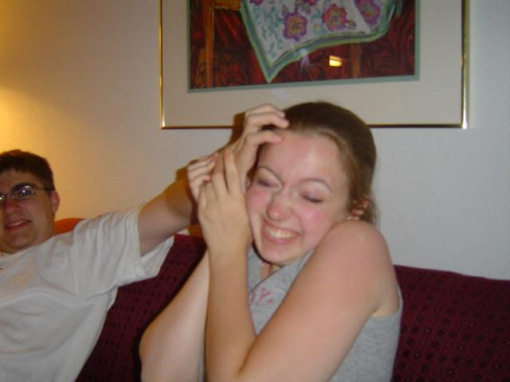
My brother really annoys me

Slide 5
I get on well with my parents

Slide 6
Don’t argue ! Turn that off now.

Slide 7
They’re having a row

Slide 8
I love my cat and my cat loves me. We love each other .

Slide 9
Kelly is Tara’s closest friend

Slide 10
I spend a lot of time with my friends

Slide 11
Teenagers
Are teenagers rebels ?
look at the book and see the three British teenagers ,what are their names ? Where are they from ? and how they share the same ideas with teenagers in your country ?

Slide 12
Direct & Indirect Speech
(reported speech)

Slide 13
What does the reporting speech mean?

Slide 14
We use reported speech to talk about what someone said.

Slide 15
Reporting speech
There are two ways of reporting what somebody says;
direct speech
indirect (or reported) speech.

Slide 16
Let’s have examples in different tenses.

Slide 17
Change the pronoun
Change the tense
Example 1 :
Joe said, ‘I love chocolate.’ (Direct Speech)
Joe said that he loved chocolate. (Indirect Speech)
Put in ‘that’
Example 2 :
Put in ‘that’
Carman said, ‘I am sick.’ (Direct Speech)
Carman said that she was sick. (Indirect Speech)
Change the pronoun
Change the tense

Slide 18
Example 3:
Change the tense
Put in ‘that’
Joe said, ‘Carman is doing homework.’ (Direct Speech)
Joe said that Carman was doing homework. (Indirect Speech)
Change the tense
Example 4 :
Carman said, ‘They are tired.’ (Direct Speech)
Carman said that they were tired.
(Indirect Speech)

Slide 19
Example 5:
Put in ‘that’
Change the pronoun
Joe said, ‘You have not returned the book to me.’ (Direct Speech)
Change the pronoun
Joe said that you/I had not returned the book to him. (Indirect Speech)
Change the tense
Example 6 :
Carman said, ‘You can use my computer.’ (Direct Speech)
Carman said that you/I could use her computer. (Indirect Speech)
Change the possessive adjective

Slide 20
When we report a statement, we have to:

Slide 21
take away the quotation marks
e.g ‘Some students are talking,’ said the teacher.
⇨ The teacher said (that) some students were talking.

Slide 22
change the tense
simple present
 simple past
present continuous
 past continuous
e.g ‘I am very happy today,’ said Susanna.
⇨ Susanna said (that) she was very happy that day.
e.g ‘Some students are talking,’ said the teacher.
⇨ The teacher said (that) some students were talking.

Slide 23
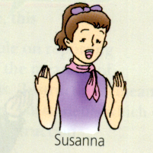
I am very happy today.
Susanna said (that) she was very happy that day.

Slide 24
change the pronouns
I/you
 he/she
we/you
 they
me/you
 him/her
us/you
 them
my/your
 his/her
our/your
 their
mine/yours
 his/hers
ours/yours
 theirs
e.g ‘I am very happy today,’ said Susanna.
⇨ Susanna said (that) she was very happy that day.

Slide 25
How to change the tense:
is/am/are | was/were
do/does not work | did not work
Present simple | Past simple
is/are working | was/were working
Present continuous | Past continuous
has/have worked | had worked
can work | could work

Slide 26
How to change the pronouns and possessive adjectives:
I/you | he/she
me/you | him/her
my/your | his/her
mine/yours | his/hers
we/you | they
us/you | them
our/your | their
ours/yours | theirs

Slide 27
Let’s summarize our grammar !

Slide 29
Step 2
Question tags
Pardon, could you say that again ?
So that you can
Ask if something is true or not, or ask agreement
Ask for clarification when you don’t understand

Slide 30
what happened to these people ?

Slide 32
Let’s look at the book and see what happened with Charlie? Does he look happy ?

Slide 33
Tag questions
What is a taq question ?

Slide 34
What is a tag question !
A tag question is a special form in English. It is a statement followed by a mini-question. The whole sentence is a "tag question", and the mini-question at the end is called a "question tag".

Slide 35
Let’s see a few examples !
Snow is white, isn't it?
You don't like me, do you?
This will work, won't it?
The weather's bad, isn't it?
Nobody knows, do they?

Slide 36
Now
Do you have any idea ?
So again what is a tag question ?

Slide 37
Tag question
Question that expect the answer “Yes”

Slide 38
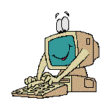
Verb to “be”

Slide 39
is
a student,
isn't he?
Sámi
Yes, he is
Vto be
S
O

Slide 40
aren't they?
are
students,
They
Yes, they are
Vto be
S
O

Slide 41
✰


•
is
Isn,t

are
Aren,t

Weren,t-wasn,t
Was-were

Slide 42
Verb to “do”

Slide 43
She writes a letter,
S
V
O

Slide 44
She writes a letter,
Doesn't she ?
Yes,
She does .

Slide 45
they write aletter,
S
V
O

Slide 46
they write letter,
Don't they ?
Yes,
they do .

Slide 47
She wrote a letter,
S
V
O

Slide 48
She wrote a letter,
Didn't she ?
Yes,
She did .

Slide 49
✰


•
writes
Doesn,t

write
Don,t

Didn,t.
wrote

Slide 50
✰
Would you mind giving me the pen, please?
No, not at all

No, of course not


No, I, II be happy to

Slide 51
Tag question
Question that expect the answer “No”

Slide 52
Verb to “be”

Slide 53
Isn't
a student,
is he?
Sámi
No, he isn,t
Vto be
S
O

Slide 54
are they?
students,
They
Aren,t
No, they aren,t
Vto be
S
O

Slide 55

✰

•
Isn,t
is

Aren,t
are

Weren,t-wasn,t
Was-were

Slide 56
Verb to “do”

Slide 57
She doesn't write a letter,
S
V
O

Slide 58
Does she ?
She doesn,t write a letter,
No,
She doesn't .

Slide 59
they don't write a letter,
S
V
O

Slide 60
they don't write letter,
Do they ?
No,
they don't .

Slide 61
She wrote a letter,
S
V
O

Slide 62
She didn't write a letter,
Did she ?
No,
She didn,t .

Slide 63

✰

•
Doesn't
does

Don't
do

did.
Didn't

Slide 64
How we can form the taq Q ?
We use a negative “tag” after an affirmative sentence .
She is happy , isn’t she ?
They are hardworking group , aren't’ they ?
You’re going out, aren’t you ?
We use an affirmative “tag” after a negative sentence.
He isn’t in in a very good mood , is he ?
You weren’t very polite , were you ?

Slide 65
Structure
Affirmative form
(S+ verb to be (are+am+is) Or verb (s) + noun OR adjective), Negative ?
Negative form
( verb to be (is+am+are) Or Verb (base form ) +not + noun OR adjective), affirmative?

Slide 66
Asking for clarification
Pardon
Could you say that again?
What does it mean ?

